Slide 1
Science Fair
Poster and Interview Tips
SRC, Content, Poster, Interview
Jeff Adkins
Deer Valley High School
astronomyteacher@mac.com

Slide 2
Before you start a poster
Rules Wizard
SRC
Do the experiment
Write a paper

Slide 4
SRC/IRB

Slide 5
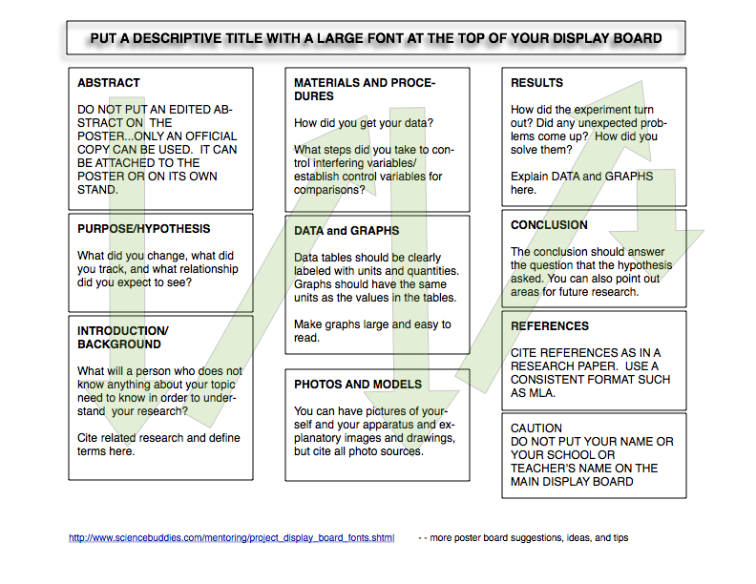
Poster Contents
Title
Purpose/Hypothesis
Intro/Background
Materials
Procedures
Photos/Models
Results
Conclusion
References
Don’t include
Abstract
Identification

Slide 7
Titles Titles Titles
BIG, Clear Sans-Serif Font
Serif font example
Puns vs. Technical Lingo
“Pulsating Globstoppers” vs. “Differential Photometry of Short-Period Variable stars in Globular Clusters”
or use both!

Slide 8
Hypothesis/Purpose
If I change the independent variable, I expect the dependent variable to do this, because...
independent = cause
dependent = effect
Doesn’t apply to Engineering- different goal
solves a problem

Slide 9
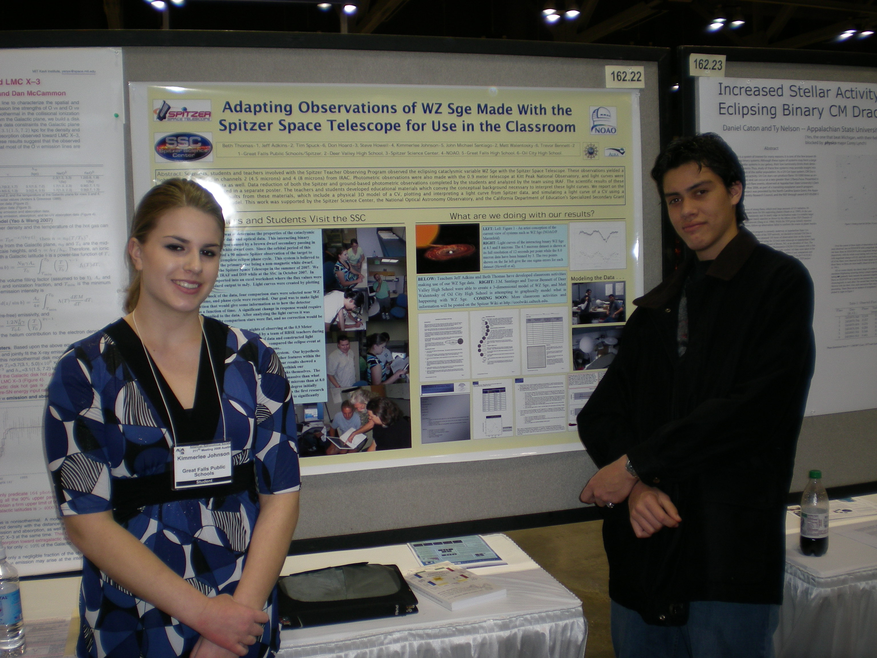
Materials and Procedures
How did you get the numbers?
How did you control interfering variables?
Step-by-step is OK
Your goal: make your procedures reproducible

Slide 10
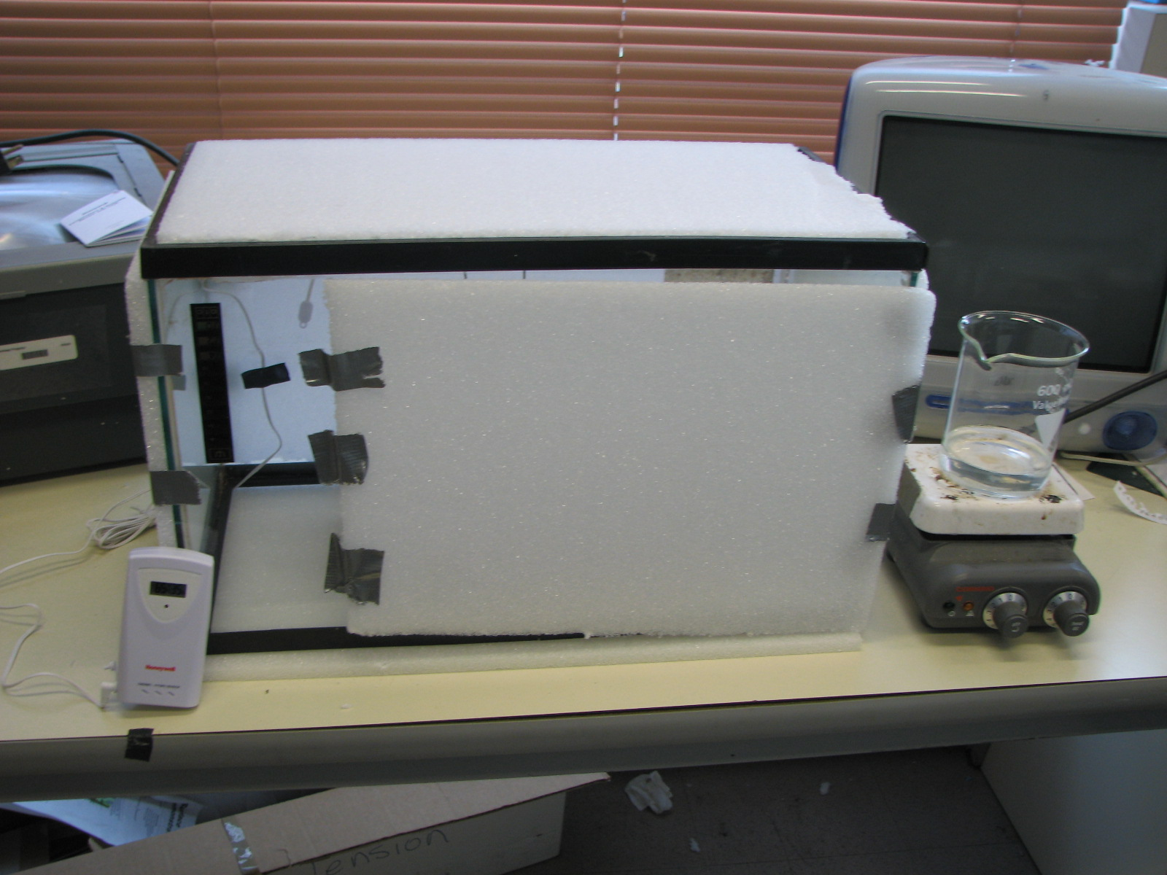
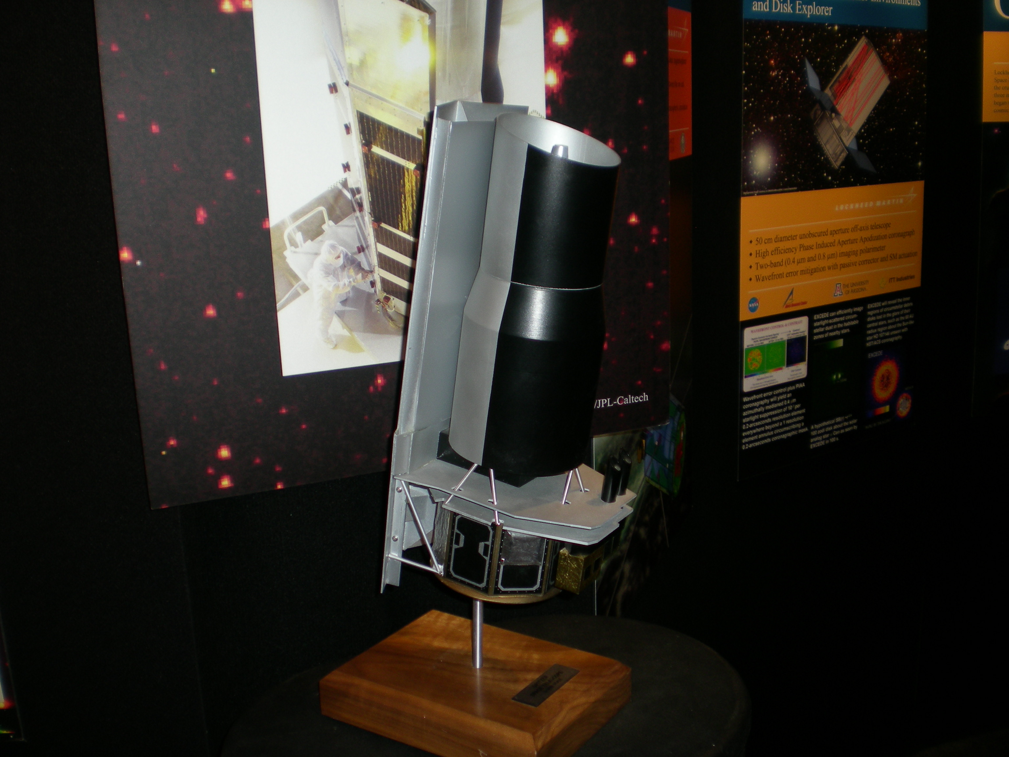
Photos and Models
Keep it safe
Photos should be large and not identify you or your school
Your picture can be in it, especially if you are working
Your apparatus or instrumentation should be displayed
Models OK, to support the point you are trying to make.

Slide 11
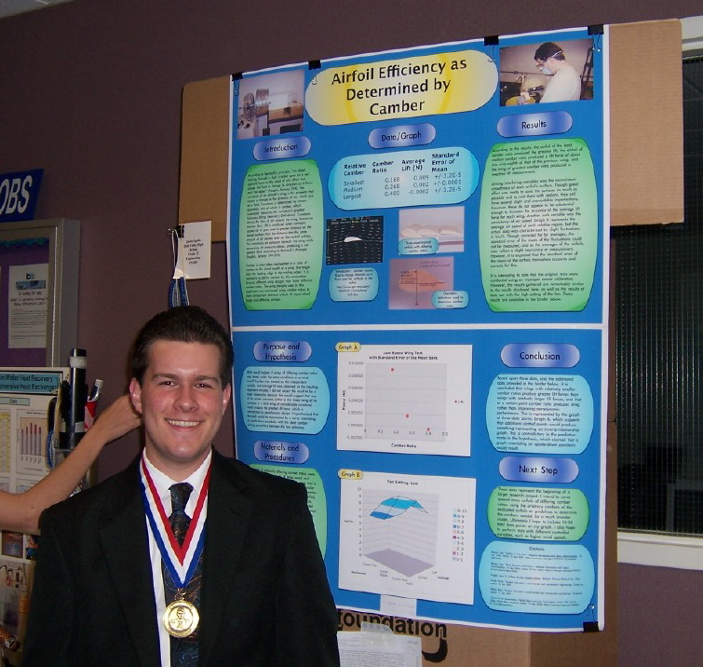
Results
Explain and interpret your data and graphs

Slide 12
Conclusion
Answer the hypothesis
According to my data, the hypothesis was supported/disproven because...
How I would do it differently
Next steps

Slide 13
References
What did you read and what did you learn from it?
Citation formats
http://www.wolverinelibrary.com/mlaformat.html
Just plug in your info and a formatted citation comes out

Slide 14
Abstract
Use the official form
Write it LAST
It includes a summary of the entire project
Includes:
hypothesis, variables, procedure, conclusion
Doesn’t include:
data, graphs, details

Slide 15
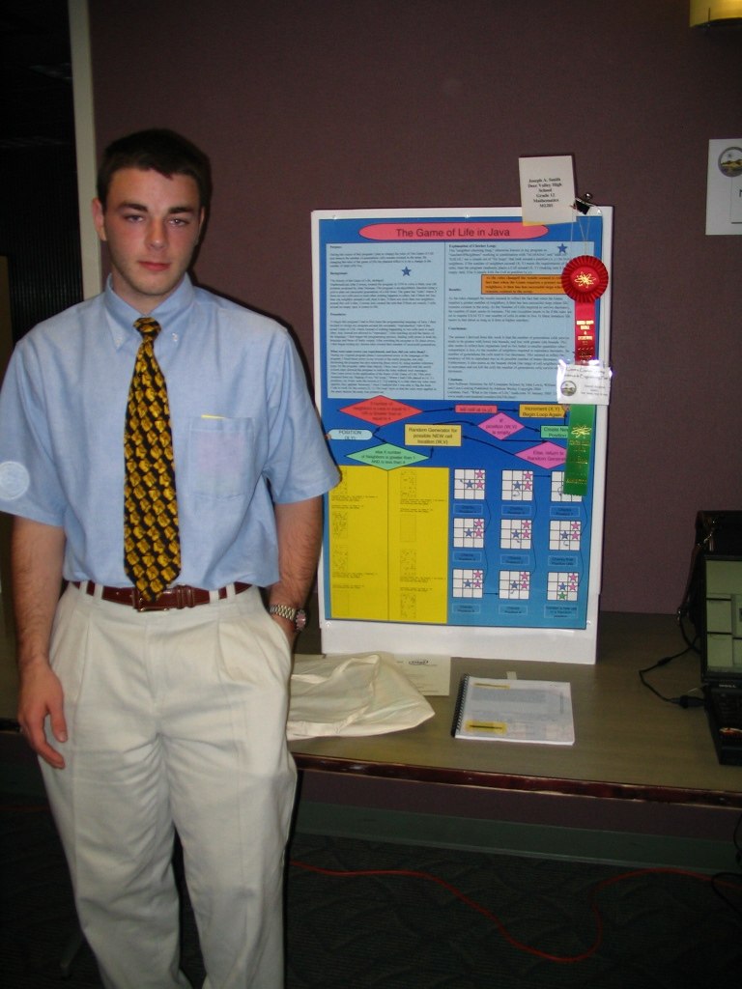
Overarching Goals
- Poster Design
Communicate the science you have done CLEARLY
Present enough information that the reader can understand what you did without assistance
Highlight graphs, results, devices, etc.

Slide 16
Readability
Is there significant text far away from eye level?
Can you read it from 5 feet away?
Are there too many words? Do you repeat yourself? Do you say the same thing over and over and over? Is there some way to say the same thing with fewer keystrokes?
Are lists bulleted or numbered?
Do headings stand out?
HEADINGS SHOULD BE SANS SERIF
Body text should use a serif font
Colors are good as long as there aren’t too many

Slide 17
Display limitations
Be sure to conform to rules
If you need power, do everything in advance! Tell everyone multiple times!
Nothing dangerous!! No critters, no flames, etc.
Don’t exceed the available space

Slide 18
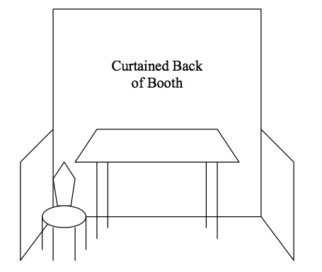
Size limitations
According to ISEF, the maximum size of the display poster is:
Depth: 30 inches (76 cm)
Width: 48 inches (122 cm)
Height: 108 inches (274 cm) or NINE FEET

Slide 19
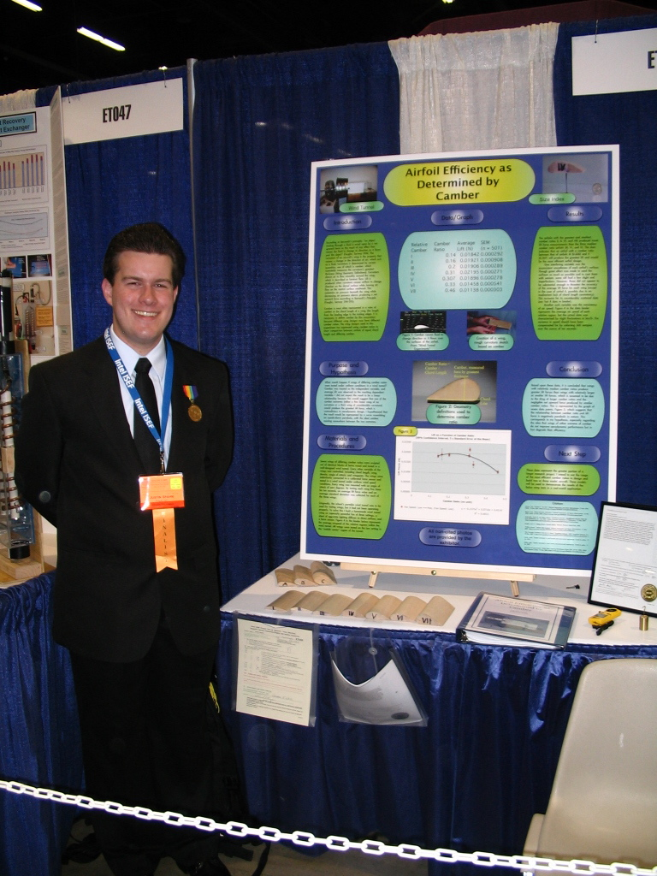
Examples:3
Big title
Smile!
The main topic is in a big photo right in the center
The graph is large enough to read.
Model

Slide 20
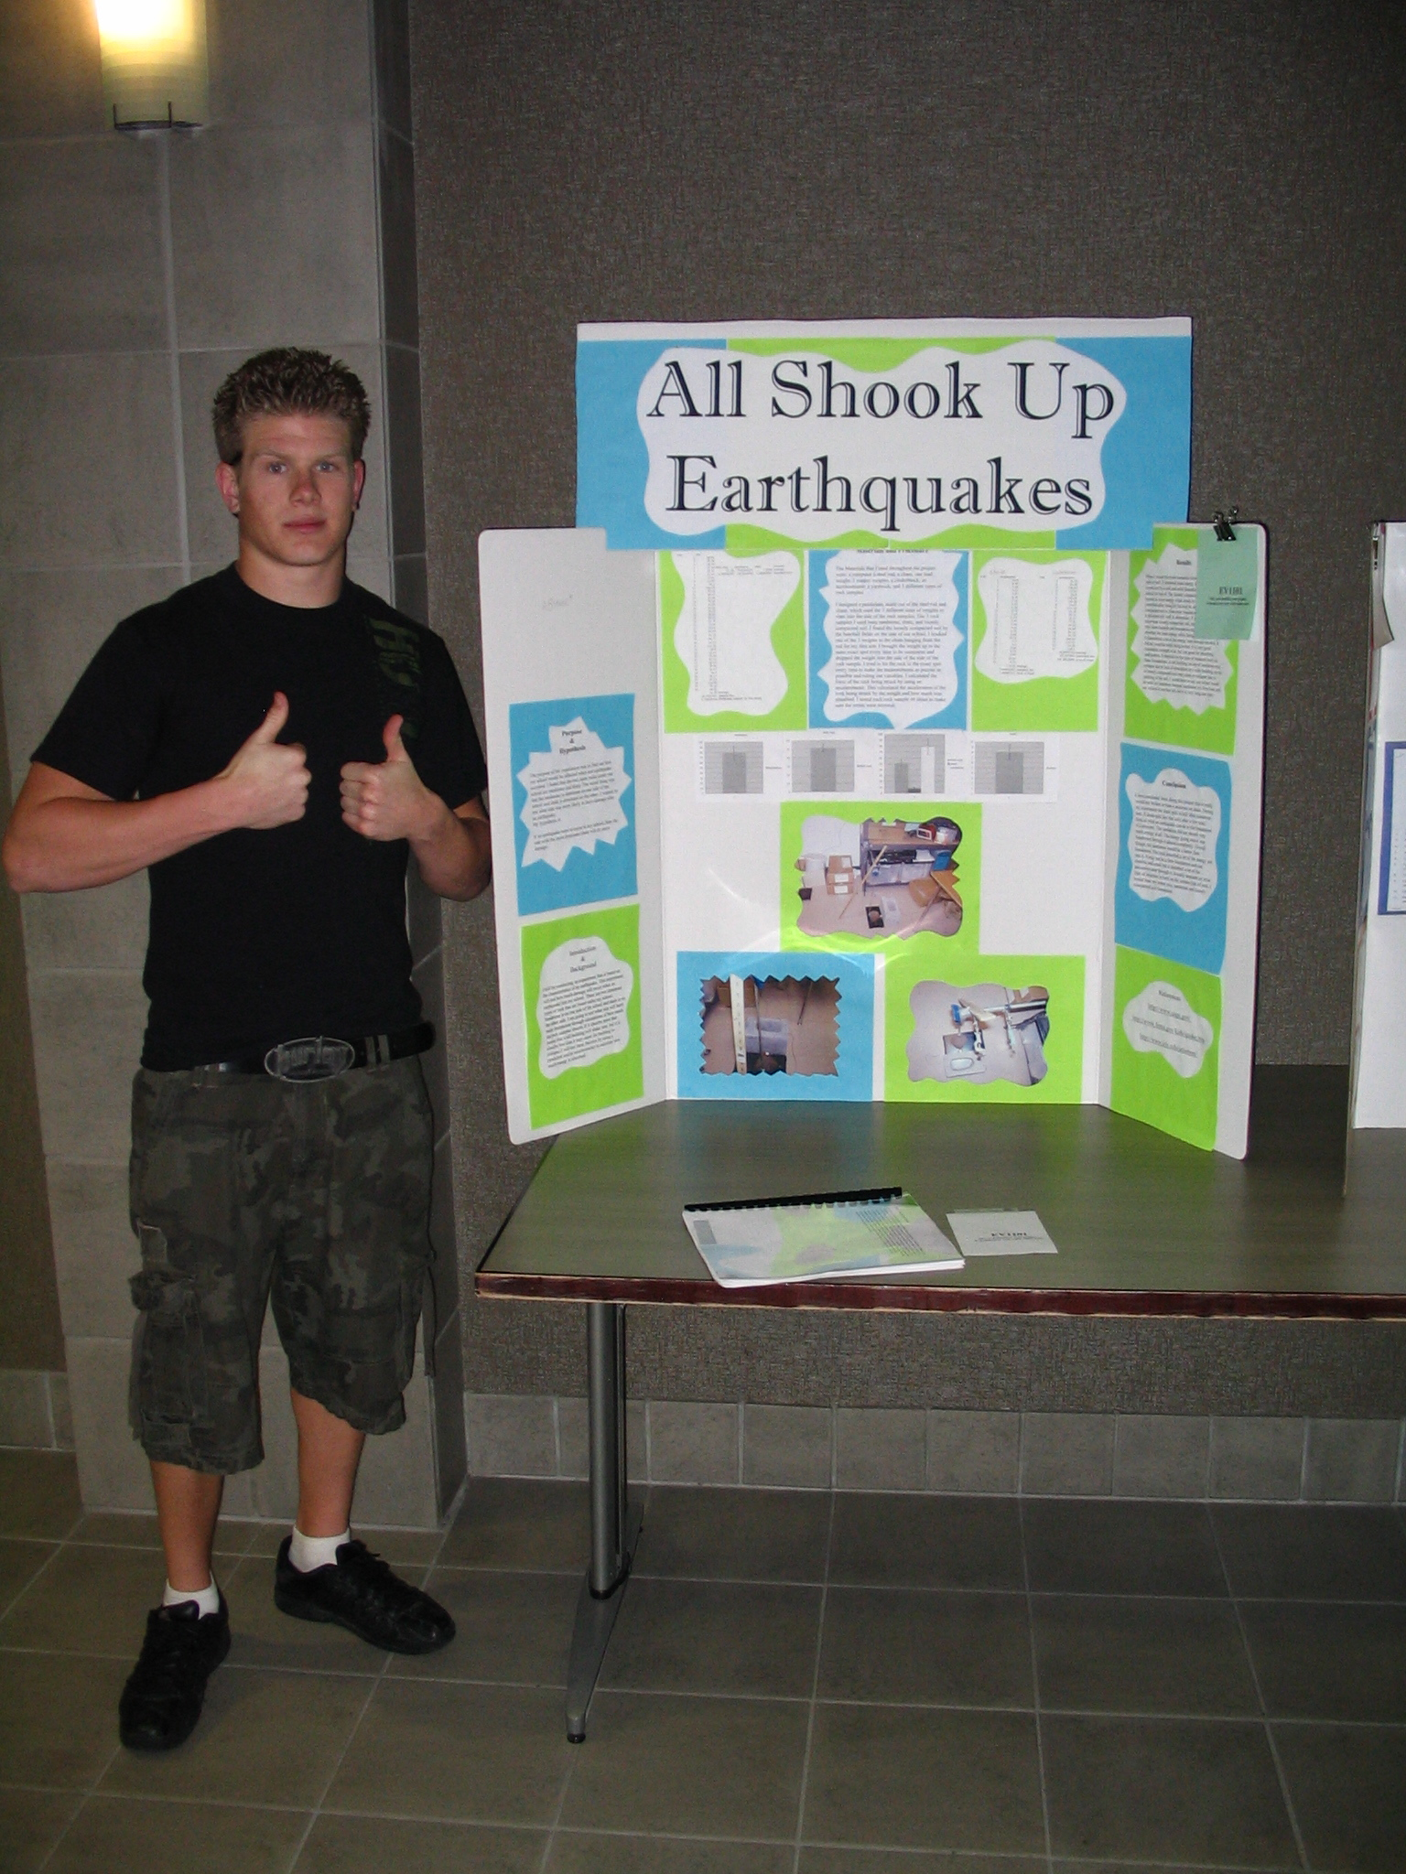
Good Title
;-) backgrounds
? backgrounds
Colored backgrounds

Slide 21
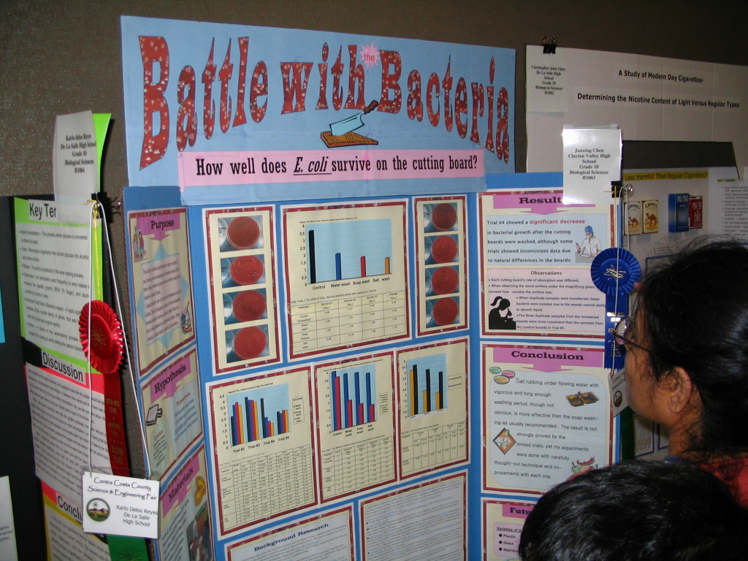
Looky here though
Great Title
2 parts
Catchy &
Technical
Photos
Big Graphs
Front and Center
Clear sections

Slide 22
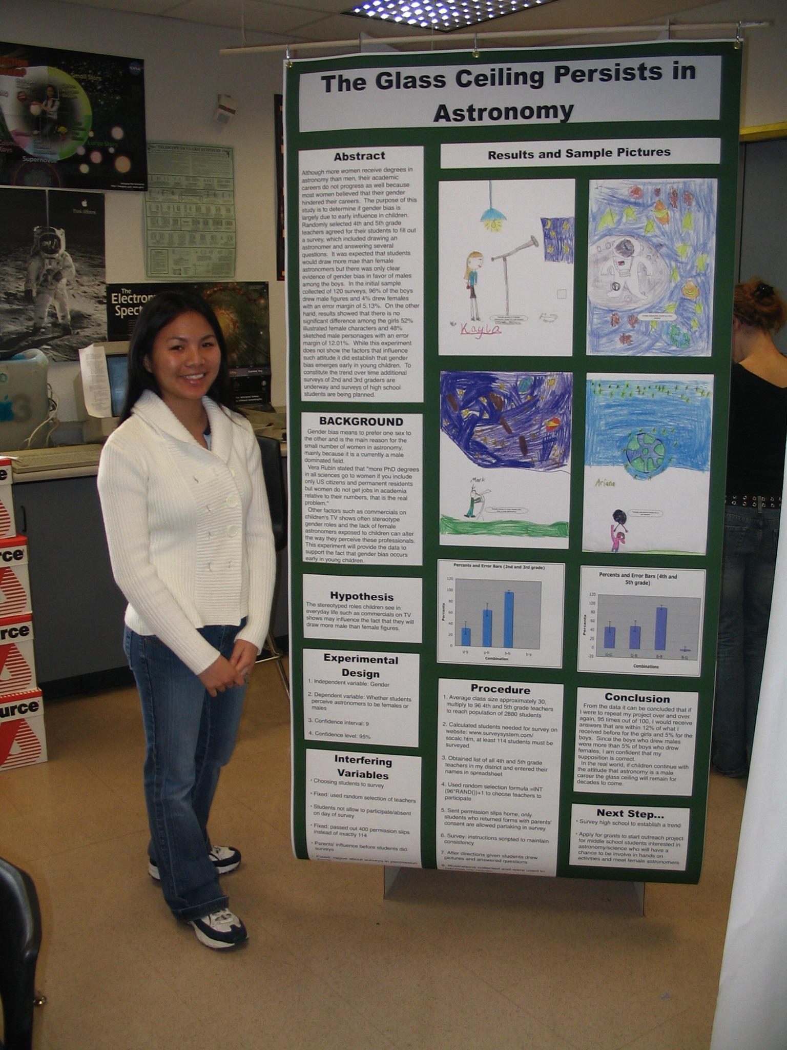
9 feet, 0 inches
Not too many words
:-)
BIG pictures

Slide 23
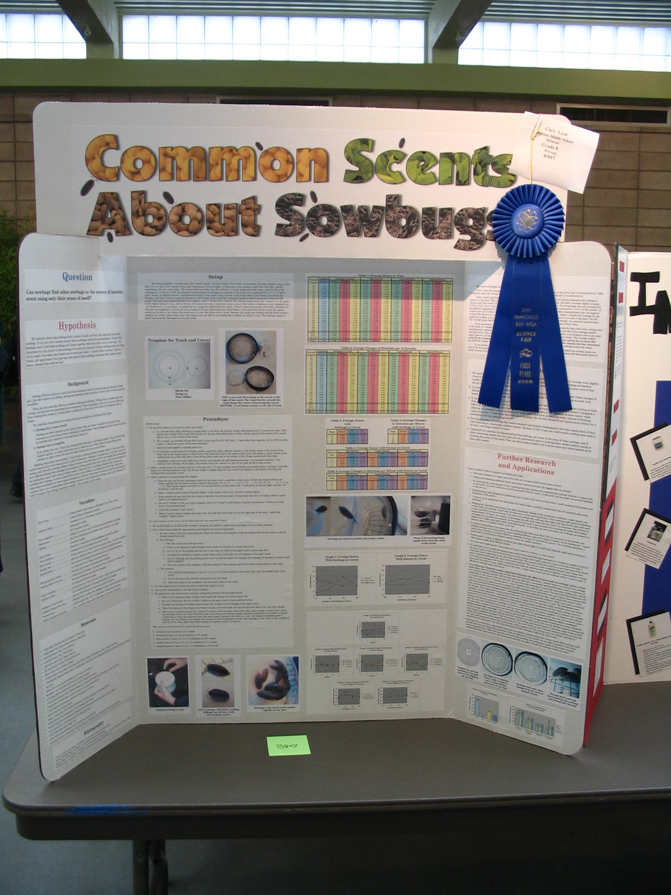
Good Title, creative and
not too hard to read
Too many words?
Bigger pictures!

Slide 24
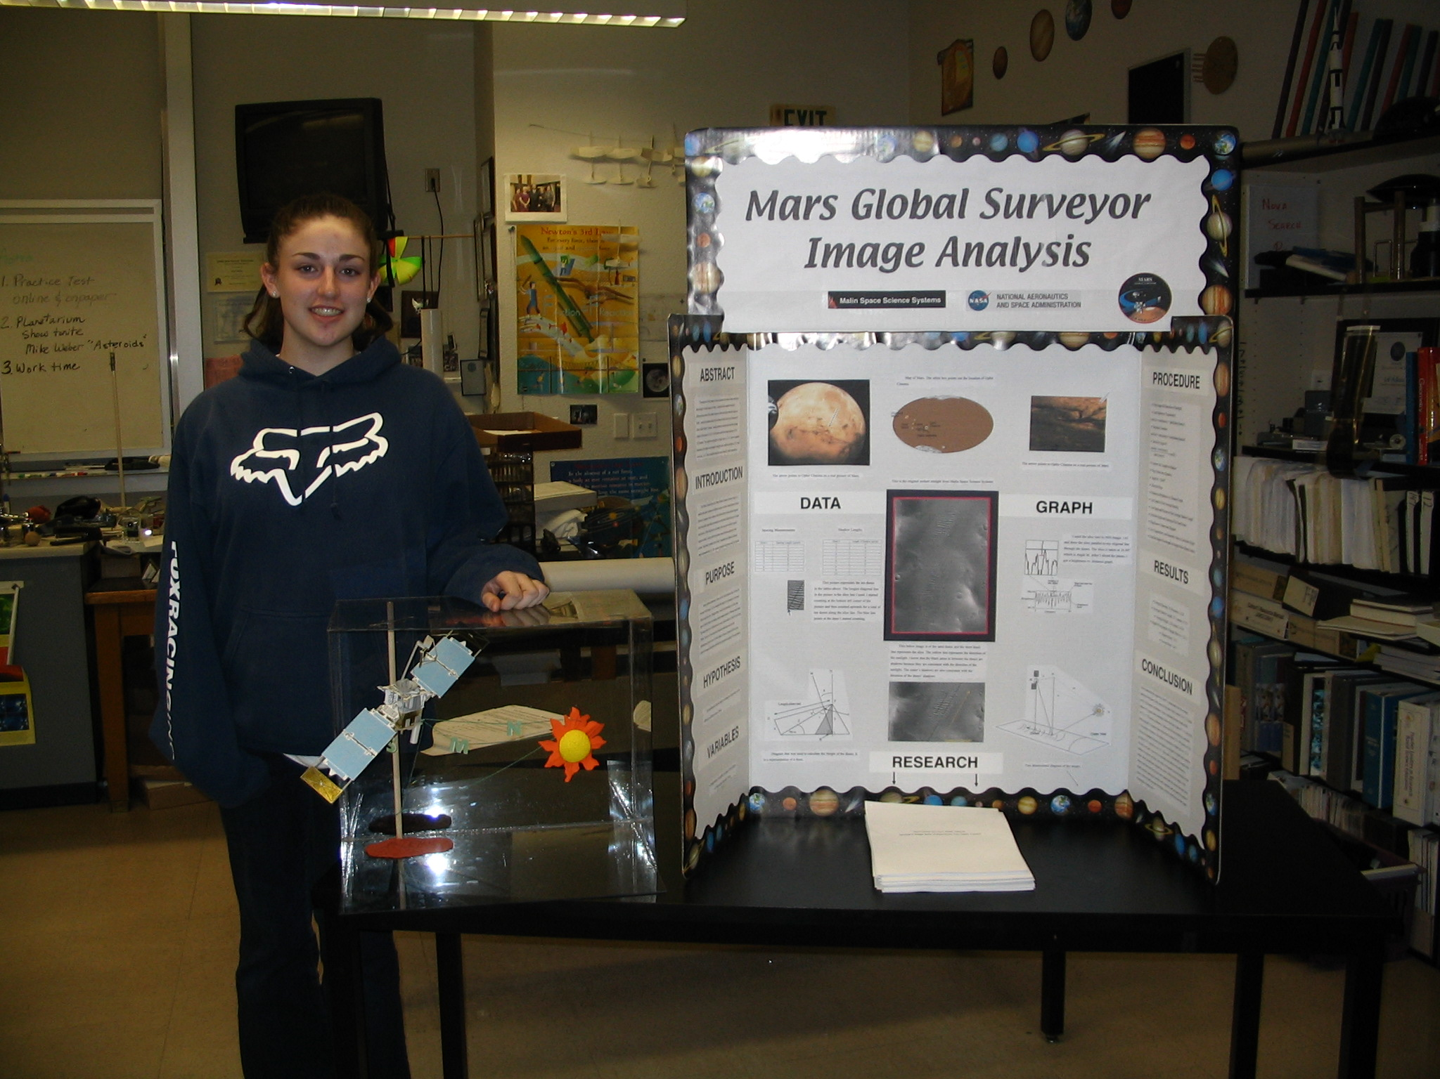
BIG ol’ Title
:-)
Main Picture
Clean, and easy to follow
Research binder

Slide 25
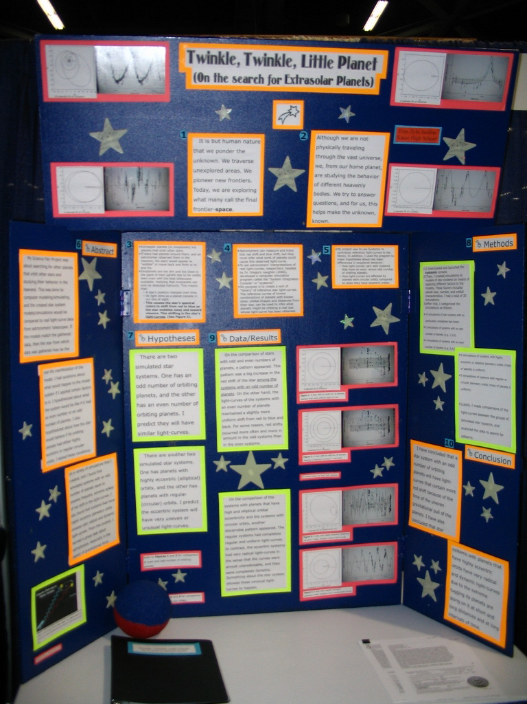
Small pictures

Slide 26
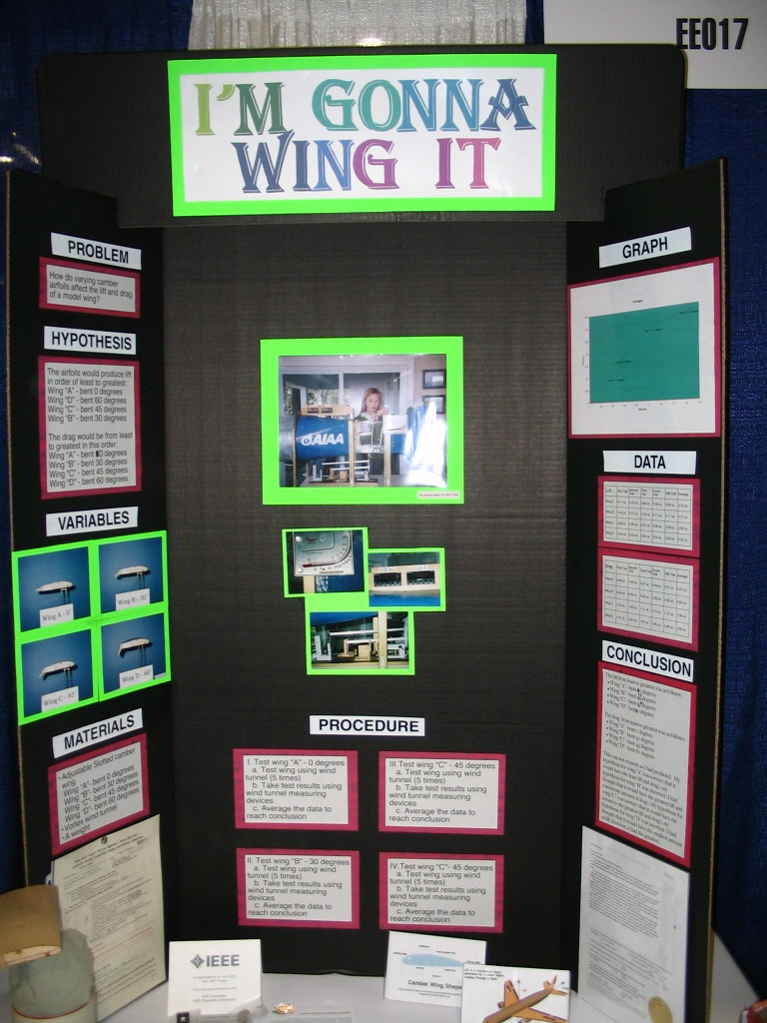
too small!
Take pictures of everything
Test How?
Typical ISEF Abstract

Slide 27
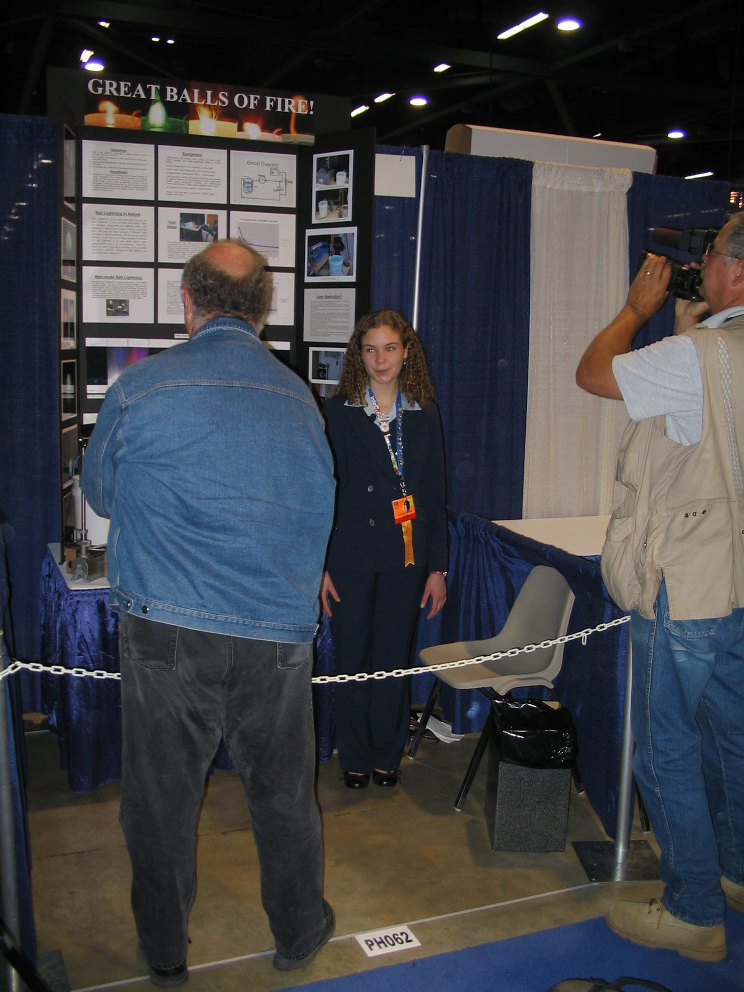
Great Title
On the verge of being too high
;-)

Slide 28
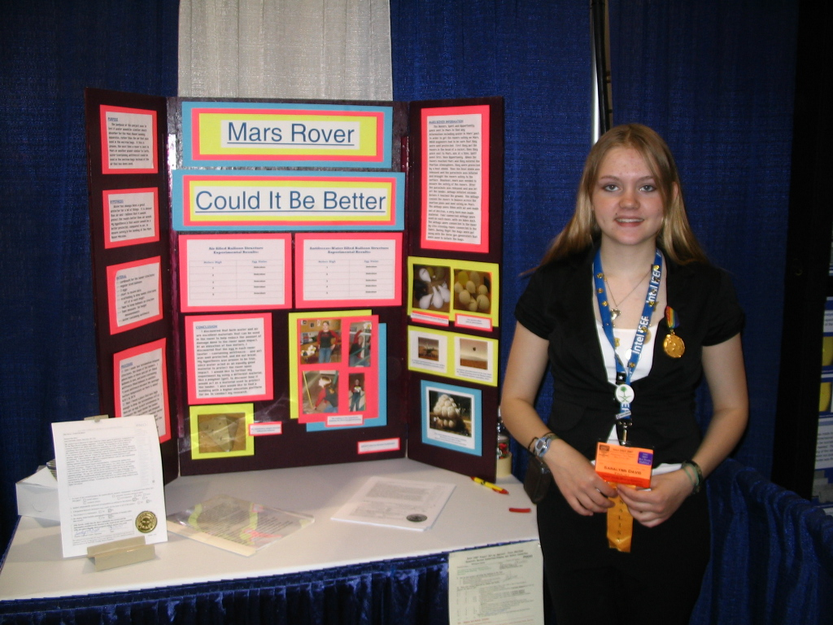
Any doubt what this is about?
Photos
Abstract

Slide 29
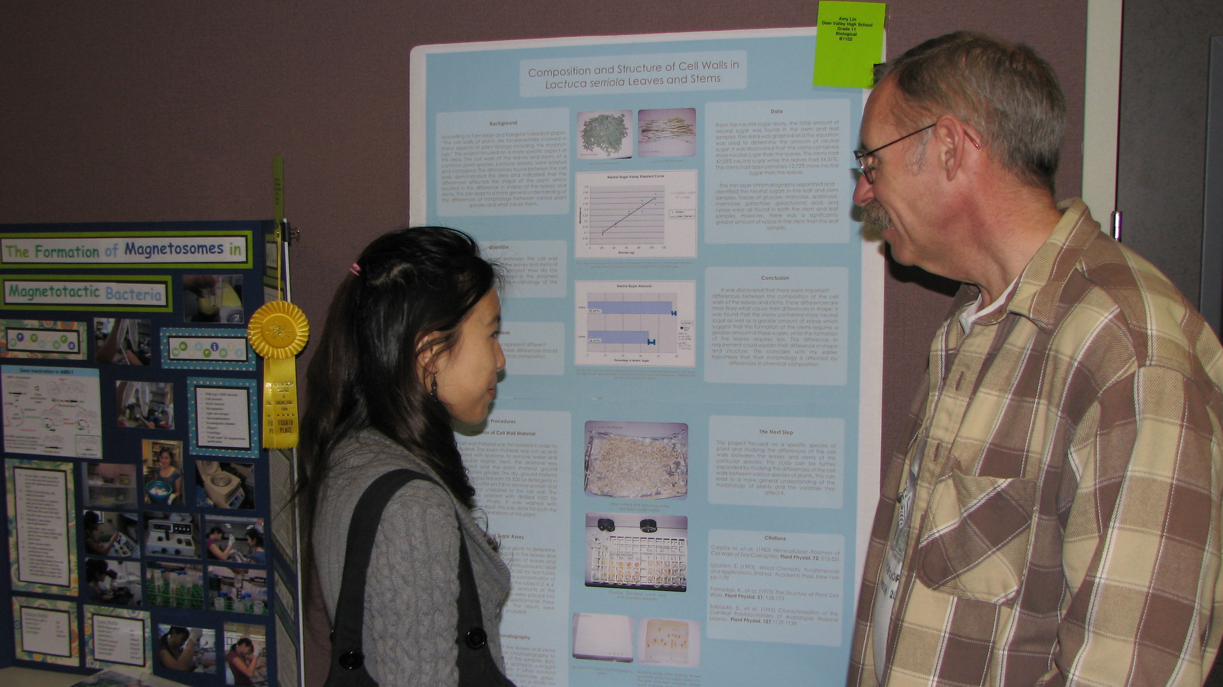
Interviews/Judging Criteria
Judging is split into two sections:
Poster evaluation
Interview
Judging criteria:
http://www.cceconptnr.org/ScienceFair/Judges.htm

Slide 30
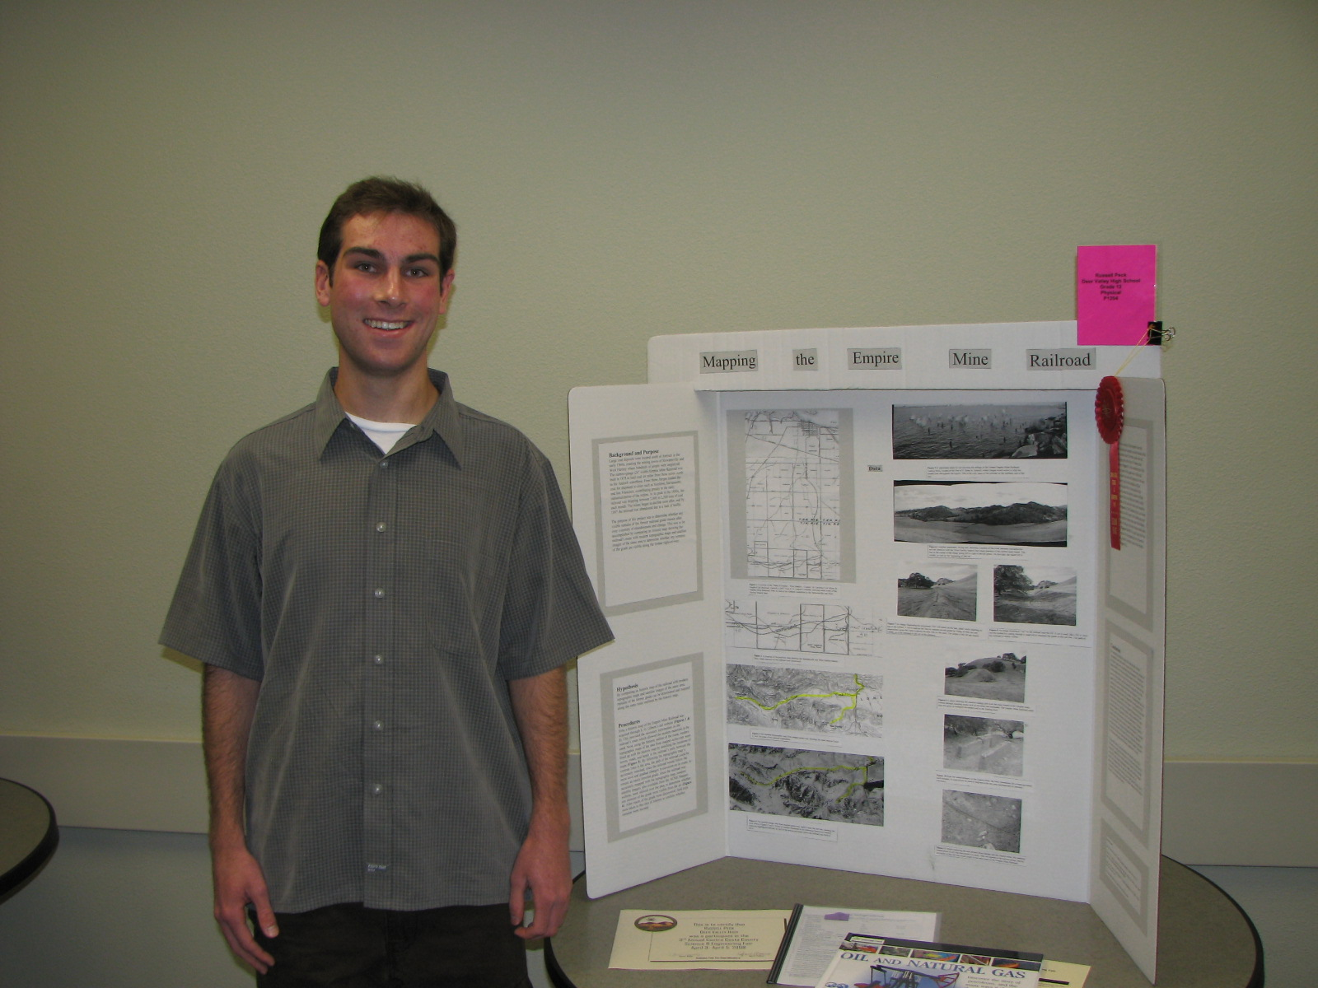
Your goal
Do good science
Communicate clearly what you have done clearly
The poster must speak for itself
You must speak with authority and confidence
Enjoy the work
Be an expert in your field

Slide 31
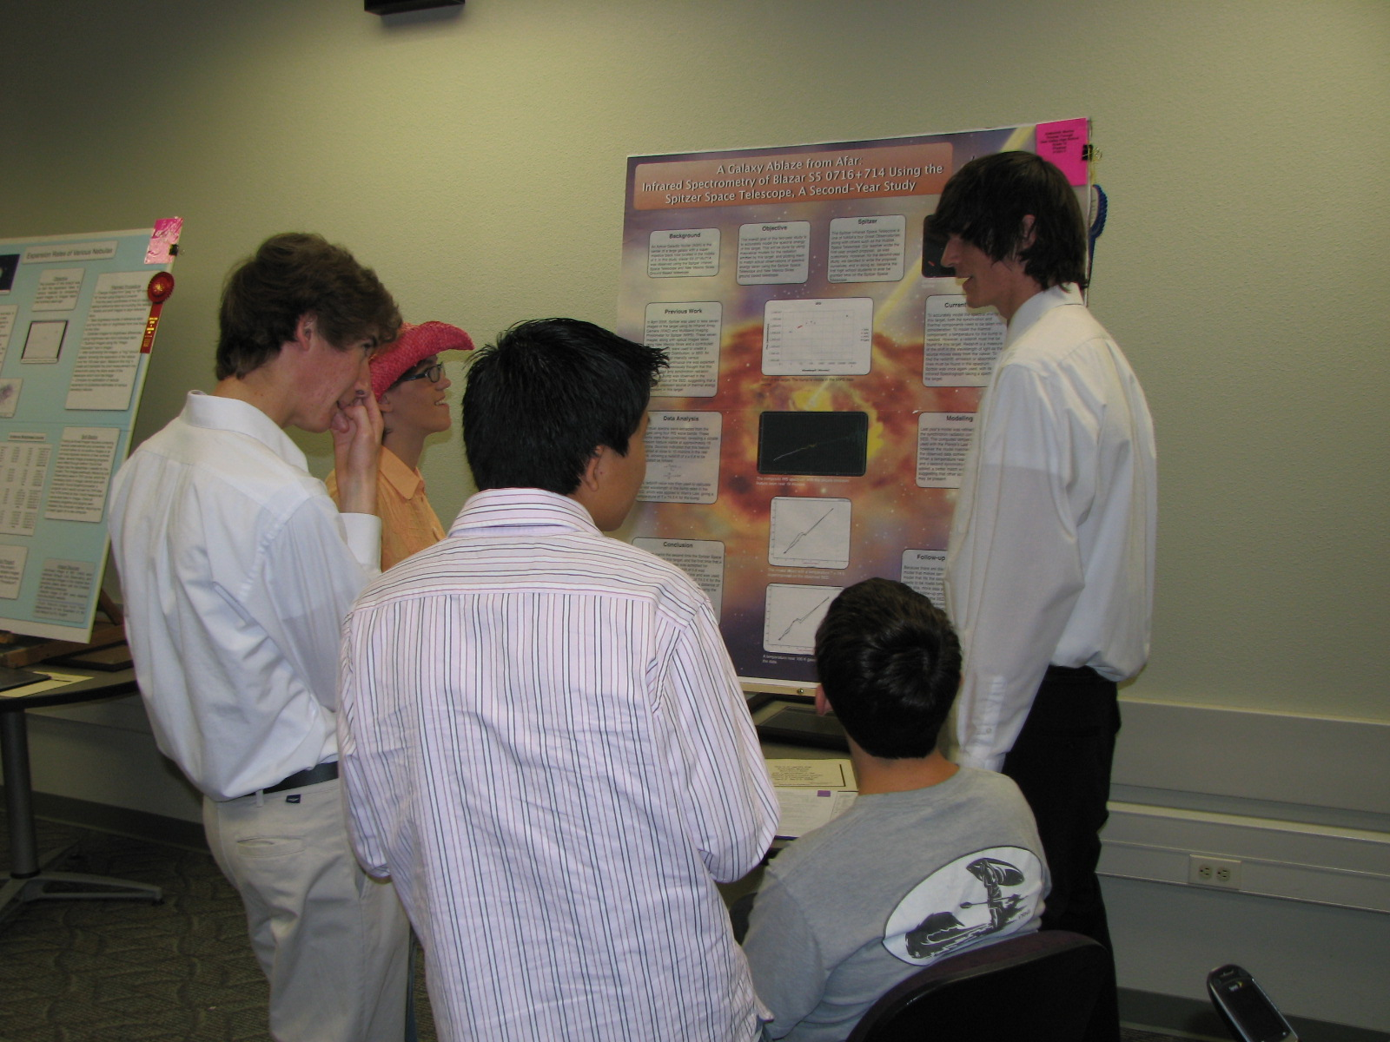
Interview Tips
Practice in front of your Mom or Dad
an intelligent, but uninformed audience
Present to skeptics
an informed audience
Practice out loud
There’s no substitute for knowing what you’re talking about.
You will probably need to talk louder, and slower, than you think is necessary.

