Slide 1
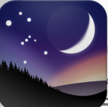
Fun with Stellarium
Jeff Adkins
www.astronomyteacher.com
For MDAS
August 25, 2026

Slide 2
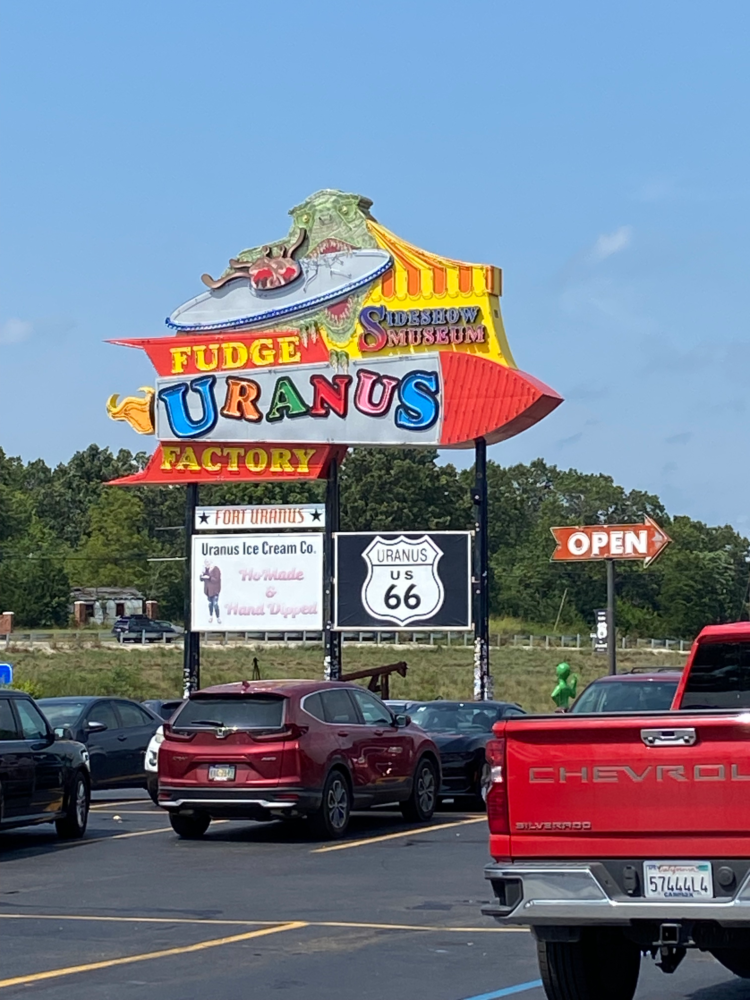
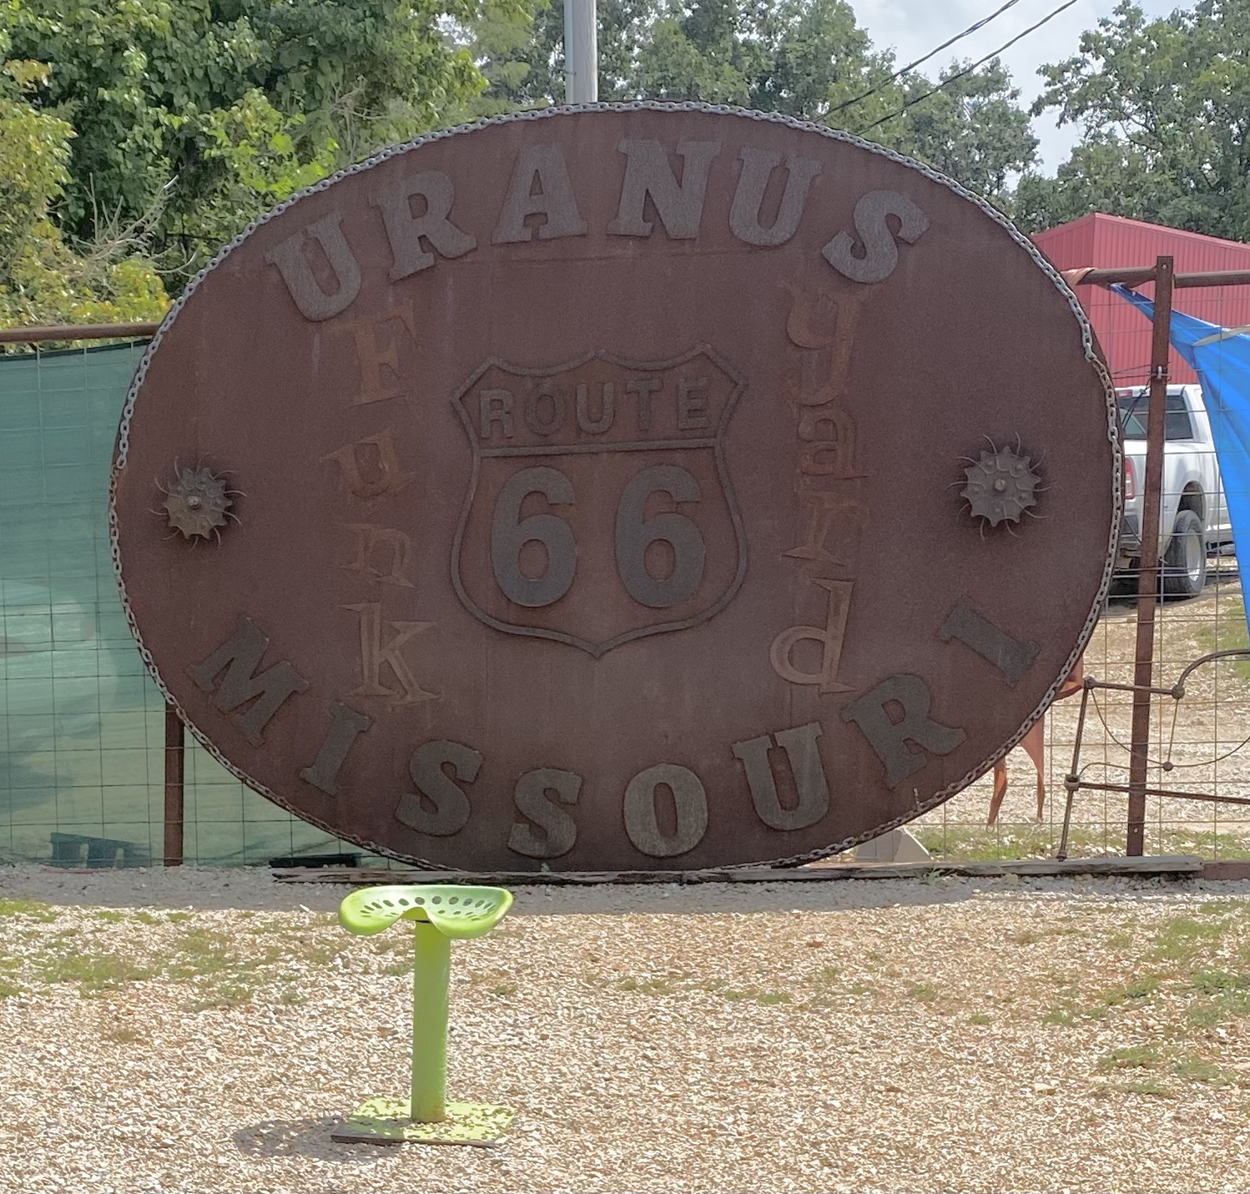
Butt first...
Route 66
Every Uranus pun ever …
"The best fudge comes from Uranus!”
‘Thank you for picking Uranus Fudge Factory”
“If you discover a mess just let one of our professional fudge packers know and we’ll scrape that right out for you.”
“It’s not pronounced Uranus, it’s pronounced Uranus.”

Slide 3
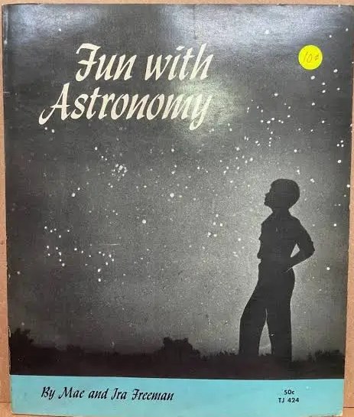
Fun with Astronomy
By Mae and Ira Freeman
Pinhole camera
Scale model solar system
Sun’s heat depends on angle and not distance
Parallax demo
Inspiration for me being an astronomy guy and for this presentation

Slide 4
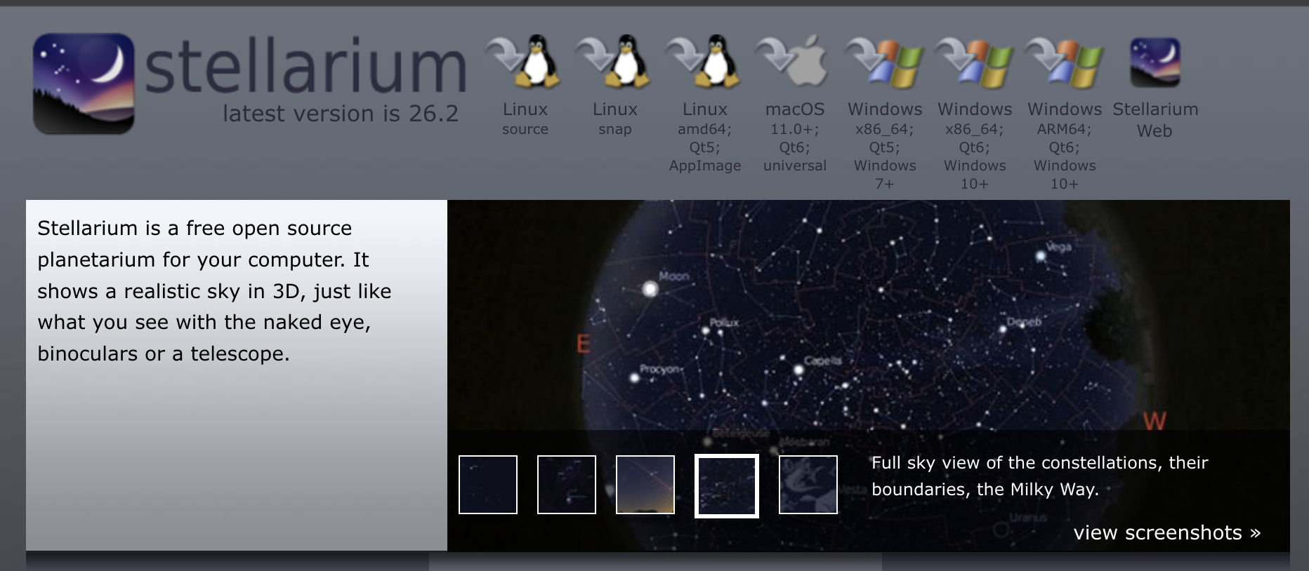
What is Stellarium?
I don’t work for them :)
Open Source sky simulator and desktop planetarium
https://stellarium.org/
Available for Mac, Windows, Linux, MacOS, web browser, iOS
“This work has made use of the Stellarium planetarium”
Zotti, G., Hoffmann, S. M., Wolf, A., Chéreau, F., & Chéreau, G. (2021). The Simulated Sky: Stellarium for Cultural Astronomy Research. Journal of Skyscape Archaeology, 6(2), 221–258. DOI: 10.1558/jsa.17822

Slide 5
Observing Aids

Slide 6
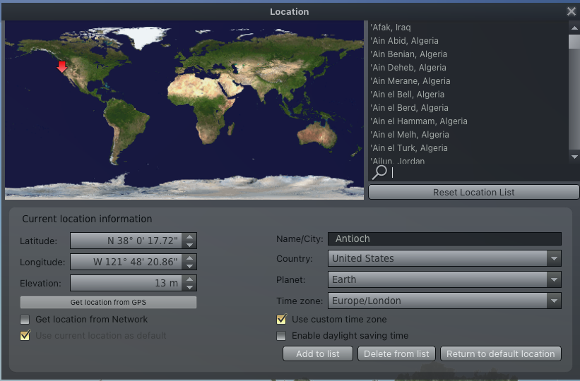
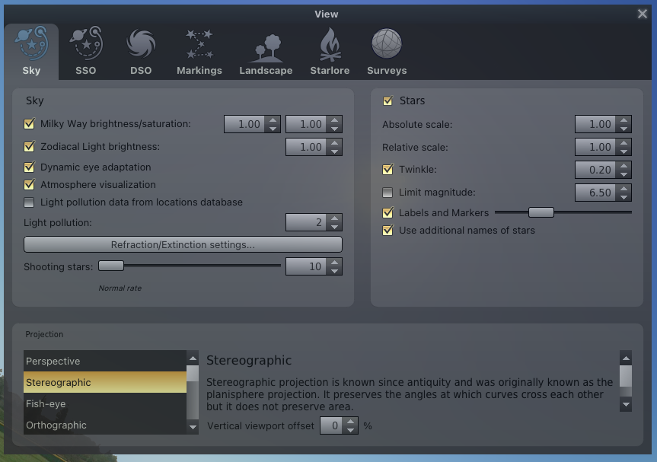
Observing Aids
Controlling limiting magnitude, light pollution
Add your location to the map!

Slide 7
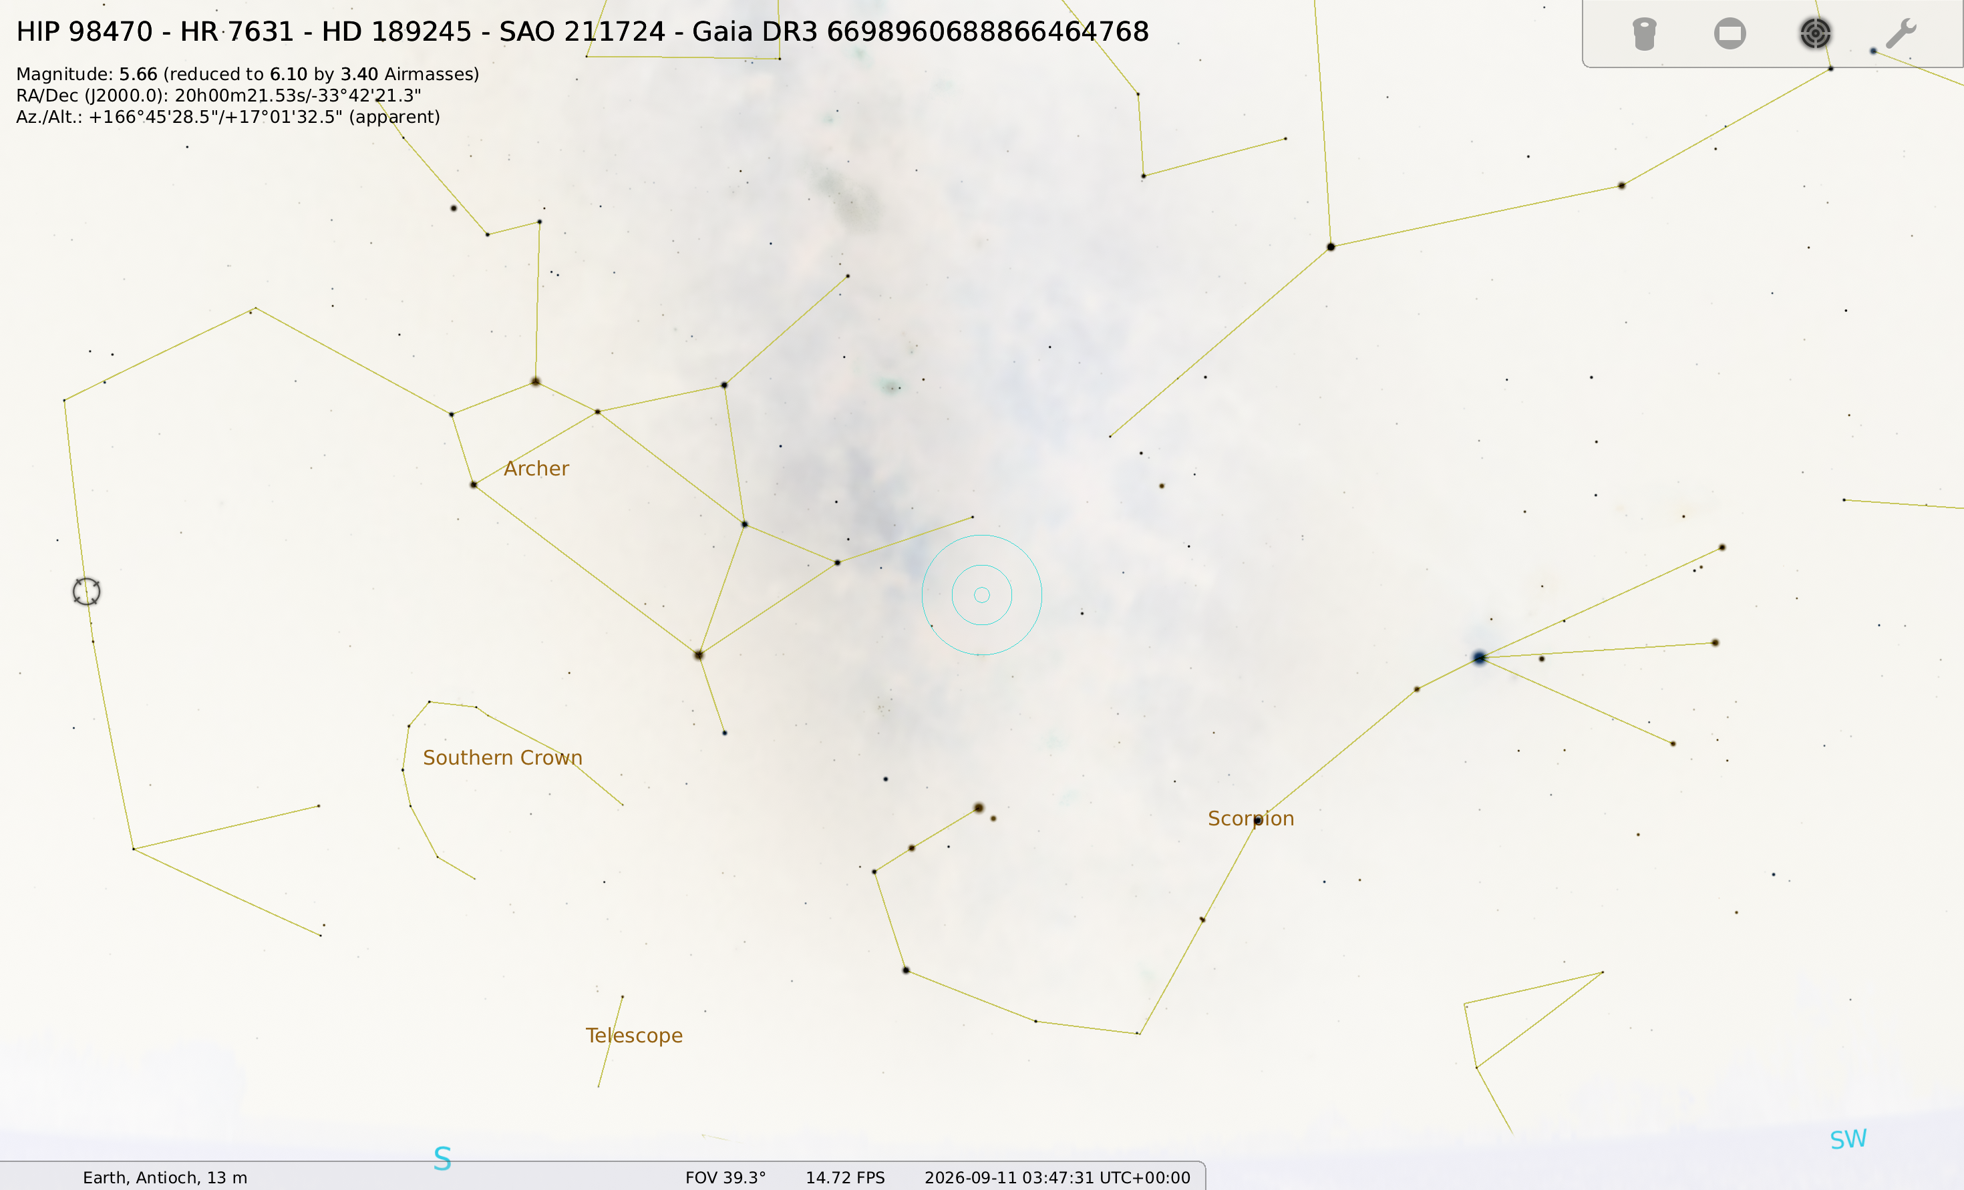
Observing Aids
When does it rise/set/cross the meridian?[:]
Speed up [L] Stop time [K] Reverse [J]
Field of View[page up/page down]
Finder Chart (reverse colors for printing)
Ocular Plugin (simulates your telescope or a Telrad)
Night Mode
Searching for Conjunctions, Oppositions
Updating databases

Slide 8
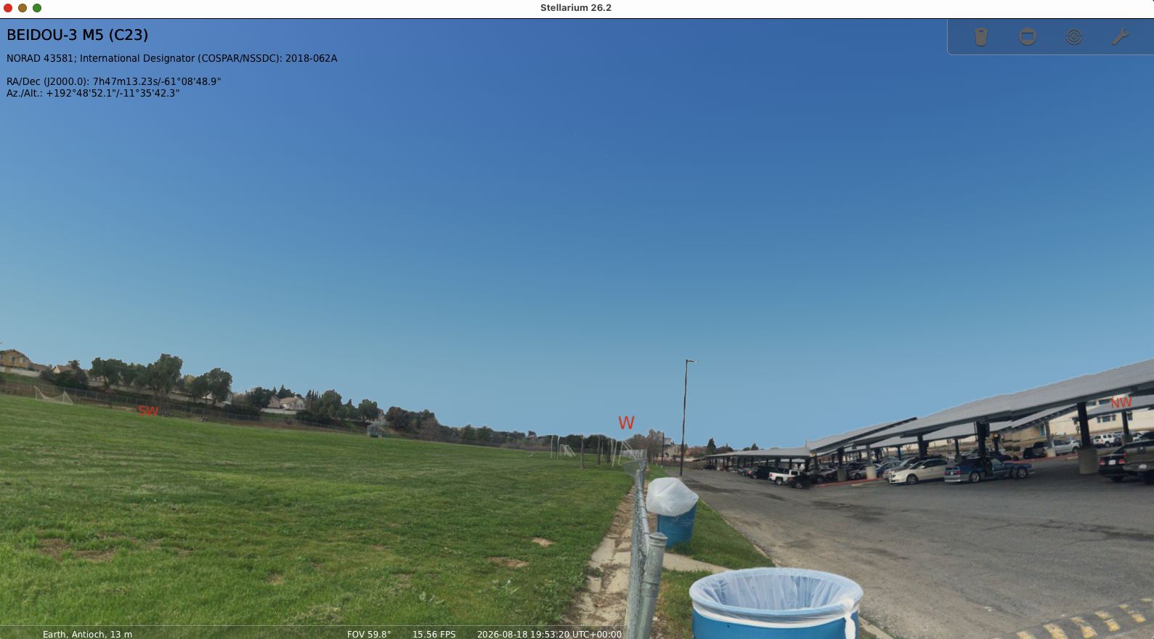
Beyond Observing Aids
Little Known Tools
Bookmarks
Built-in Scripting: Accessing scripts
  Analemma
Plugins
  The angle-measuring tool: how to activate and use it
Changing the landscape
Changing the star cultures

Slide 9
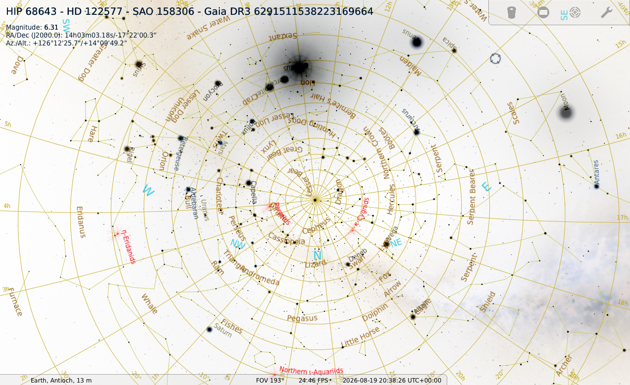
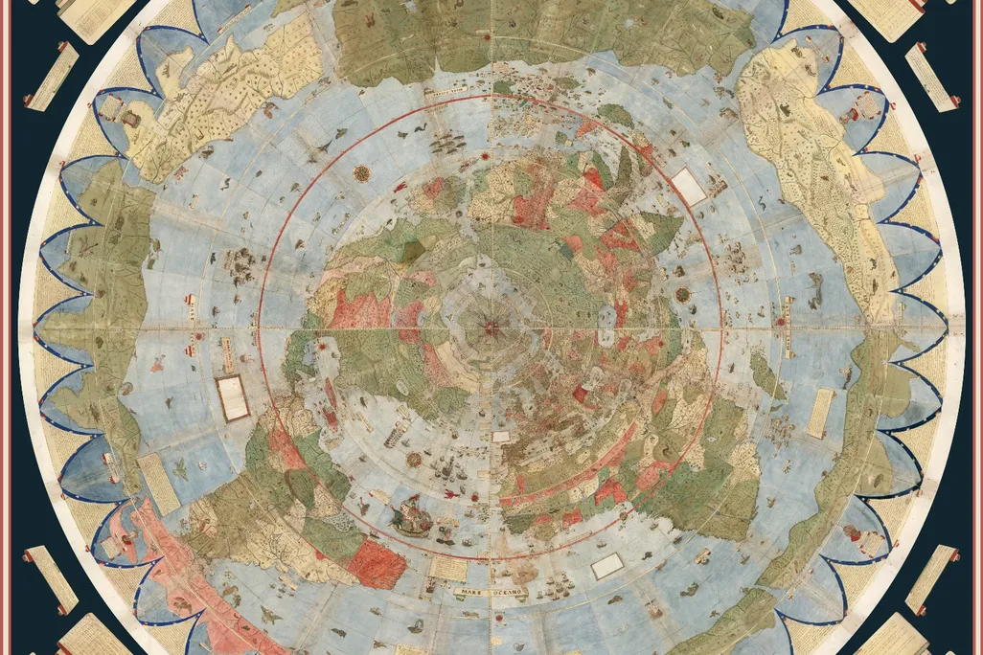
Make a Planisphere!
Center on Polaris
Gravity Labels
Screen shot
Invert Colors
Make a mask based on flat horizon
1587, a Milanese scholar named Urbano Monte designed a 10 foot planisphere

Slide 10
Projects

Slide 11
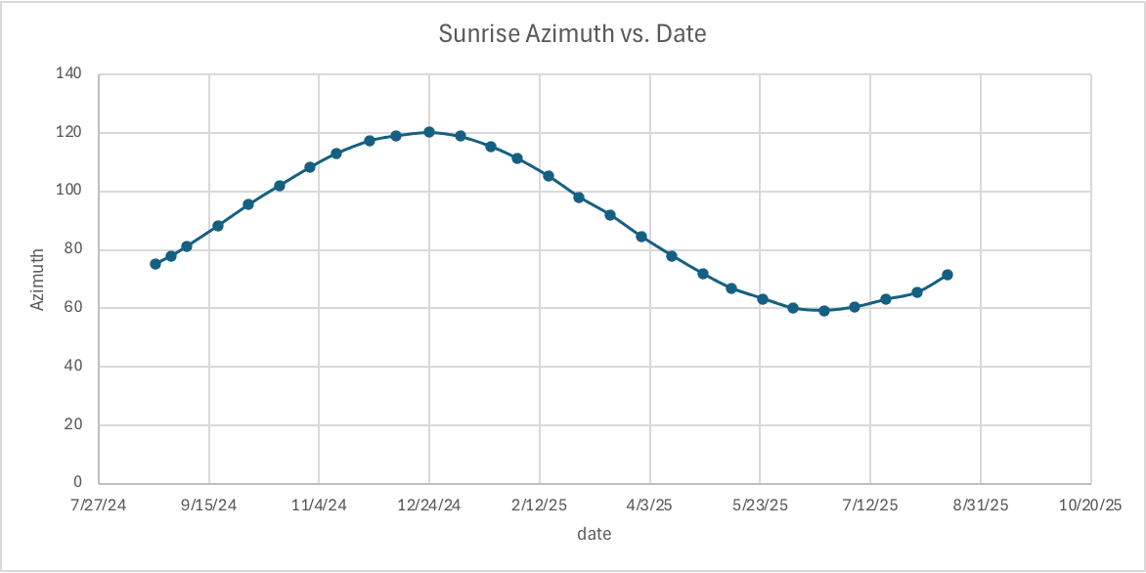
Sun’s Azimuth for a Year
DEMO
Stellarium data
Set time so altitude is zero
Record azimuth
Jump 2 weeks into the future
Repeat
  Winter Solstice
  Summer Solstice
  Spring Equinox
  Fall Equinox
B
A
C
D

Slide 12
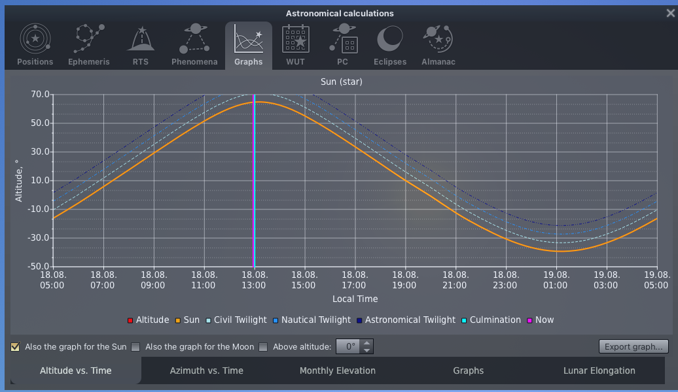
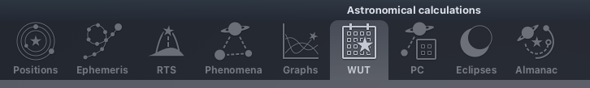
Altitude for a Day
DEMO
Using built in Graphing function
Astronomical Calculations tour
Positions
Ephemerides
Conjunctions
What’s Up Tonight
Angular separations
Eclipse calculator
Almanac

Slide 13
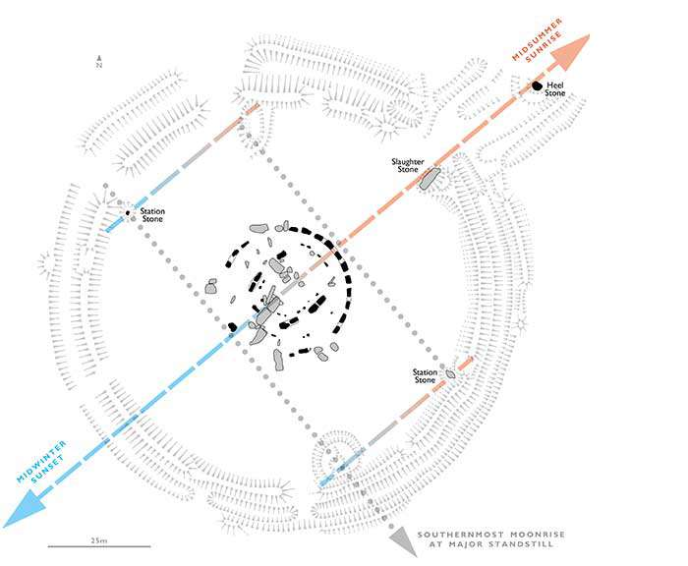
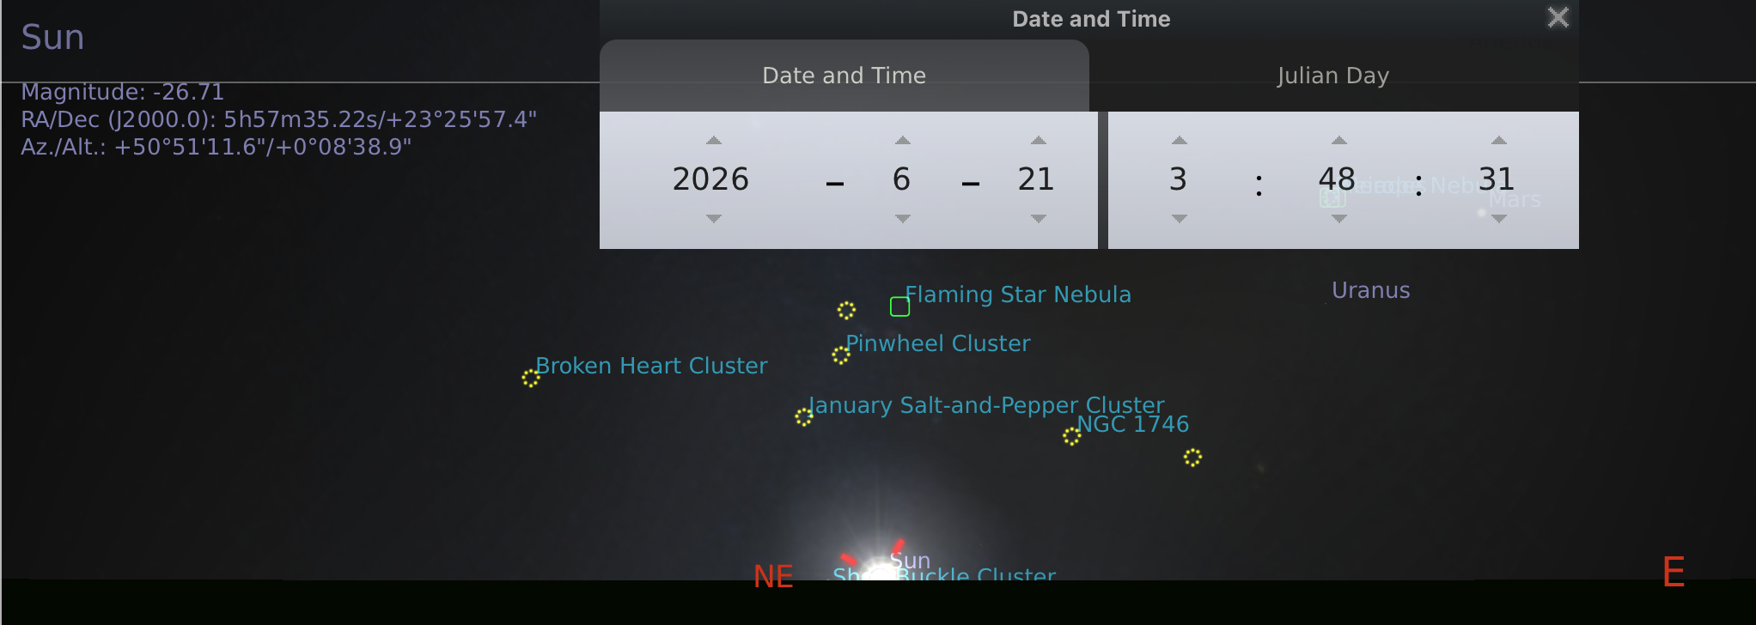
Stonehenge Alignment
North
50
Heel stone
Slaughter stone
This is a line tilted 50 degrees from the vertical. (Azimuth 50)
Project
https://www.english-heritage.org.uk/visit/places/stonehenge/history-and-stories/understanding-stonehenge/

Slide 14
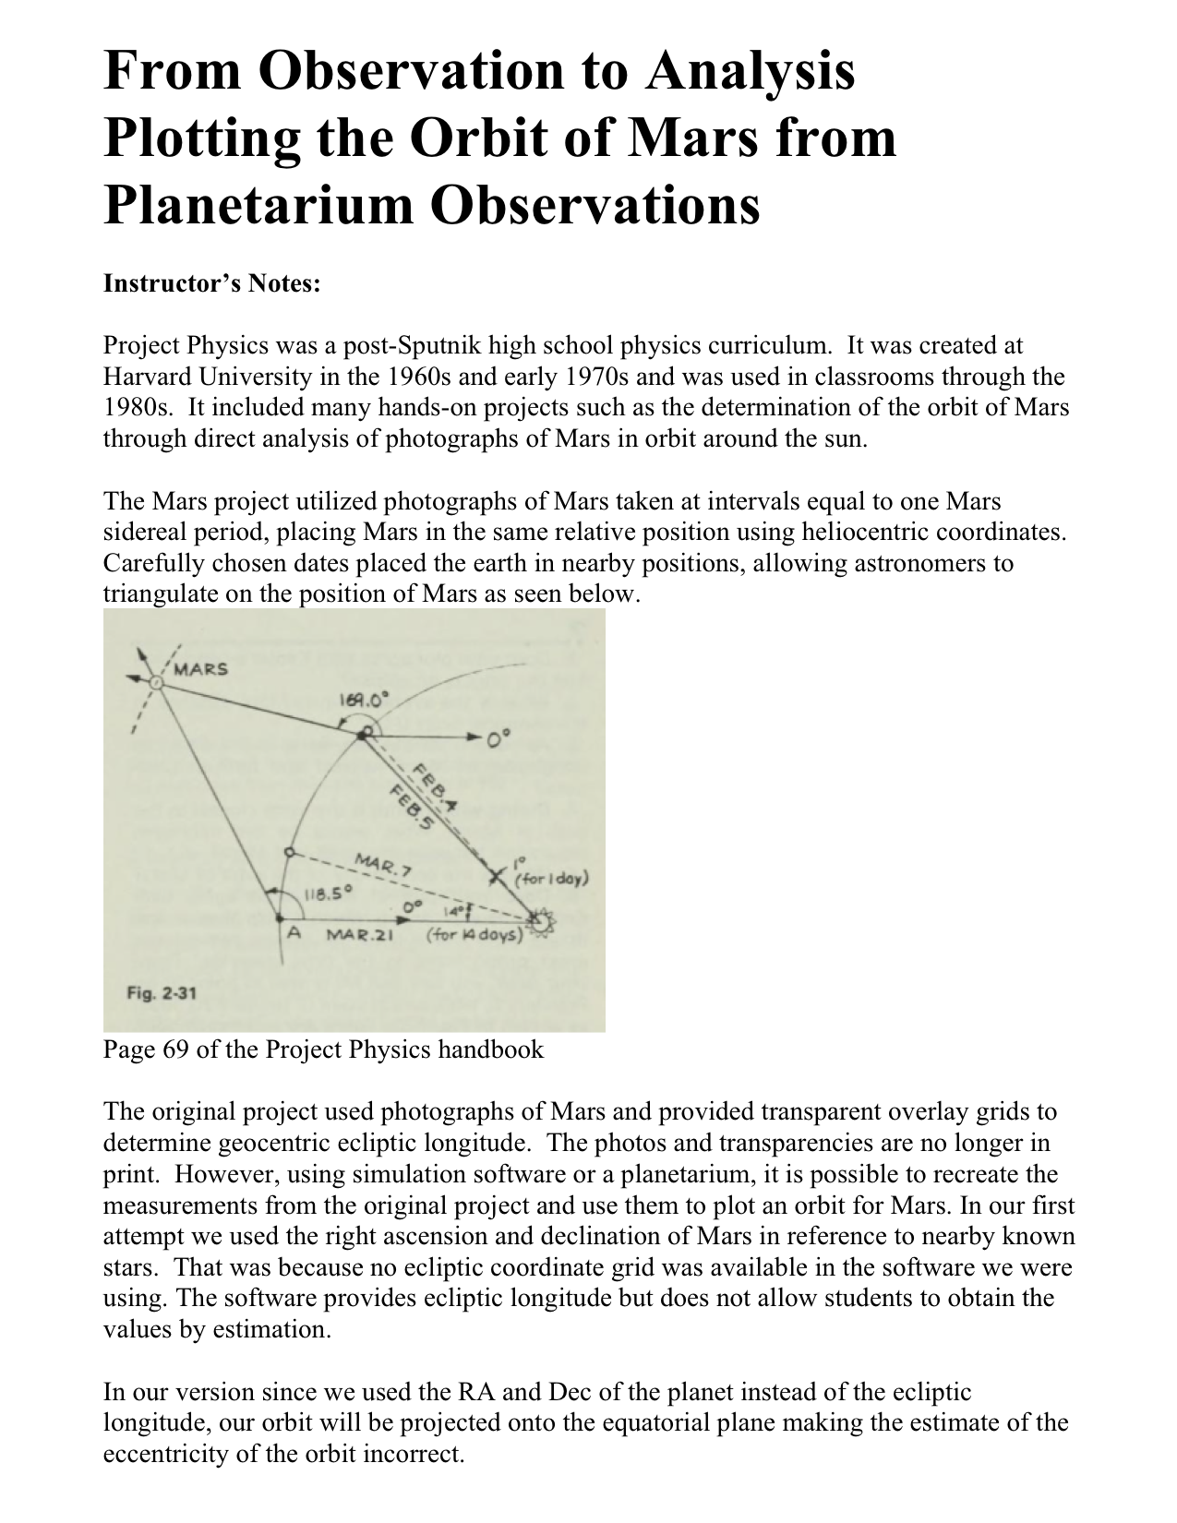
Orbit of Mars From Scratch
Project
Using Stellarium to simulate the observations
The synodic period of a planet is the time it takes to return to the same position in its orbit.
This will not be in the same position in the sky because the earth moves.
Two observations of a planet spaced one synodic period apart can be used to triangulate its position.

Slide 15
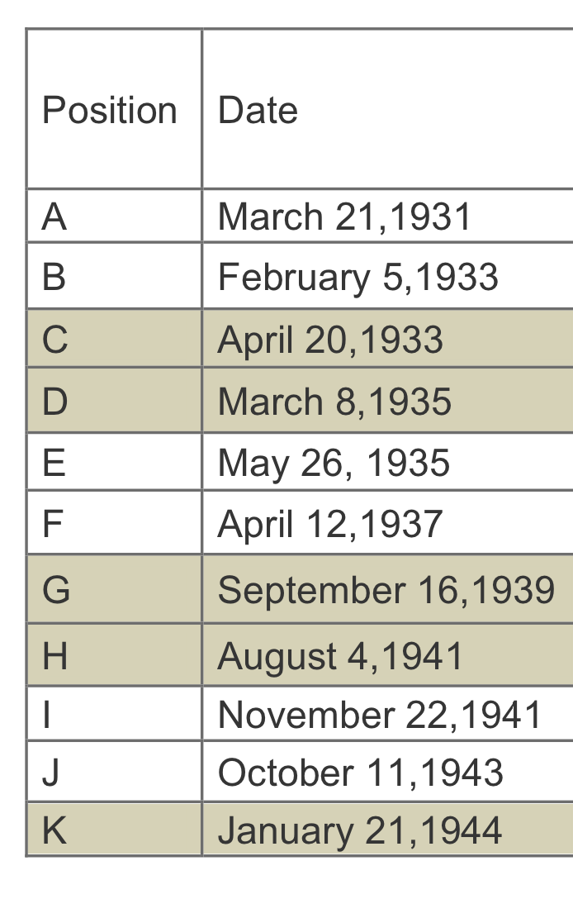
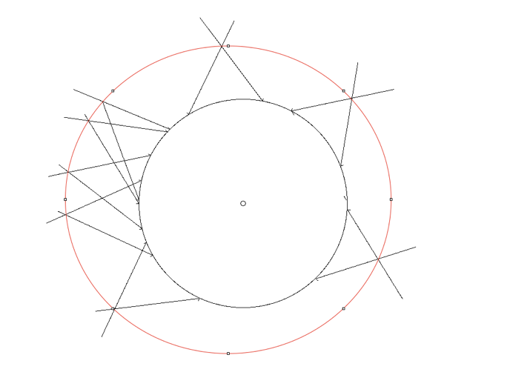
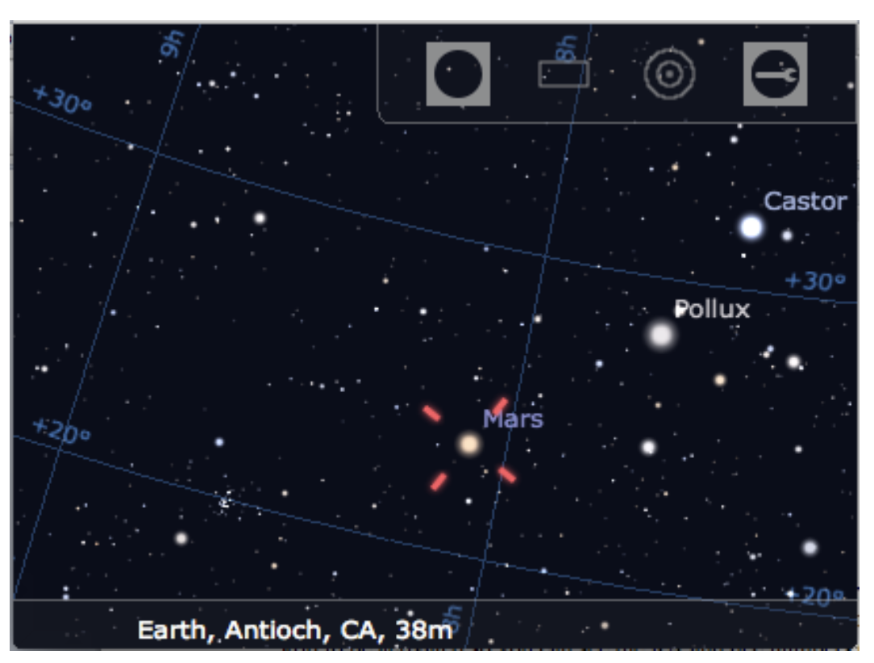
Method
Observe Mars with Stellarium. Get RA and Dec or Ecliptic Longitude. Plot Earth’s
position on that date. Establish 0 degrees and draw each angle.

Slide 16
Control Your Telescope
DEMO
Make a Dob display at what it is pointing:
  https://www.instructables.com/Control-Your-Telescope-Using-Stellarium-Arduino/
Control an LX-200 or similar telescope
  https://www.youtube.com/watch?v=27e6YJ09gds&t=81s
Load Telescope Control Plugin
  Specify Port
  Set up alignment with hand controller
  Control telescope!

Slide 17
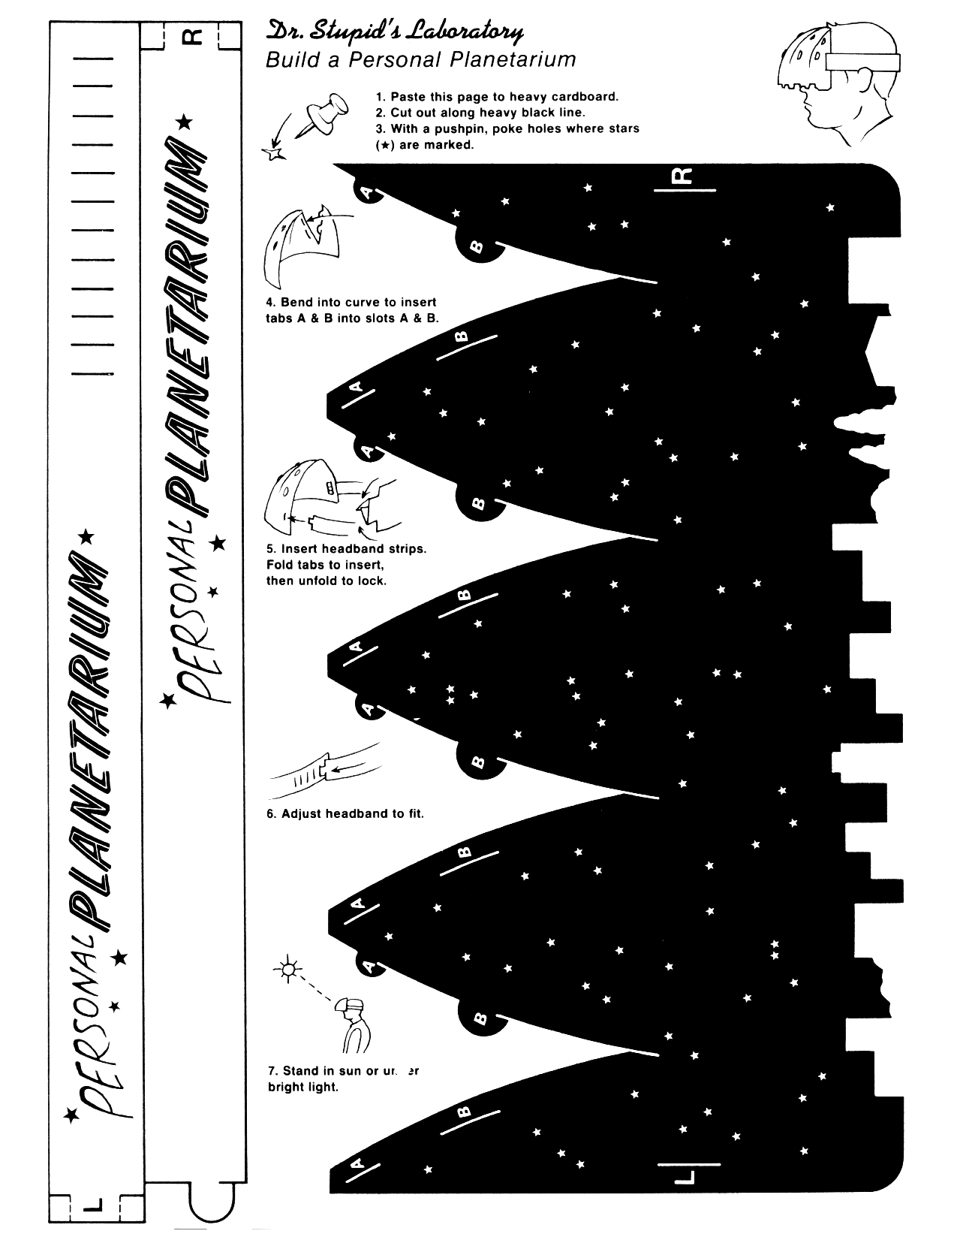
Dr. Stupid's Personal Planetarium
From “Science Made Stupid”
  Or…
Build Your own planetarium projector…cheap

Slide 18

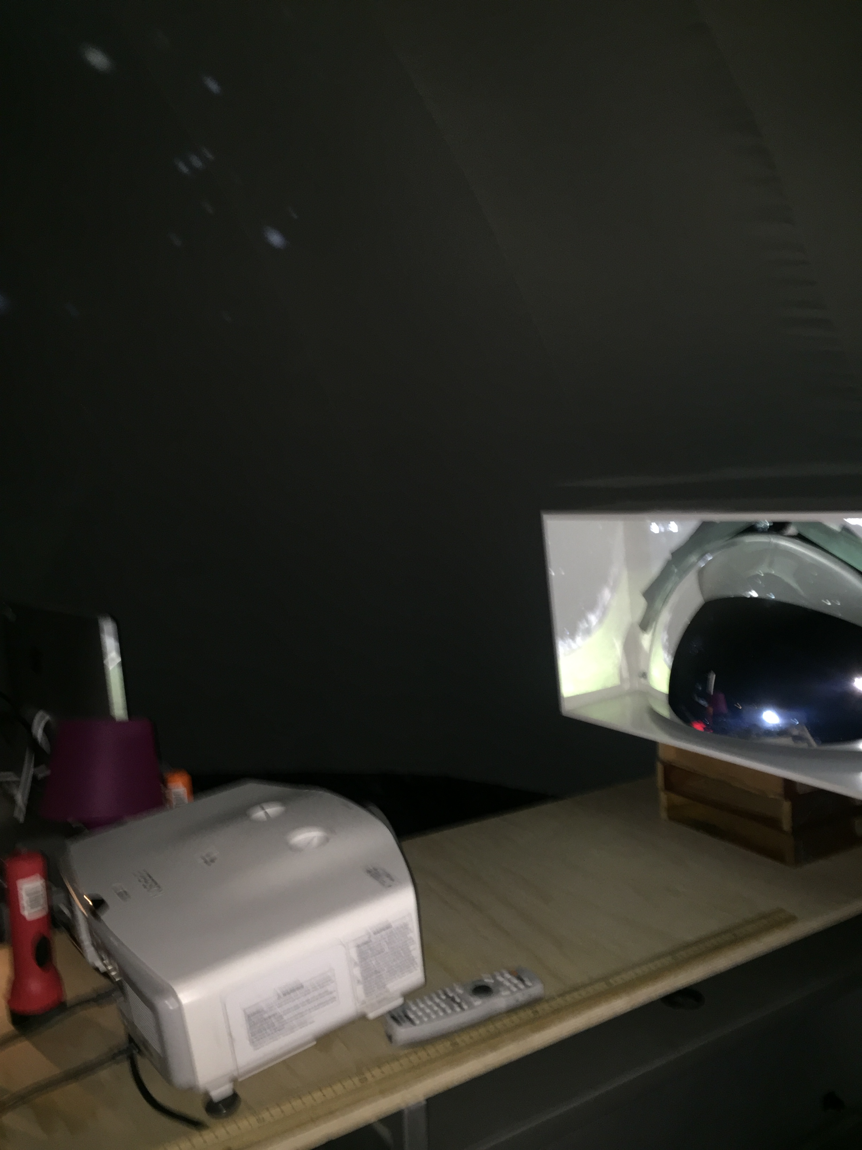



Digital Convex Mirror Projector
What if you want a better projector?
Paul Bourke’s web site: https://paulbourke.net/dome/
http://www.acrilconvex.com.au/firstsurface.html
~$400 for the mirror
convex mirror
first-surface
standard projector

Slide 19
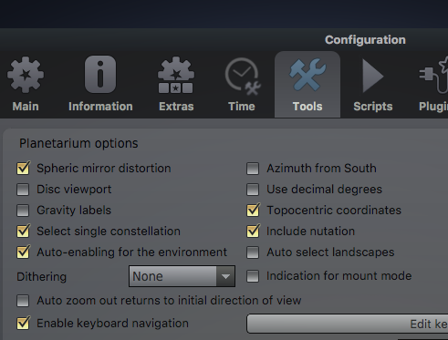

How to project digital simulations
Stellarium
  (Put into hemispherical mirror mode, zoom out and flatten the horizon)
  www.stellarium.net
  Free software for desktop
  Available for phones

Slide 20
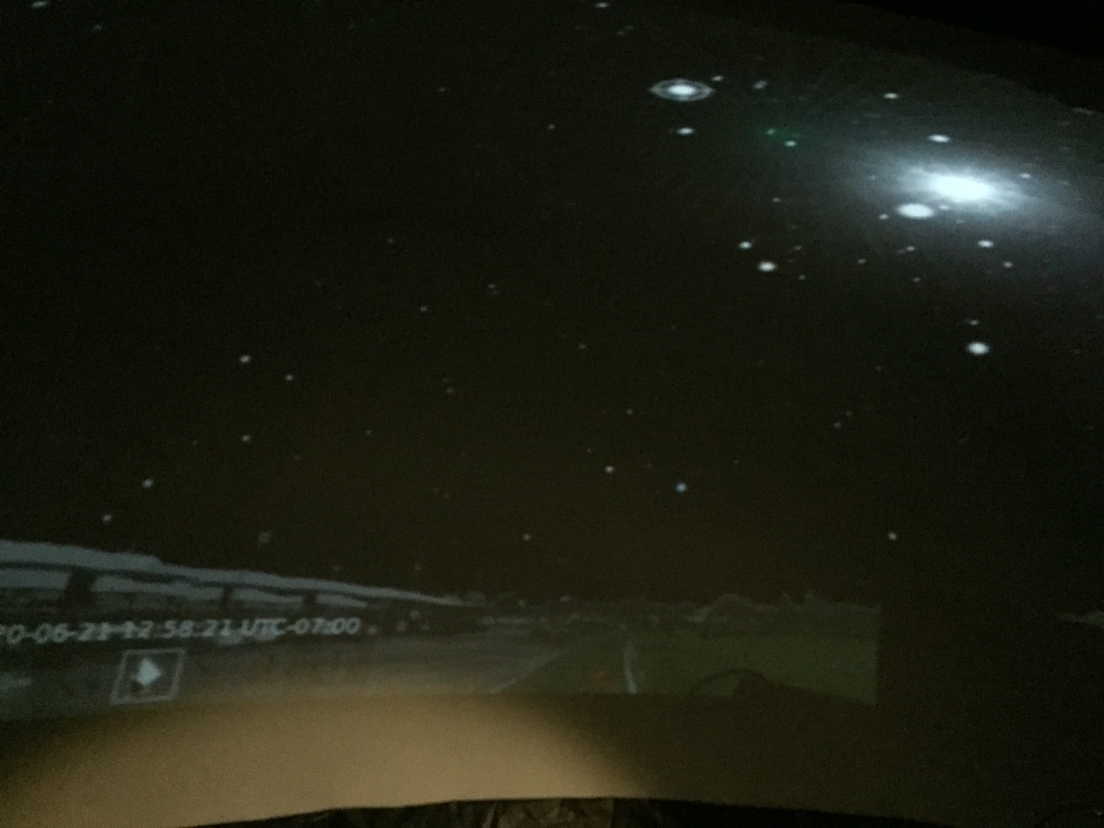
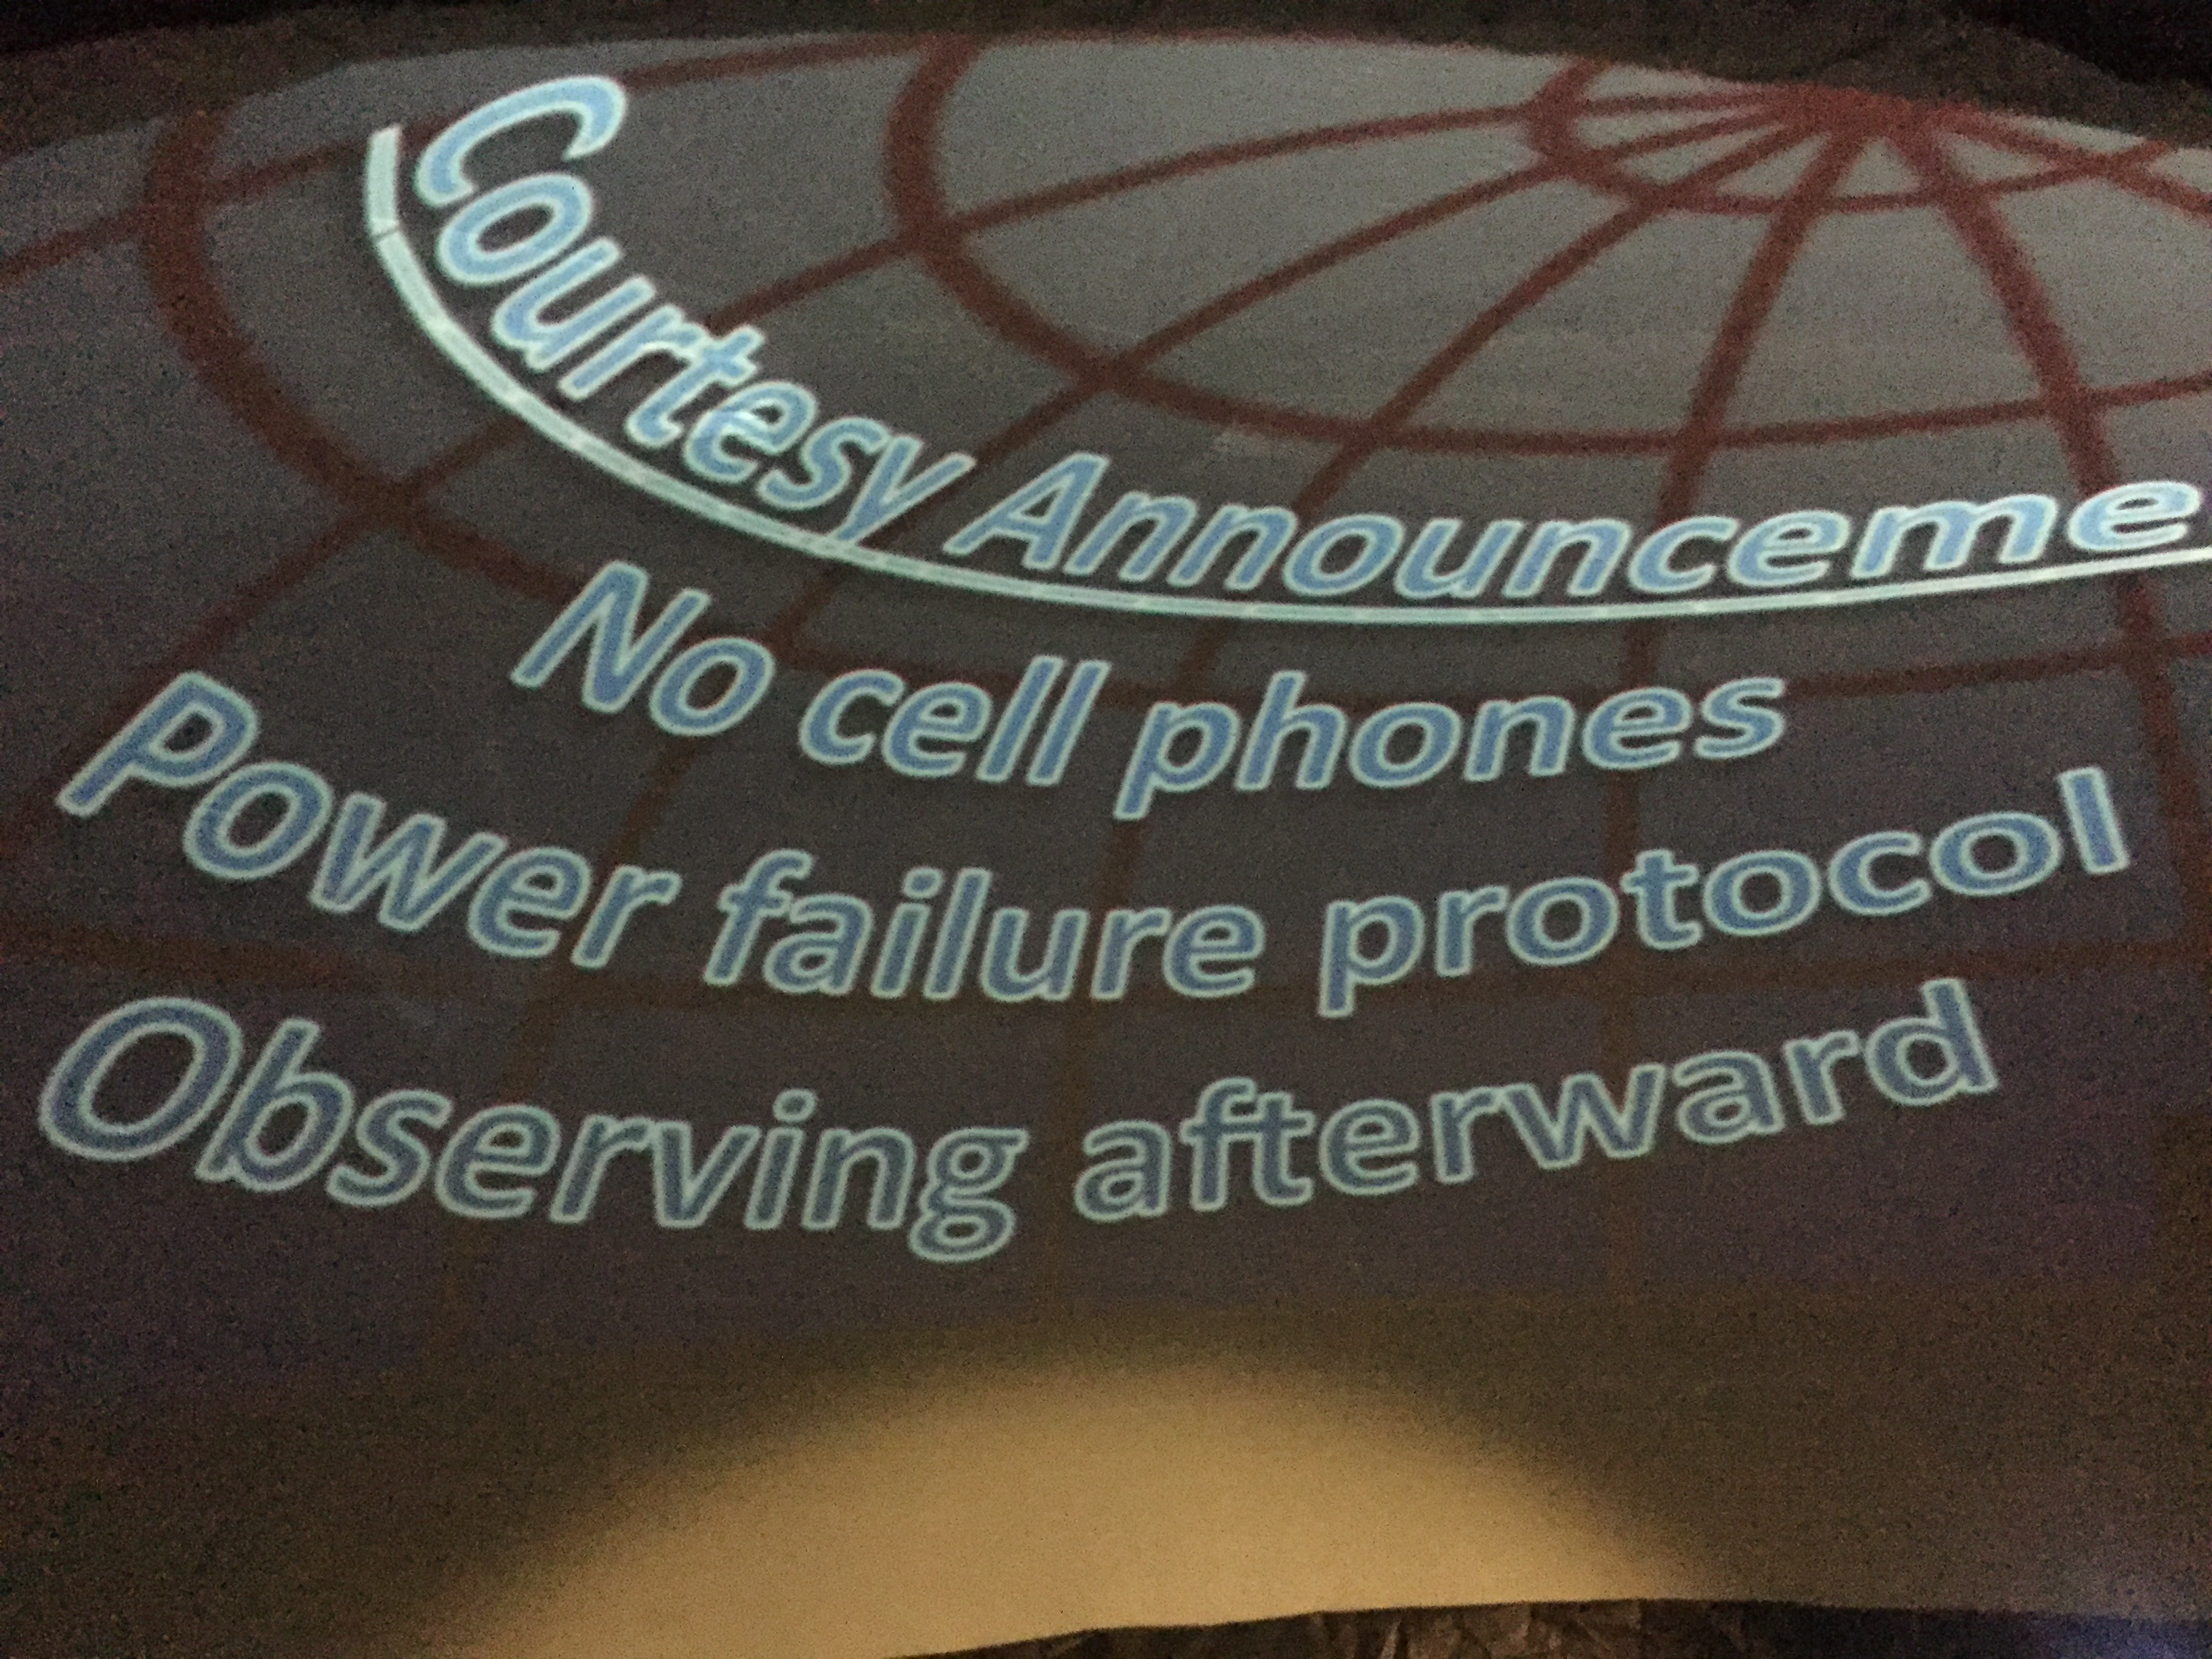
Examples projected content

Slide 21
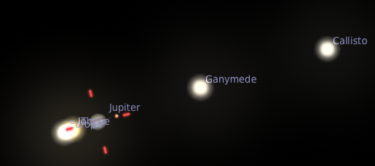
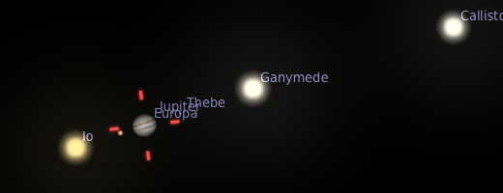
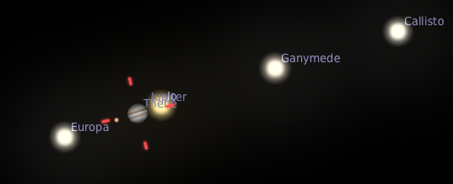
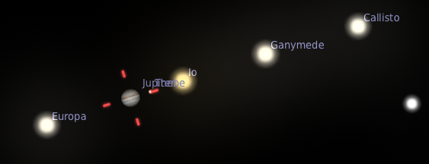
Orbits of Jupiter’s Moons
Collect angular separation vs. date
Plot graphs
Determine orbital period
Determine the mass of Jupiter using Newton’s version of Kepler’s Laws
Predict transits
Galileo tried to sell ephemerides of the moons to the Spanish crown as a military state secret…why?

Slide 22
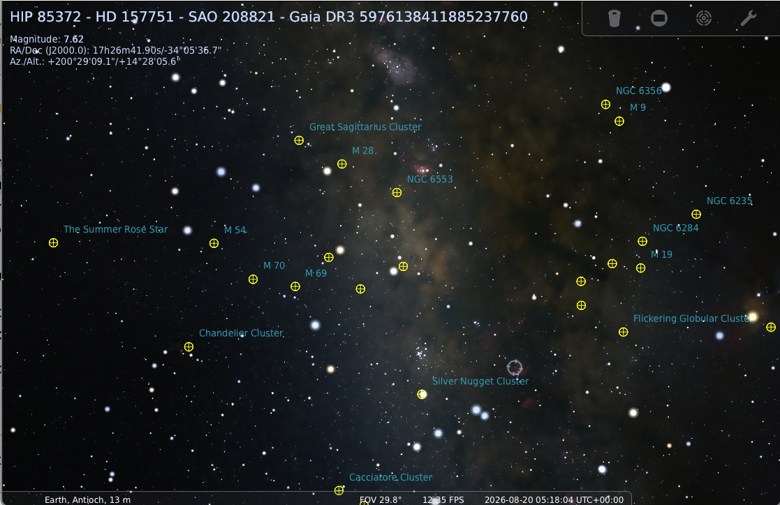
Plotting the Globulars
Interactive Demo
The globulars are roughly evenly distributed geometrically. But they appear to be concentrated in Saggitatrius.

Slide 23
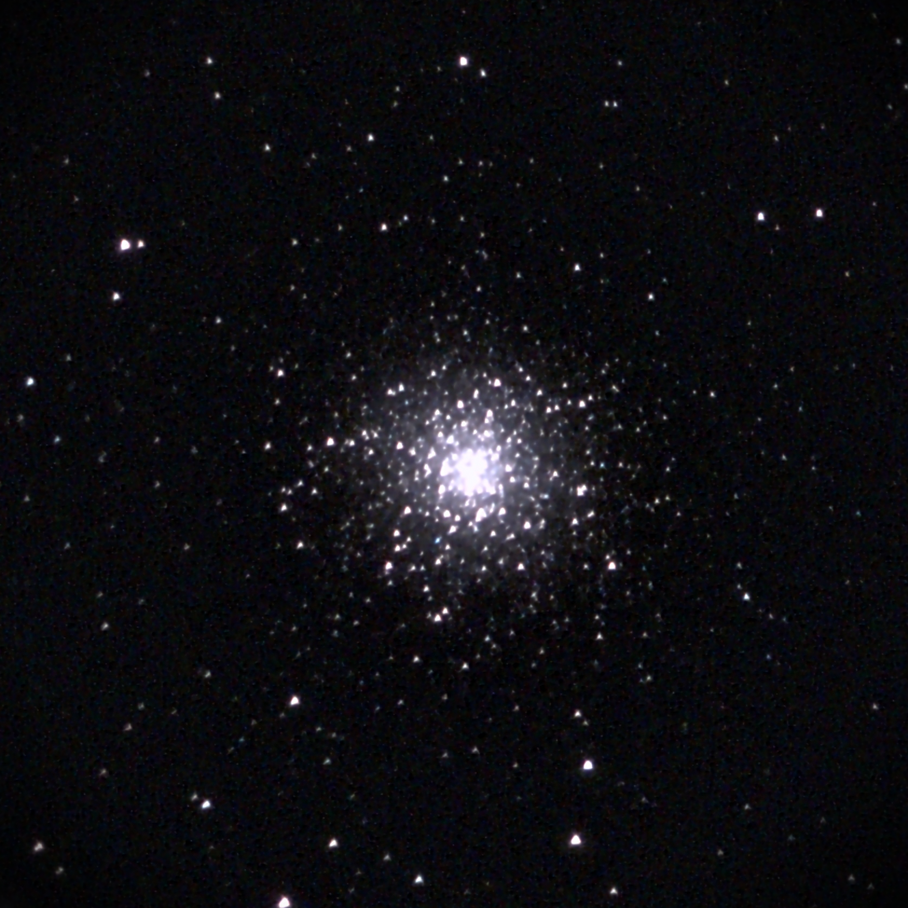
How do we know where we are?
How do we know we live in a galaxy?
Back to globular clusters...
Smaller than galaxies
100,000 stars

Slide 24

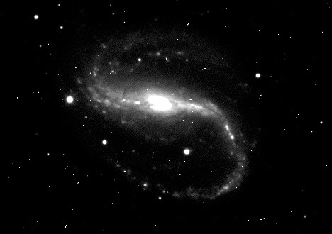
Globulars
Surrounding galaxies in a halo
Spherical distribution

Slide 25
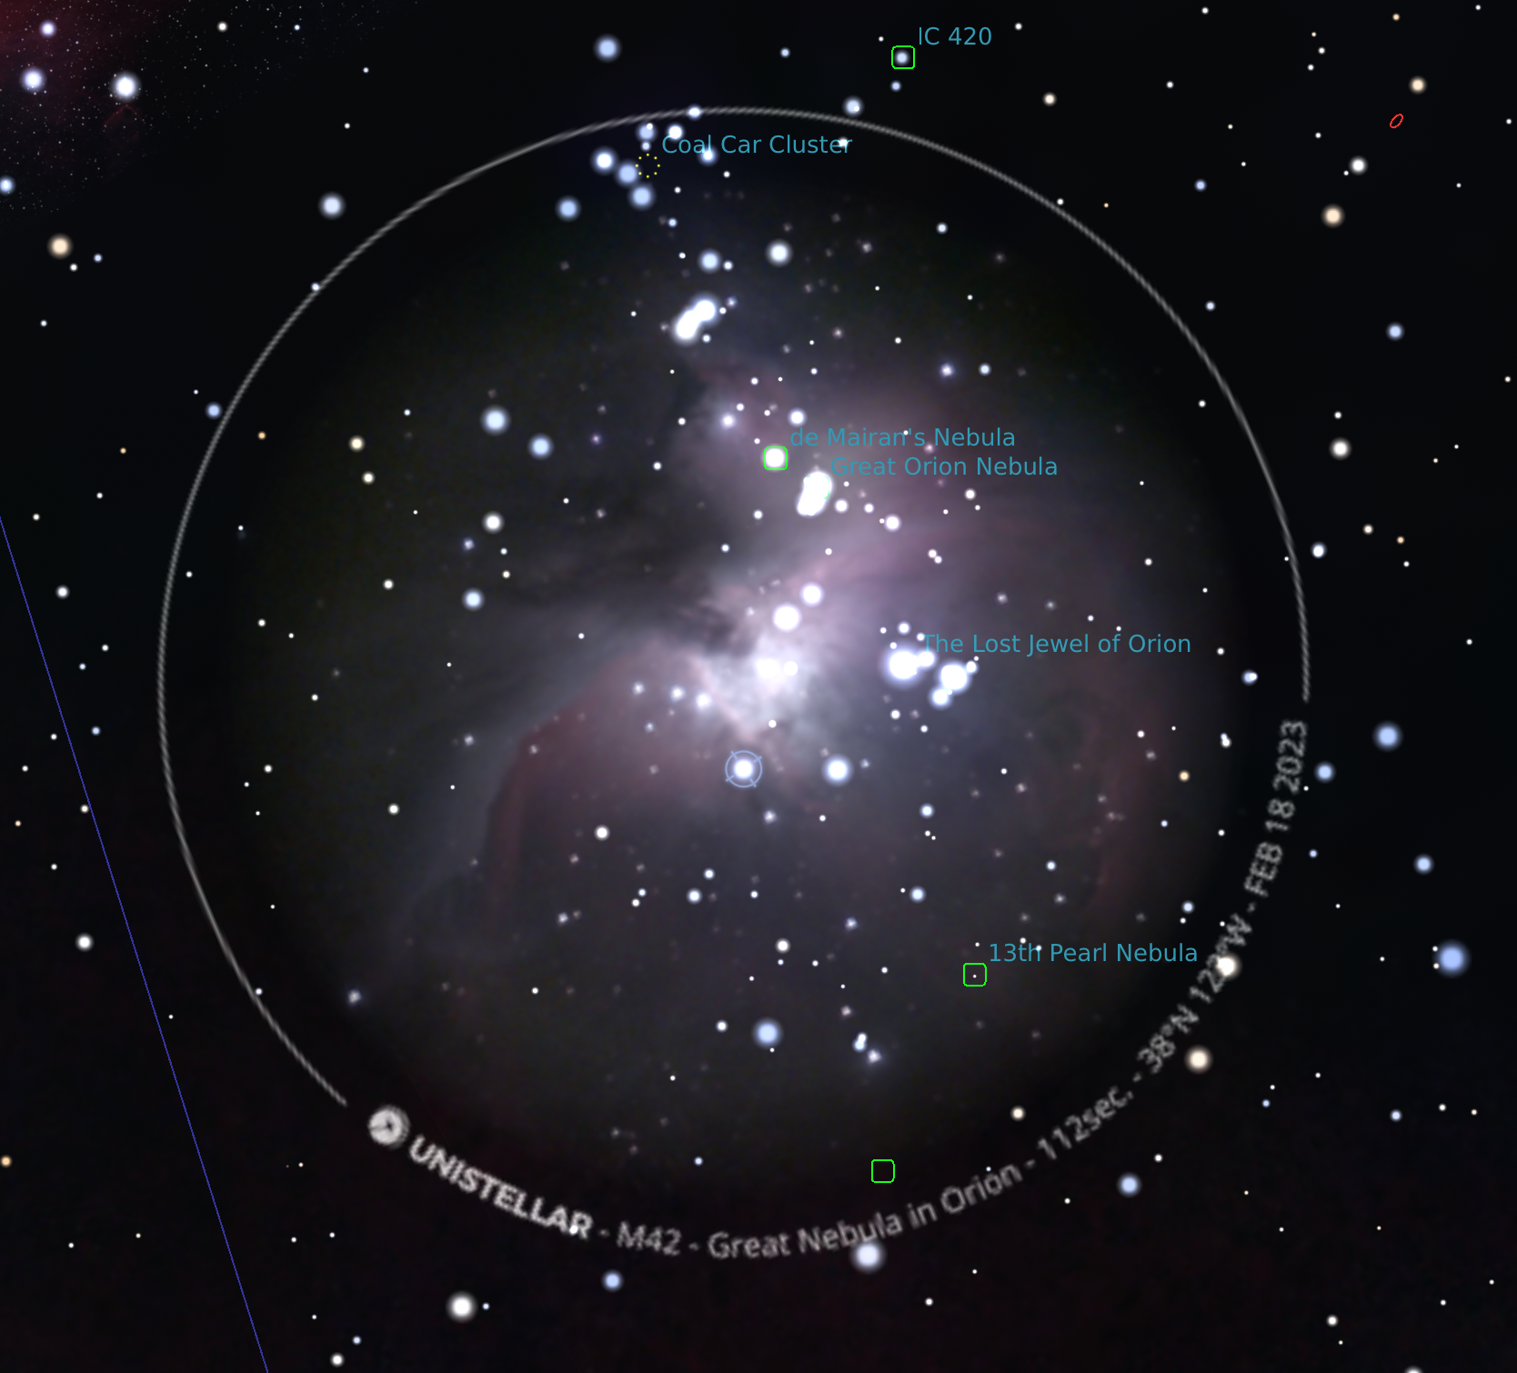
Add Your Own Photos
Project
The MDAS version of Stellarium
  https://youtu.be/WhC3GEwTgmQ
  Must be perfectly square (typically 512x512 pixels)
  Video gives complete examples including scripts, photoshop instructions, etc.
  Easier: just replace the file
Accepting submissions for an MDAS version to the following google sheet:
  https://tinyurl.com/3ec94byv
  Drive folder: https://tinyurl.com/am84x9wt

Slide 26
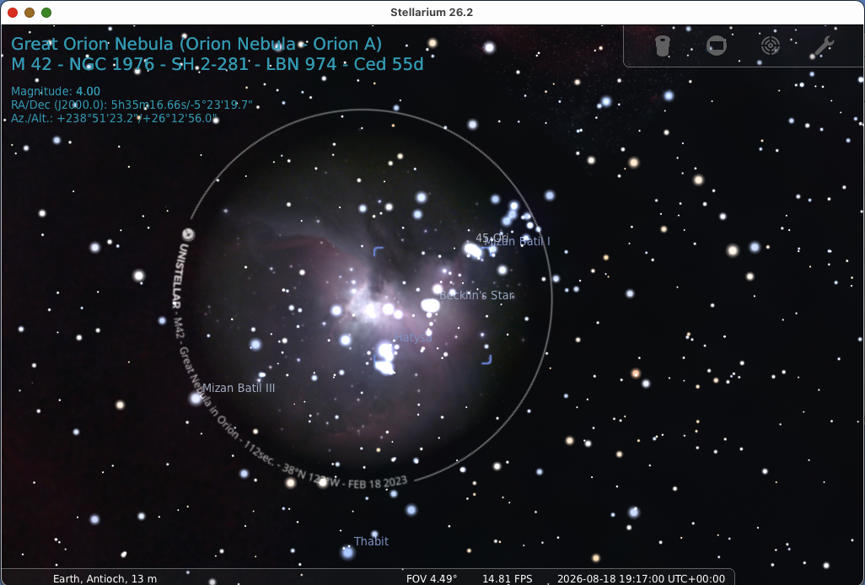
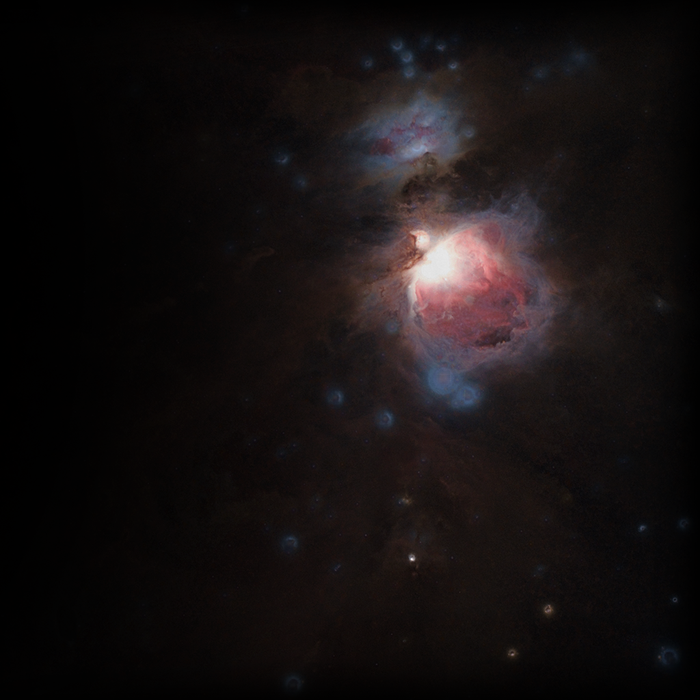
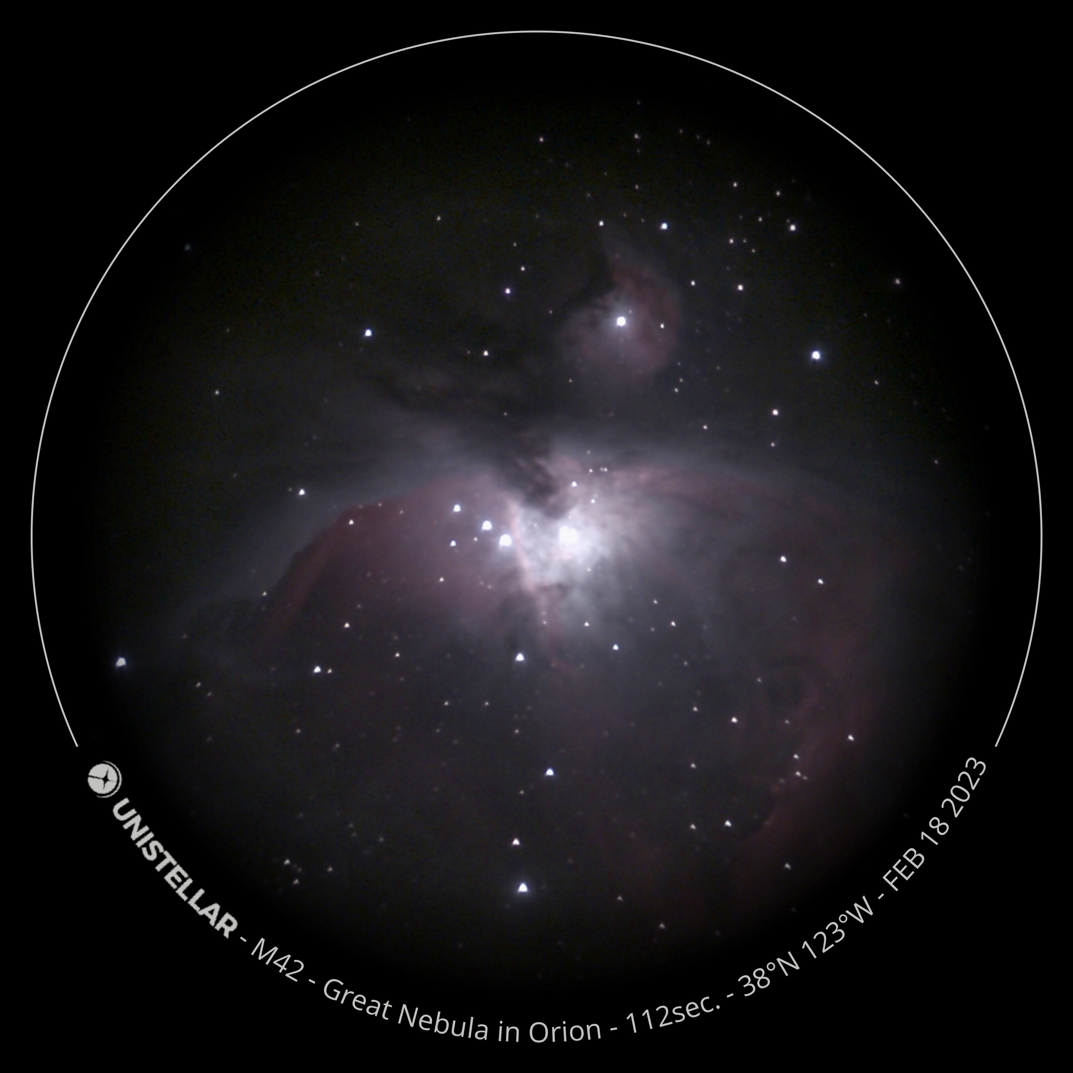
Example: M42
Original:
1024x1024 PNG
Replace original with my photo
1024x1024 PNG
My Photo:
2800x2800 JPG
1024x1024 PNG
Convert with Graphicconverter / Photoshop
1024x1024 PNG

