Slide 1
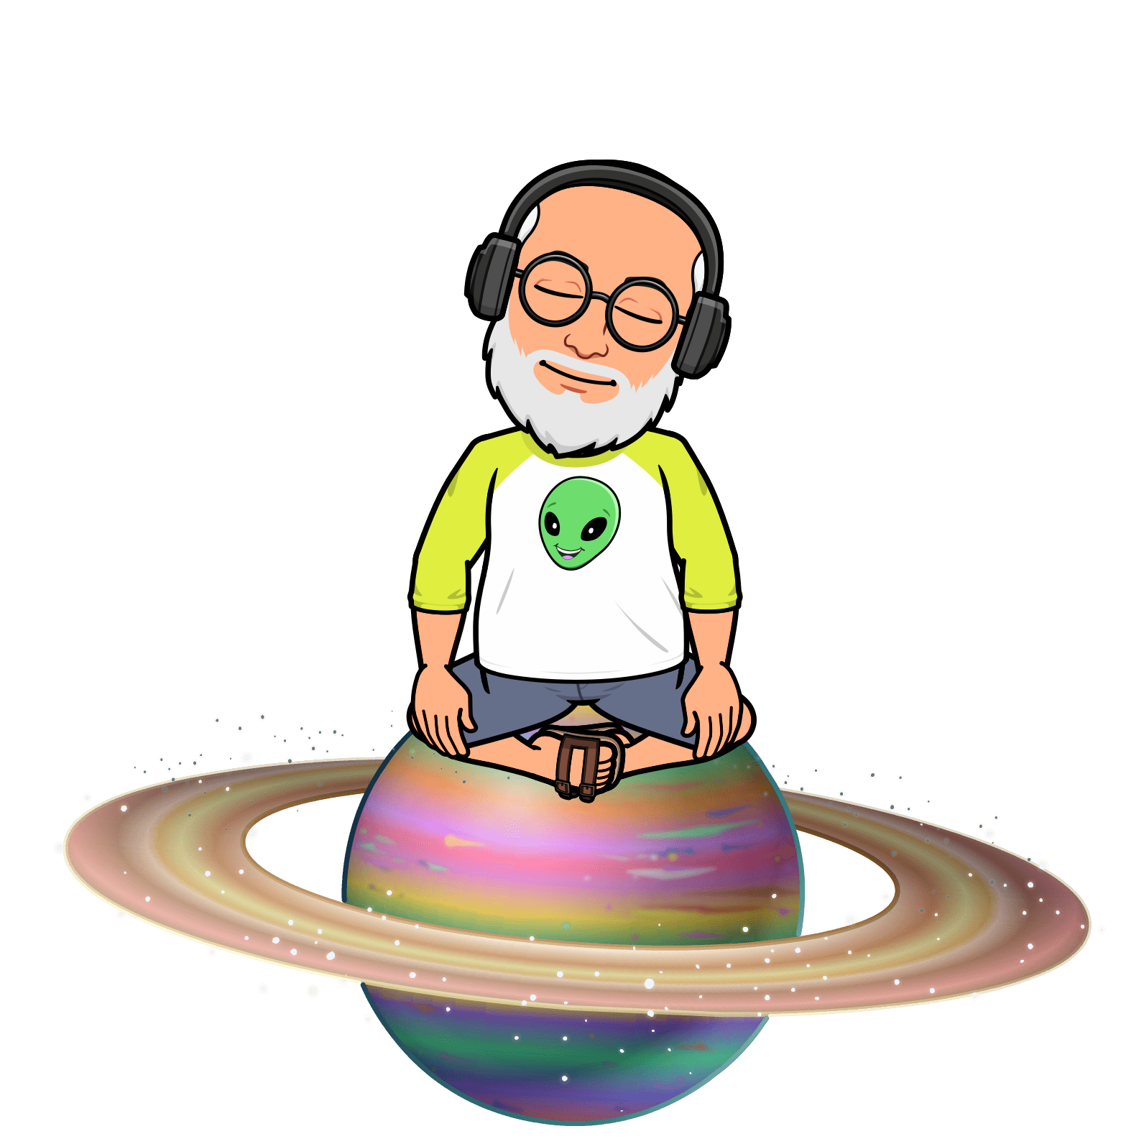
Introductory Astronomy Workshop
Sharing activities from
Jeffery “Space is My Middle Name” Adkins

Slide 2
Agenda
A complete agenda is at www.AstronomyTeacher.com
Introduction
Stellarium and other apps
Building a planetarium
Survey of resources
Galaxies and the Big Bang
Black Holes and Stellar Evolution
Potpourri (a bunch of activity ideas)
Door Prizes

Slide 3
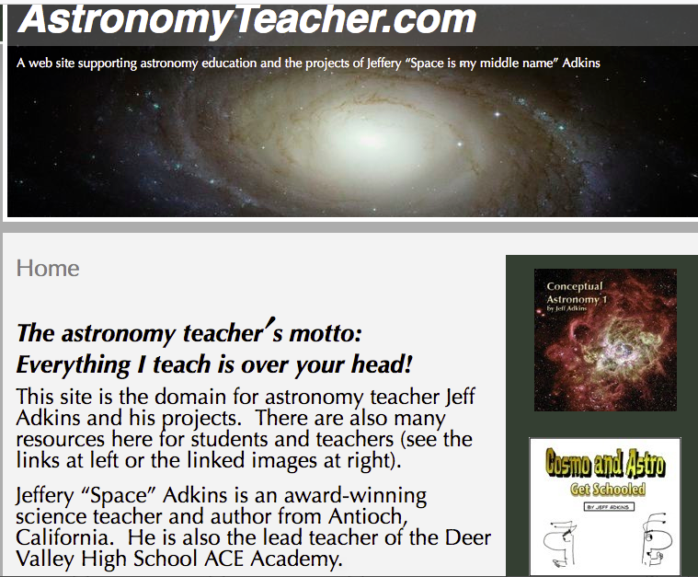
1. Introduction
About me
Jeffery “Space is my middle name” Adkins
Everything I teach is over your head
www.astronomyteacher.com
Conceptual Astronomy
Astronomy at Deer Valley HS in Antioch, CA
A-g compliant (counts as lab course)
Articulated (3 hr. Credit by Examination)
Dual-Enrollment (4 hr. Astro 10&11 with Los Medanos College in Pittsburg, CA)
jeff@astronomyteacher.com
About you
Survey results

Slide 4
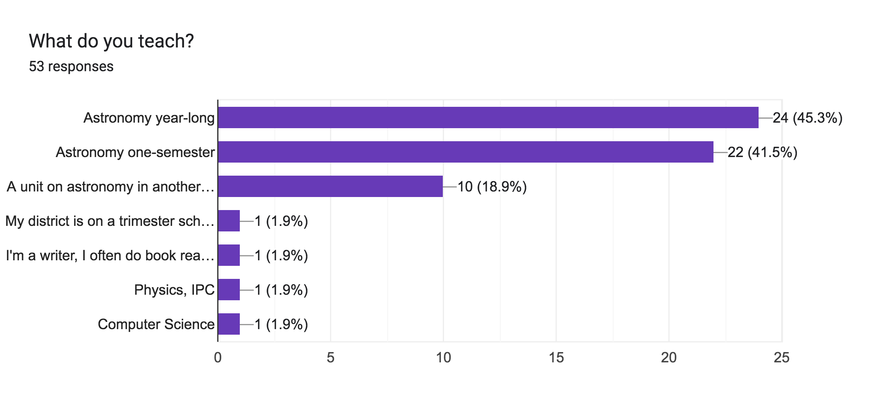
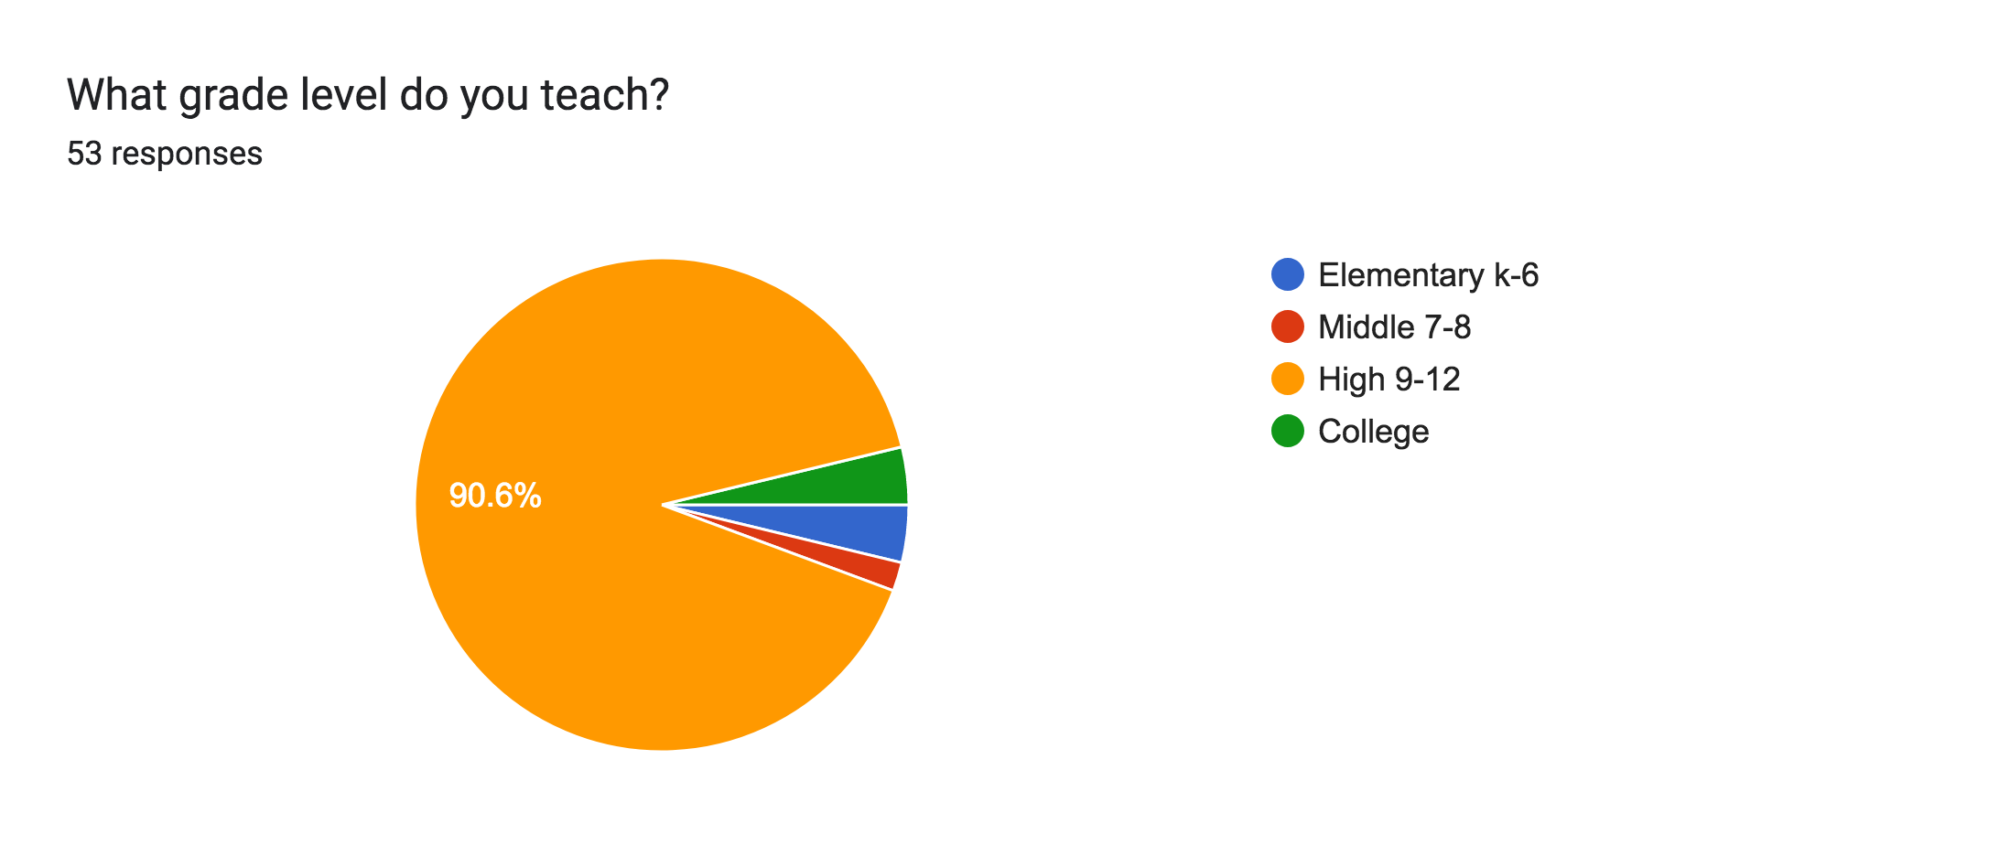

Slide 5
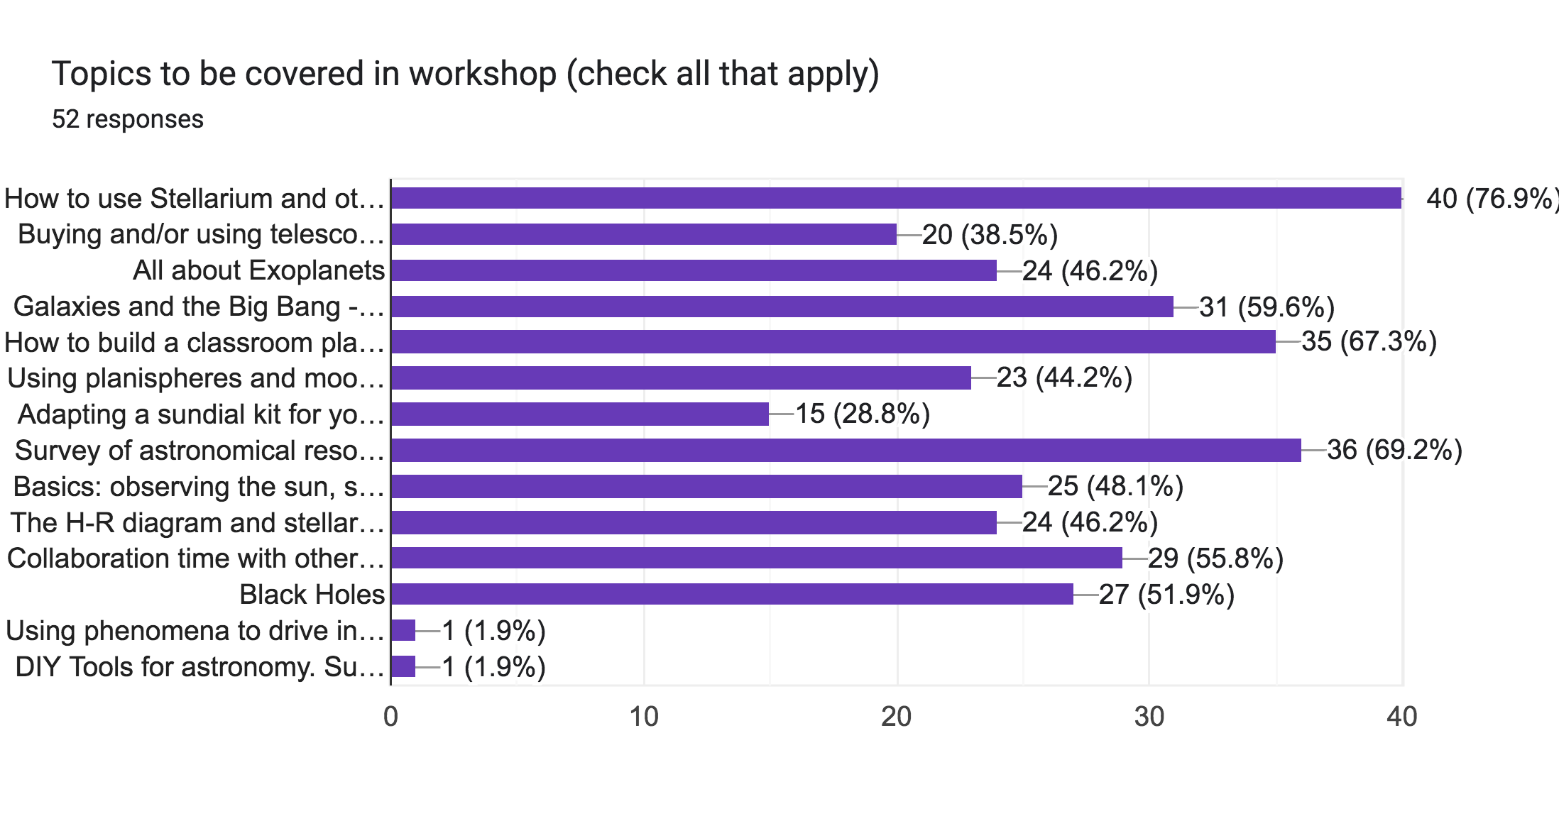

Slide 6
2. Stellarium
How to use Stellarium and other astronomy apps
***STELLARIUM www.stellarium.org. - for simulating the night sky, virtual experiments, observation planning and identification. Can be used to drive a digital planetarium.
***ACTIVITY (moderate) : INVESTIGATING AZIMUTH OF THE SUN FOR A YEAR (requires Stellarium)
ACTIVITY: PLOTTING THE ORBIT OF MARS USING SIMULATED OBSERVATIONS (advanced) also Powerpoint including directions.
CELESTIA https://celestia.space/ - for simulating the solar system from space
SKYVIEW LITE https://apps.apple.com/us/app/skyview-lite/id413936865 - for identification of stars and constellations while observing
ASTRO IMAGE J https://www.astro.louisville.edu/software/astroimagej/. - for manipulating digital images and measuring images with photometry and more
Anything you use regularly not on this list?

Slide 7
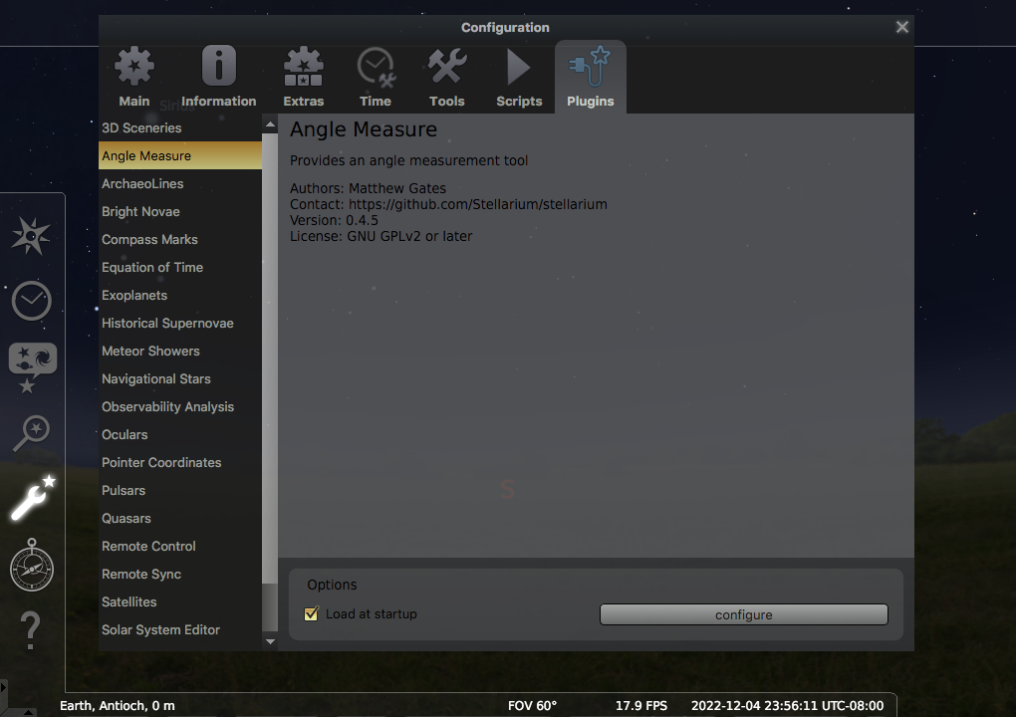
Activating the Angle Measurement Tool
Choose the wrench on the left menu
Pick Plugins
Choose Angle Measure
Choose Load at Startup
Restart Stellarium
Tip for Measuring Angles in Stellarium
Useful for:
Elongation angles of inferior planets- size of Venus’ orbit
Mars orbit lab
Mapping constellations

Slide 8
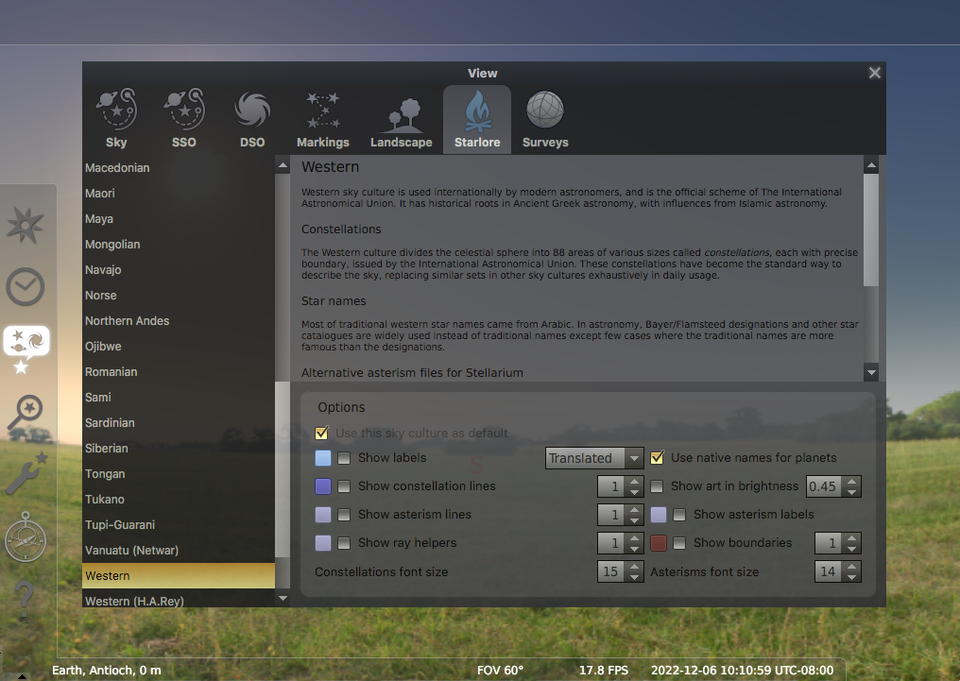
Integrating Other Cultures
Activating other Culture’s Constellations
Pick Sky Options
Pick Starlore
Change Culture

Slide 9
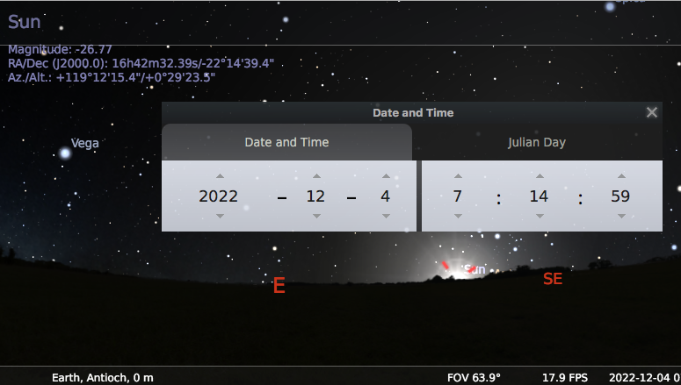
Azimuth of the Rising Sun for a Year
Using Stellarium for the Azimuth for a Year lab
Type “K” to stop the clock
Click on the sun (targeting reticle active)
Sun appears in HUD
Adjust time until Altitude is 0 degrees
Record Azimuth and date
Advance 2 weeks and repeat, for a year

Slide 10
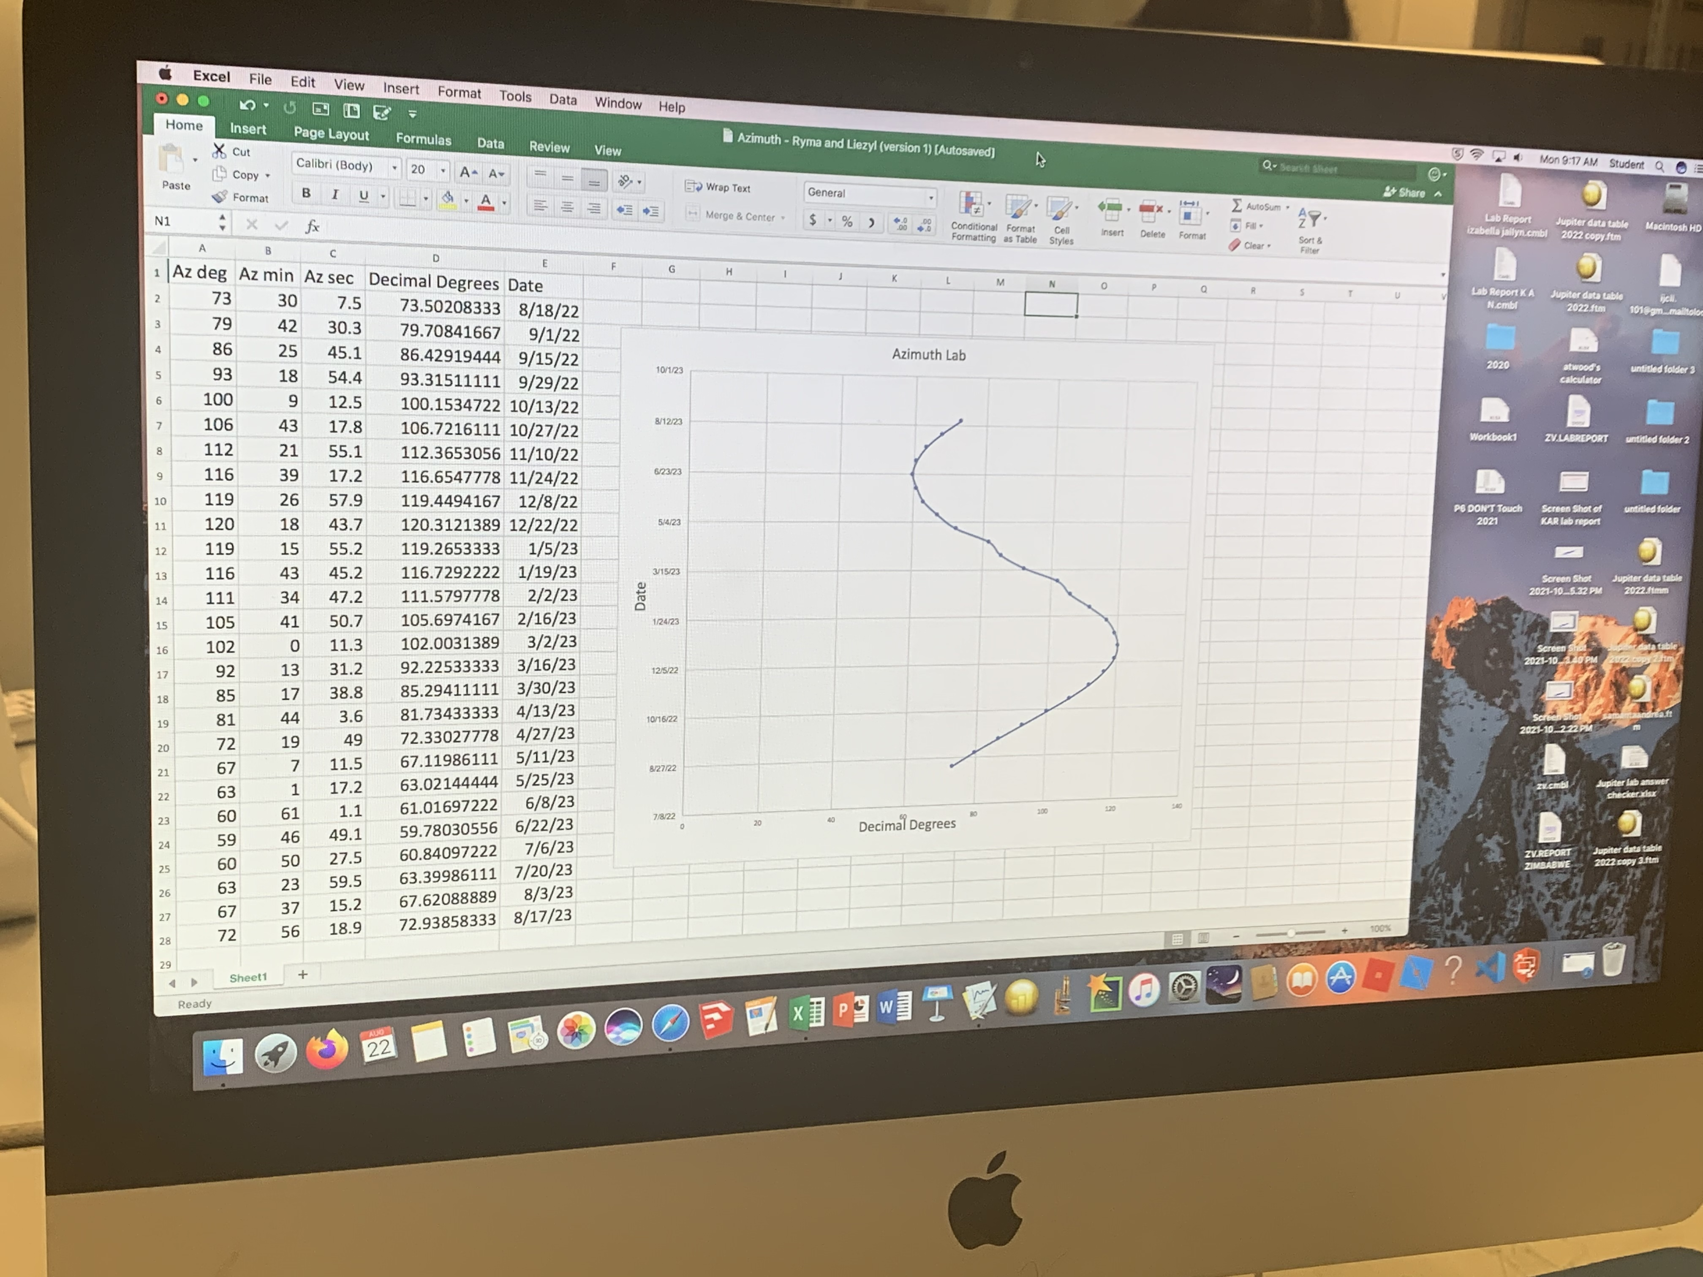
Northernmost
Sunrise
(Summer solstice)
Autumnal Equinox
Southernmost
Sunrise
(Winter solstice)
Vernal Equinox
Due East

Slide 11
3. Build a Planetarium
How to build a classroom planetarium
***ACTIVITY (easy): A QUICK AND EASY 1 FREQUENCY PLANETARIUM DOME (requires scissors, tape/stapler, something round to trace)
BUILD A 2F DOME (challenging): http://www.cccoe.net/stars
MAKE A PROJECTOR (advanced): http://paulbourke.net/dome/faq/
BUY A PROJECTOR Projectors: https://amzn.to/3tpkwy5
SO NOW YOU HAVE A PLANETARIUM…What do you do with it?
Azimuth lab (like with Stellarium)
Seasonal changes
Design a stonehenge
Scale model solar system
Latitude effects on the sky (North Pole, Equator, etc.)
Basic navigation (altitude of north star = latitude
Altitude lab
Maximum elongation of Venus
Plot the orbit of Mars (like with Stellarium)
Planet mysteries
Planetarium activities for Student Success (PASS)

Slide 12
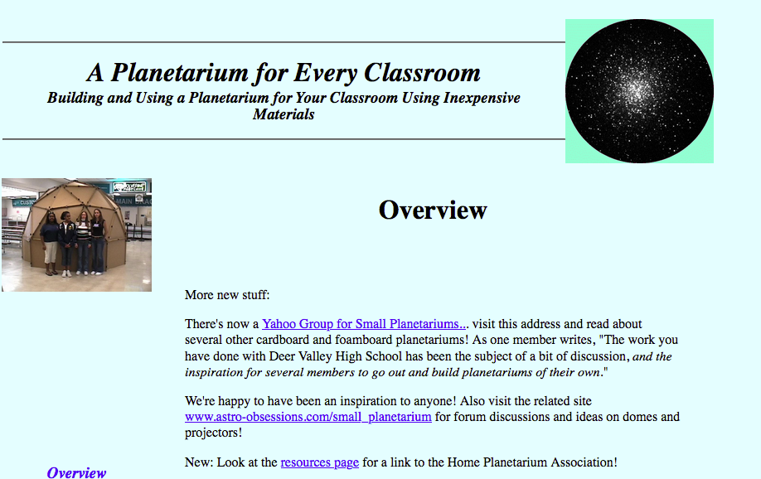

Slide 13
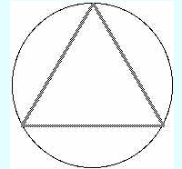
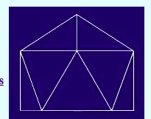
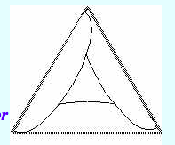
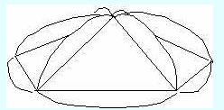
1. Cut out 15 circles the same size.
2. Fold each into equilateral triangles.
6. Put the cap on the ring and you’re done!
3. Connect 5 together via the flaps leaving the 6th space empty.
4. Close the gap and make a cap.
5. Connect 10 in a row alternating up and down. Connect ends to make a ring.

Slide 14
https://www.cccoe.net/stars/printsmalldome.html

Slide 15
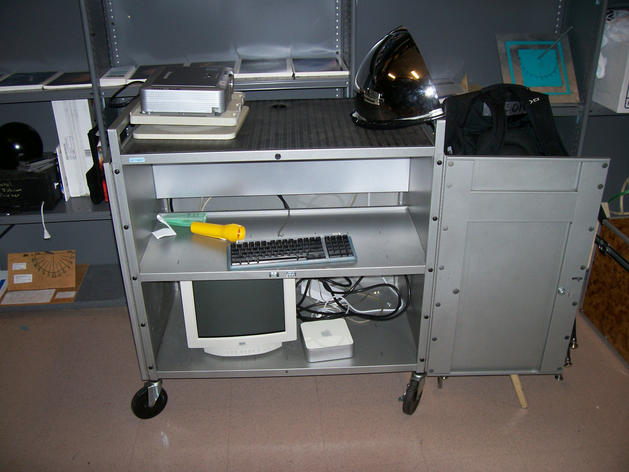

Slide 16
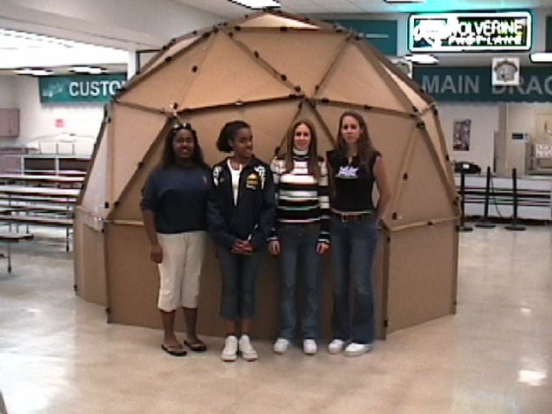
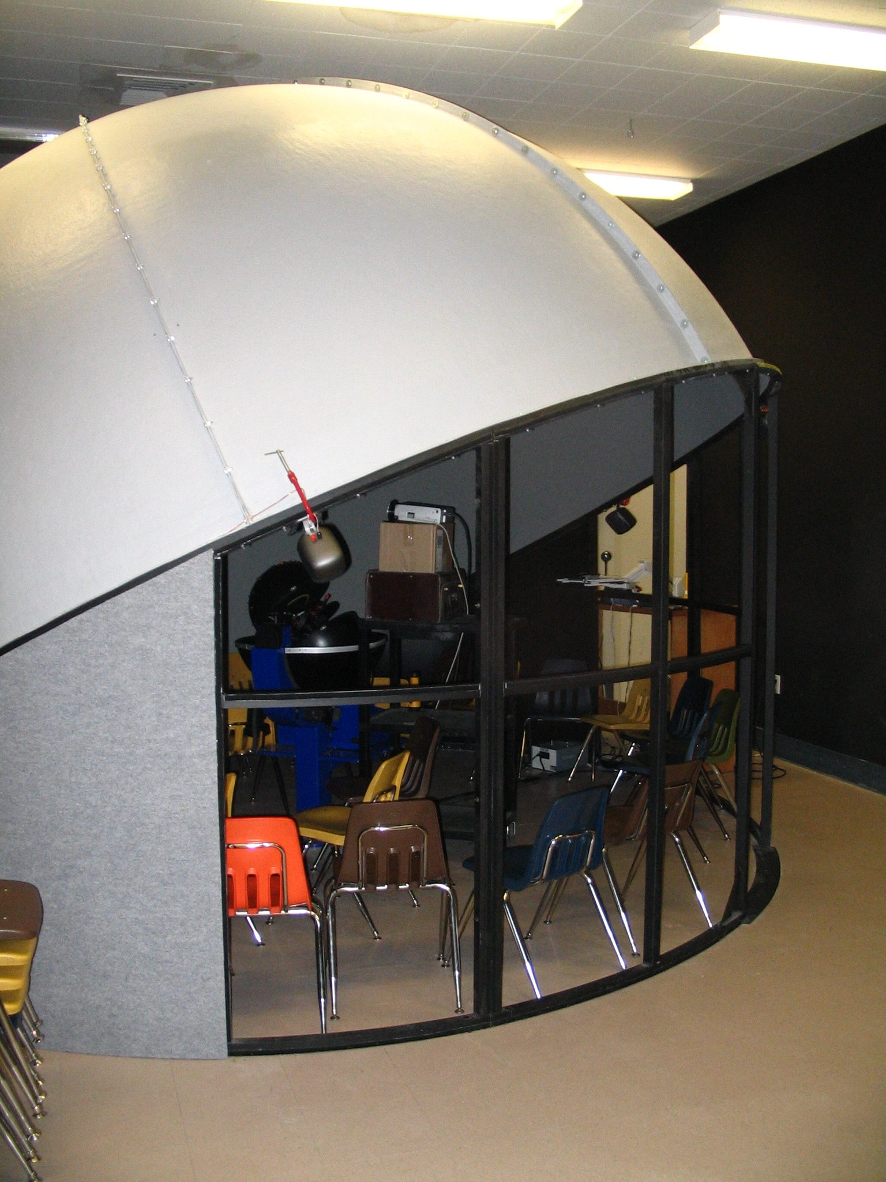
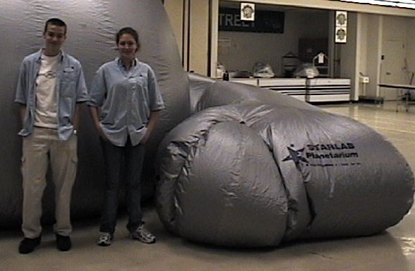
5 m cardboard dome
5 m custom fiberglass dome
Starlab inflatable

Slide 17
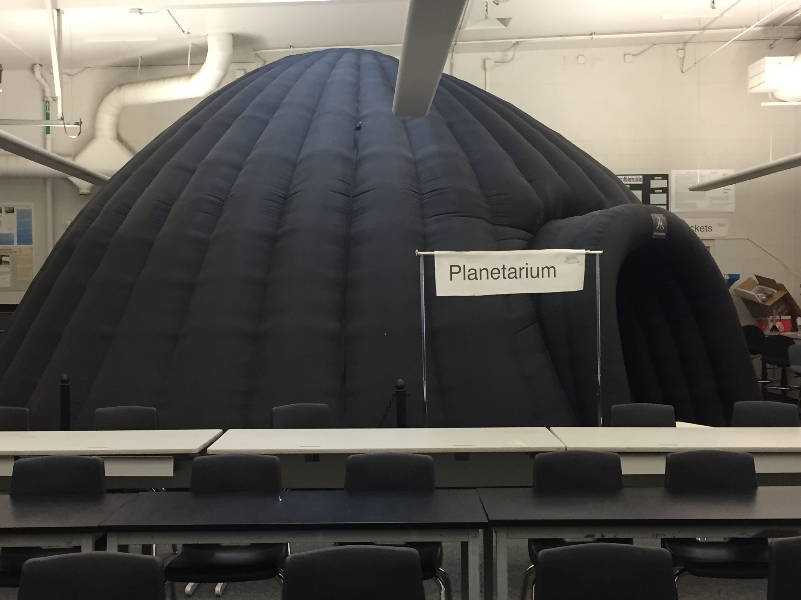
Double-walled negative pressure 7 meter dome

Slide 18
4. Survey of resources
All links are on the AstronomyTeacher.com Resource page.
JPL’s Hands On Astronomy Project page
NOIRlab Education page
The Astronomy Education Newsletter from The Classroom Astronomer site
The Universe in the Classroom DVD-ROM archive
Vera C. Rubin Educator site
https://businesscostsaver.co.uk/astronomy-guide/
CAPER - Center for Astronomy and Physics Education Research
http://www.caperteam.com
Night Sky Network
https://nightsky.jpl.nasa.gov/index.cfm
Astronomical Society of the Pacific
http://www.astrosociety.org/education/resources/naep.html#1
American Astronomical Society
http://www.aas.org
Astronomy Education Review
http://aer.aas.org
Association for Astronomy Education
http://www.astroed.org/
SETI Institute
http://www.seti.org
McDonald Observatory Teacher Workshops
http://mcdonaldobservatory.org/teachers/profdev/
The Planetary Society
www.planetary.org
Research Experience for Teachers (RET)
Hands On Universe (HOU)
http://hou.lbl.gov
Teacher Leaders in Research Based Science Education ARBSE
http://www.noao.edu/outreach/arbse/
Science Buddies

Slide 19
5. Galaxies and the Big Bang
***ACTIVITY (advanced) - MEASURING THE AGE OF THE UNIVERSE
Spreadsheet for doing final calculation
Galaxy Zoo online activity (easy): https://www.zooniverse.org/projects/zookeeper/galaxy-zoo/classify

Slide 20
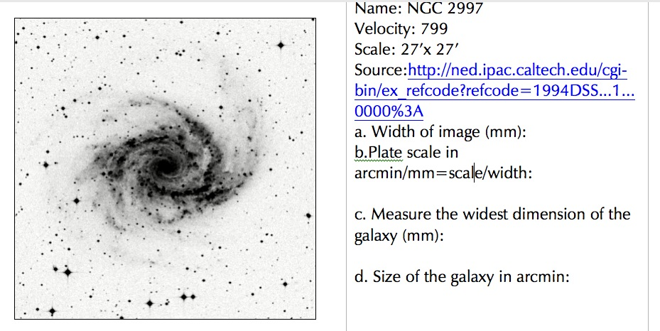
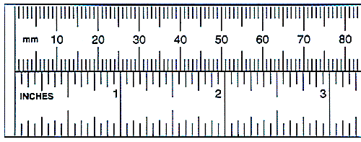
a. CA2 4.8
measure the FRAME in mm
a. (mm)

Slide 21
b. Plate Scale
b. Scale divided by a.
Text

Slide 22
c. Width of galaxy along widest dimension (mm)
Text
c. mm

Slide 23
Size of Galaxy in arcmin
Text
d= CxB

Slide 24
Summary
b. Scale divided by a.
Text
c. mm
a. (mm)
d= CxB

Slide 25
Convert an Angle into a Distance
d
100,000 ly
30,000 ly
angular size
Typical galaxy
It’s kind of like
parallax

Slide 26
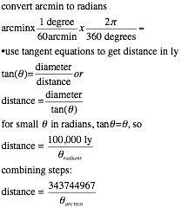
Converting
arcminutes to distance

Slide 27
Convert Mpc to km
Recall t = 1/slope from the car example.

Slide 28
Age of the Universe from Slope
Slope of v vs. d graph ((km/s)/Mpc) | Age of Universe (years)
10 | 97,800,000,000
15 | 65,200,000,000
20 | 48,900,000,000
30 | 32,600,000,000
40 | 24,450,000,000
50 | 19,560,000,000
60 | 16,300,000,000
70 | 13,971,000,000
80 | 12,225,000,000
90 | 10,867,000,000
100 | 9,780,000,000
110 | 8,891,000,000
120 | 8,150,000,000
130 | 7,523,000,000
Previously worked out values
Our specific value

Slide 29
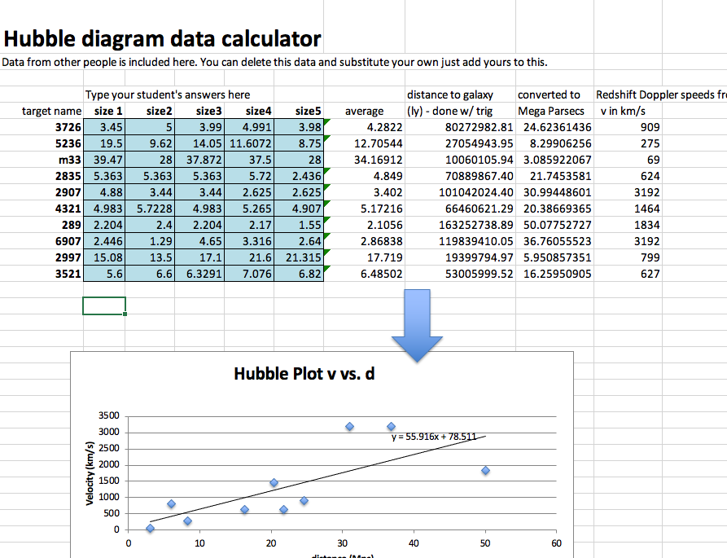

Slide 30
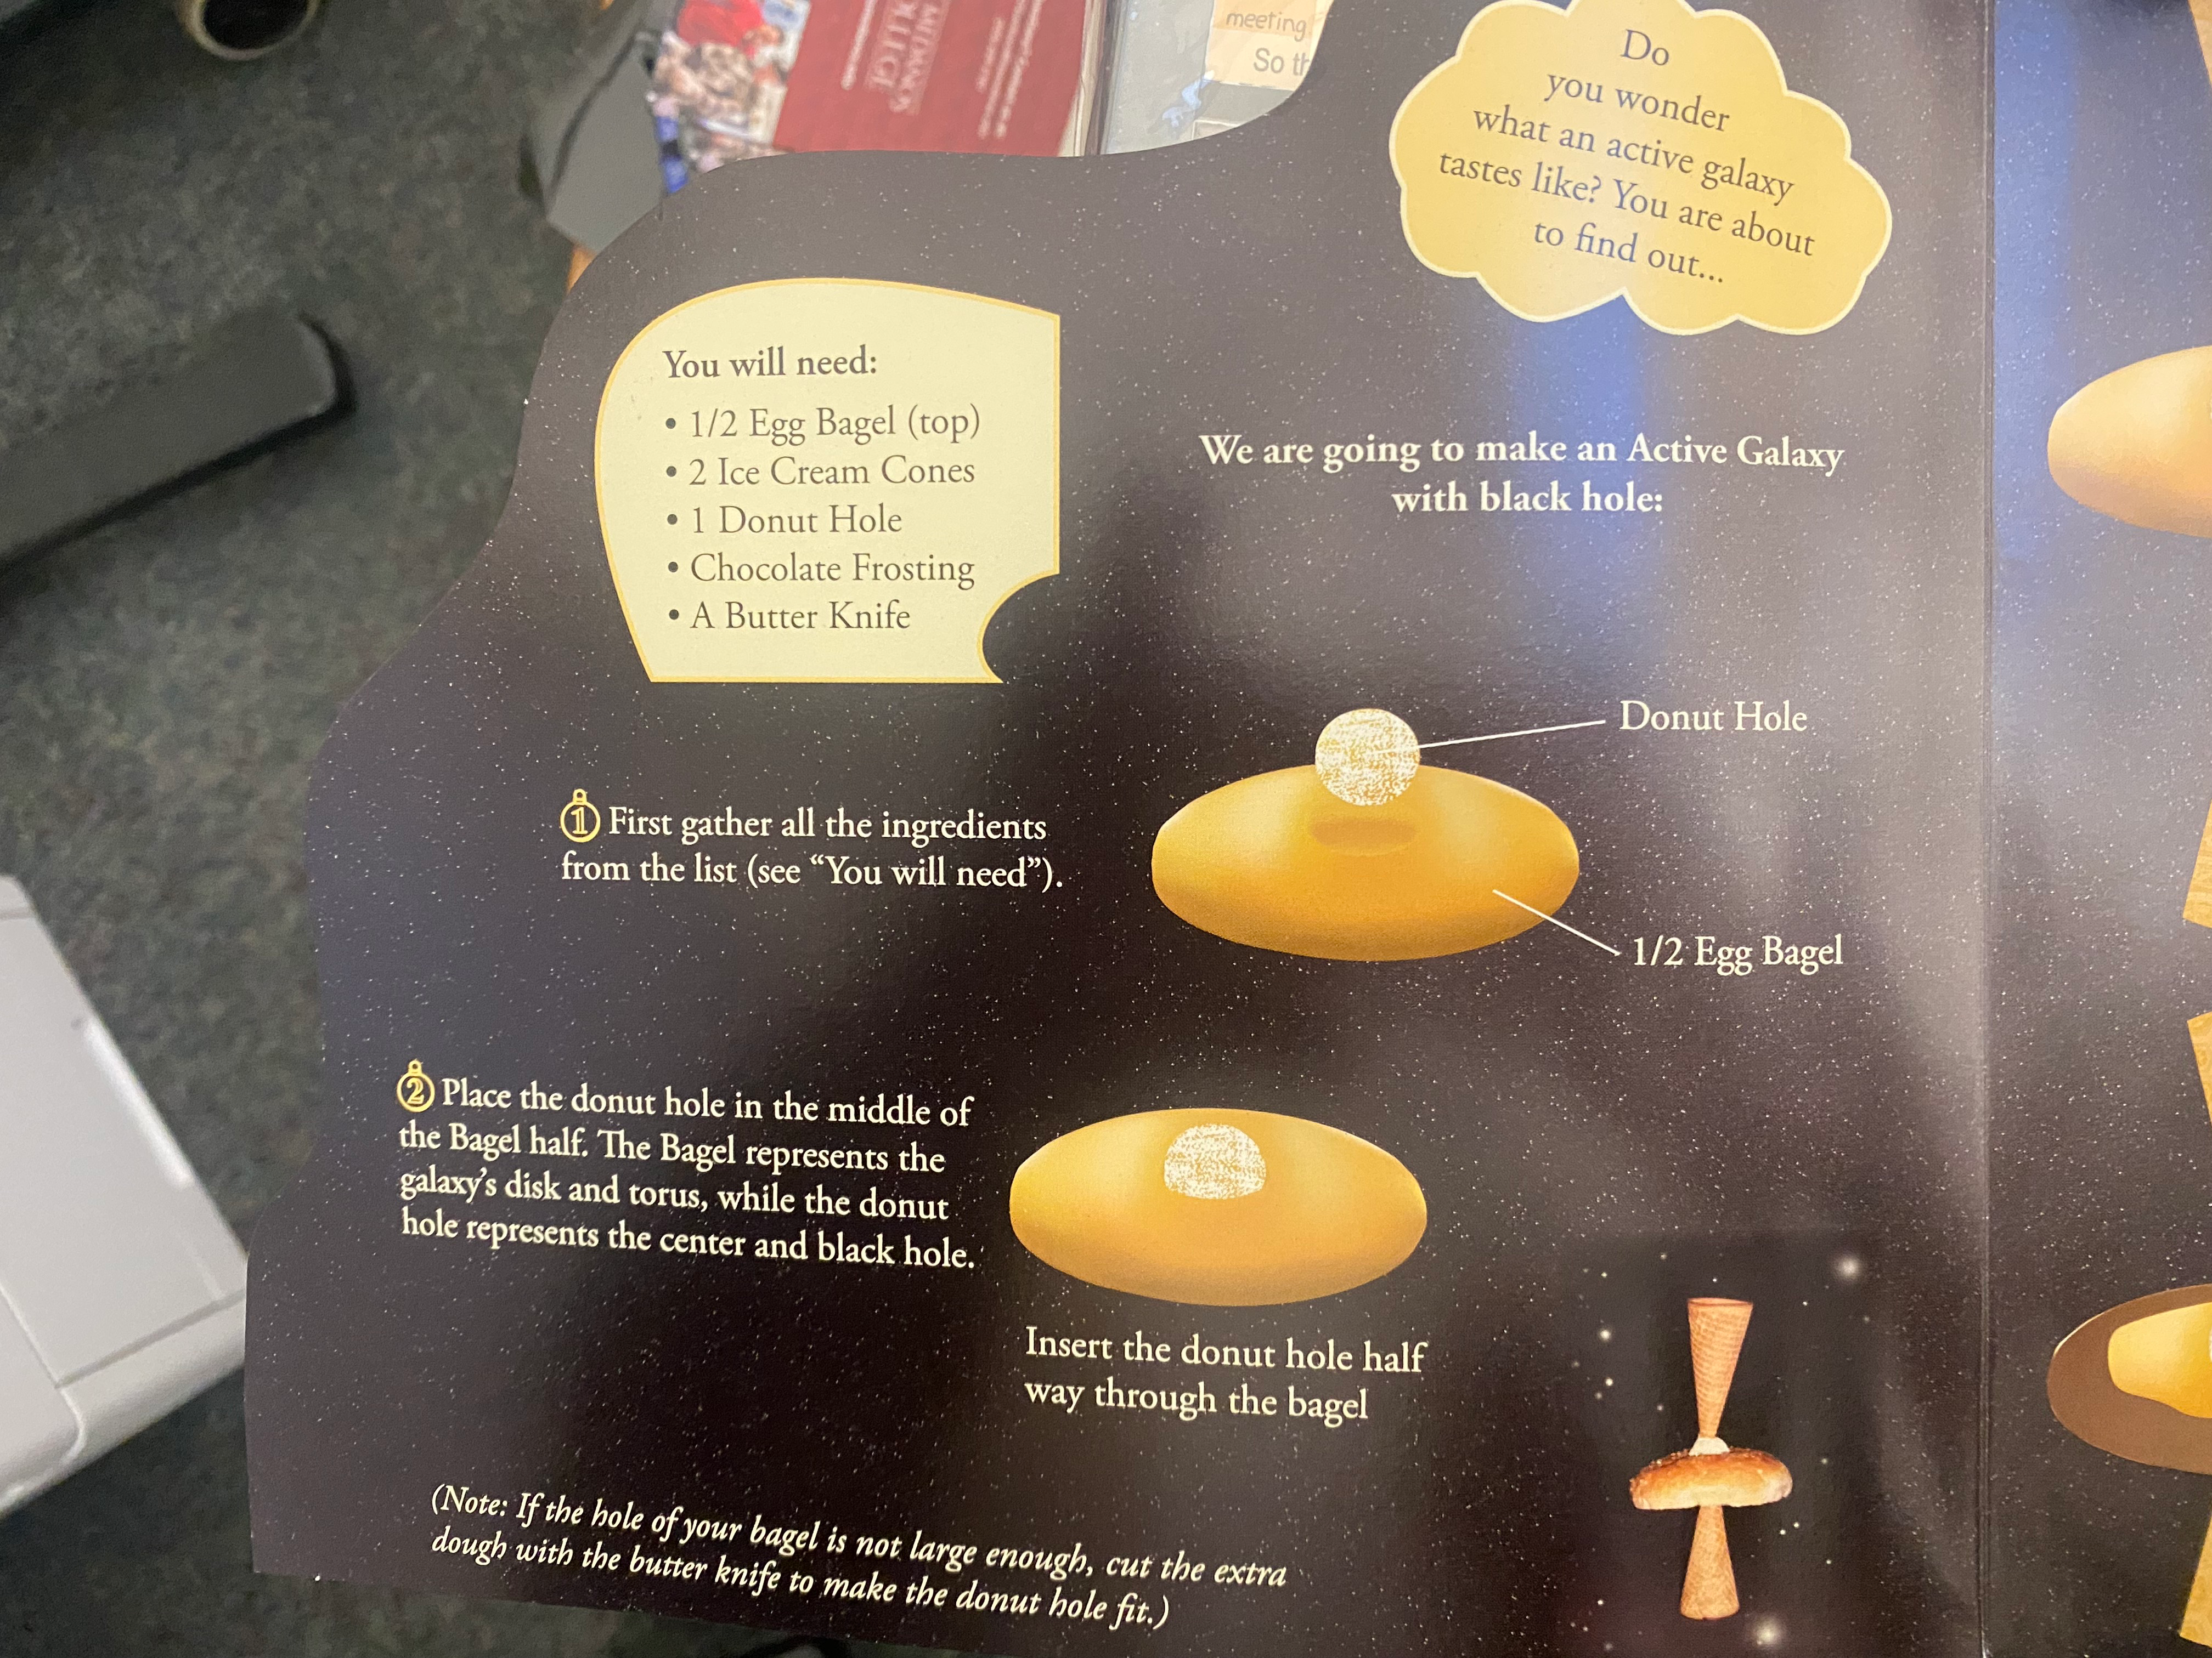
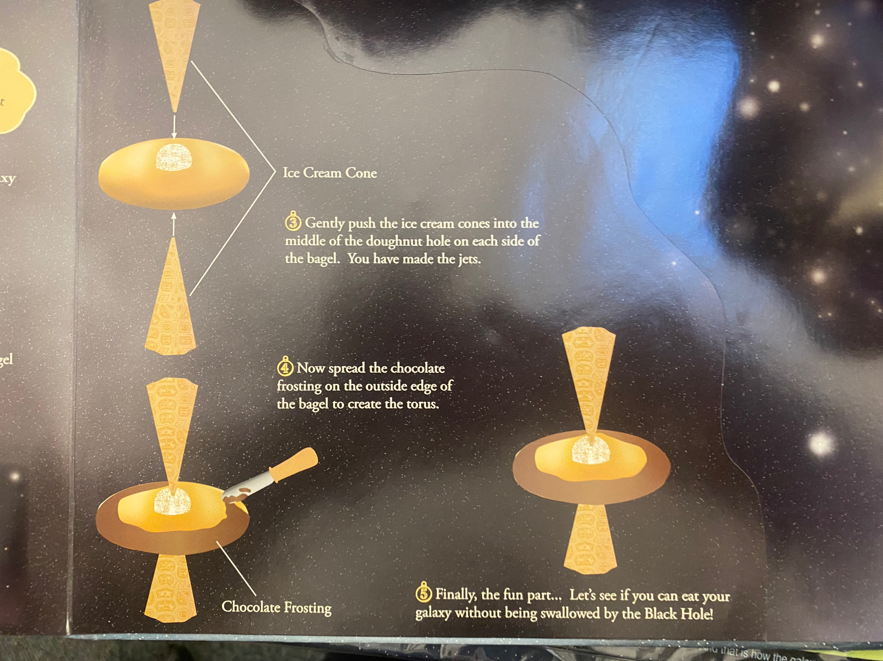
6. Stellar Evolution and Black Holes
HR diagrams
***ACTIVITY (easy) : JEWEL BOX CLUSTER (print out on a color printer)
Jewel box cluster powerpoint for those who don’t have color printers
ACTIVITY (Easy) : MAKING A TASTY AGN

Slide 31
H-R diagrams
Hertzprung-Russell Diagram
Like a periodic table for Chemistry
x axis is Spectral Class, Color or Temp
y axis is magnitude, luminosity, or brightness

Slide 32
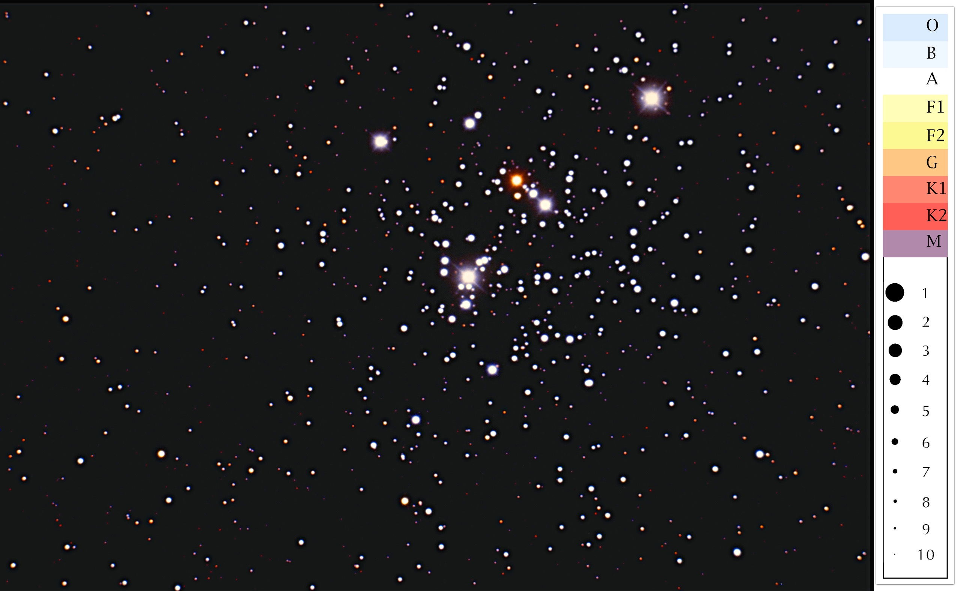
The Jewel Box Cluster
Class participation activity
CA2 3.1 P. 156

Slide 33
Spectral class K2
Magnitude 3

Slide 34
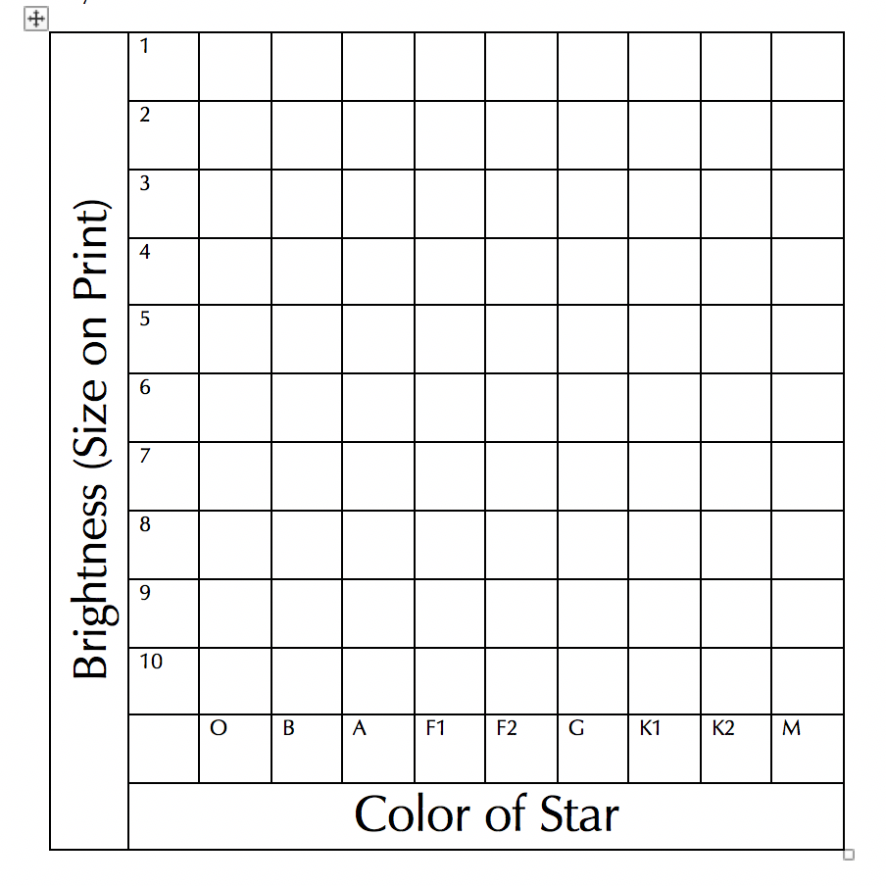

Slide 35
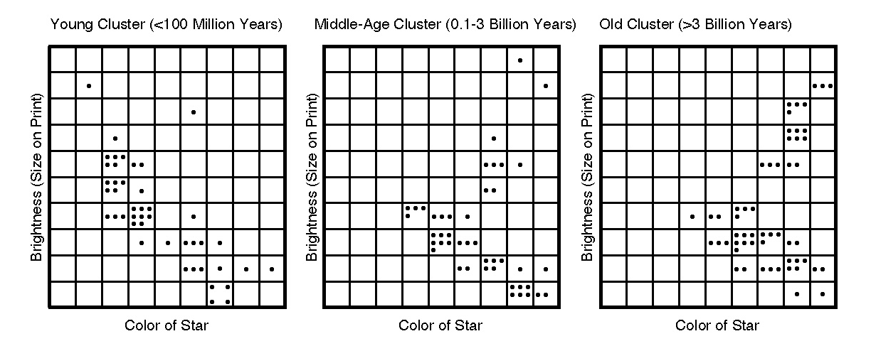
Ages of Clusters
If there are any blue, bright stars, it must be a young cluster

Slide 36
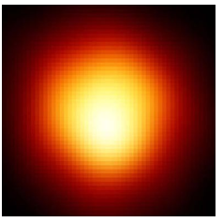
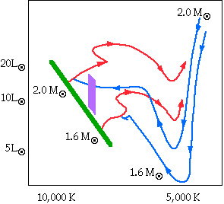
Stellar Evolution
Stars move around on the H-R diagram as they age
http://www.tim-thompson.com/hr.html#fig2

Slide 37
7. A bunch of activities
Sundial kit
ACTIVITY (moderate) : SUNDIAL KIT
Exoplanets
ACTIVITY (moderate) : EXOPLANET GRAPH
Exoplanet simulation with sensors. Vernier light sensor link. Computer Interface needed as well.
How to observe the solar eclipses in 2023 and 2024
ACTIVITY (moderate): Ellipse Lab
ACTIVITY (moderate): Moon Phase Diagram with labels and a Powerpoint and Keynote
ACTIVITY (advanced): Astrolabes
ACTIVITY (easy): Uncle Al’s Planisphere

Slide 38
Door Prizes Workshop 1
1 printed copy of the Student Book for Volume 1 and 2.
Winner
2 copies of the Student e-Book for each volume.
Winner 1
Winner 2
For the grand prize, 1 copy of the Teacher Manual e-Book for the volume of choice picked by the seminar attendee.
Winner
One NASA pop-up book on Active Galactic Nuclei
Winner

Slide 39
Door Prizes Workshop 2
1 printed copy of the Student Book for Volume 1 and 2.
Winner
2 copies of the Student e-Book for each volume.
Winner 1
Winner 2
For the grand prize, 1 copy of the Teacher Manual e-Book for the volume of choice picked by the seminar attendee.
Winner
One NASA pop-up book on Active Galactic Nuclei
Winner

Slide 40
The End
Stay in touch via FB?
Contact me directly if I can help
More workshops? Brainstorm topics
Door Prizes provided by TeachingPoint
New edition of Conceptual Astronomy coming soon (adding a short 1 volume 1 semester version).

