Slide 1
H-R diagrams
Hertzprung-Russell Diagram
Like a periodic table for Chemistry
x axis is Spectral Class, Color or Temp
y axis is magnitude, luminosity, or brightness

Slide 2
HR Diagram basics
Bright
Brightness
Dim
O B A F G K M
Hot
Cold
Temperature

Slide 3
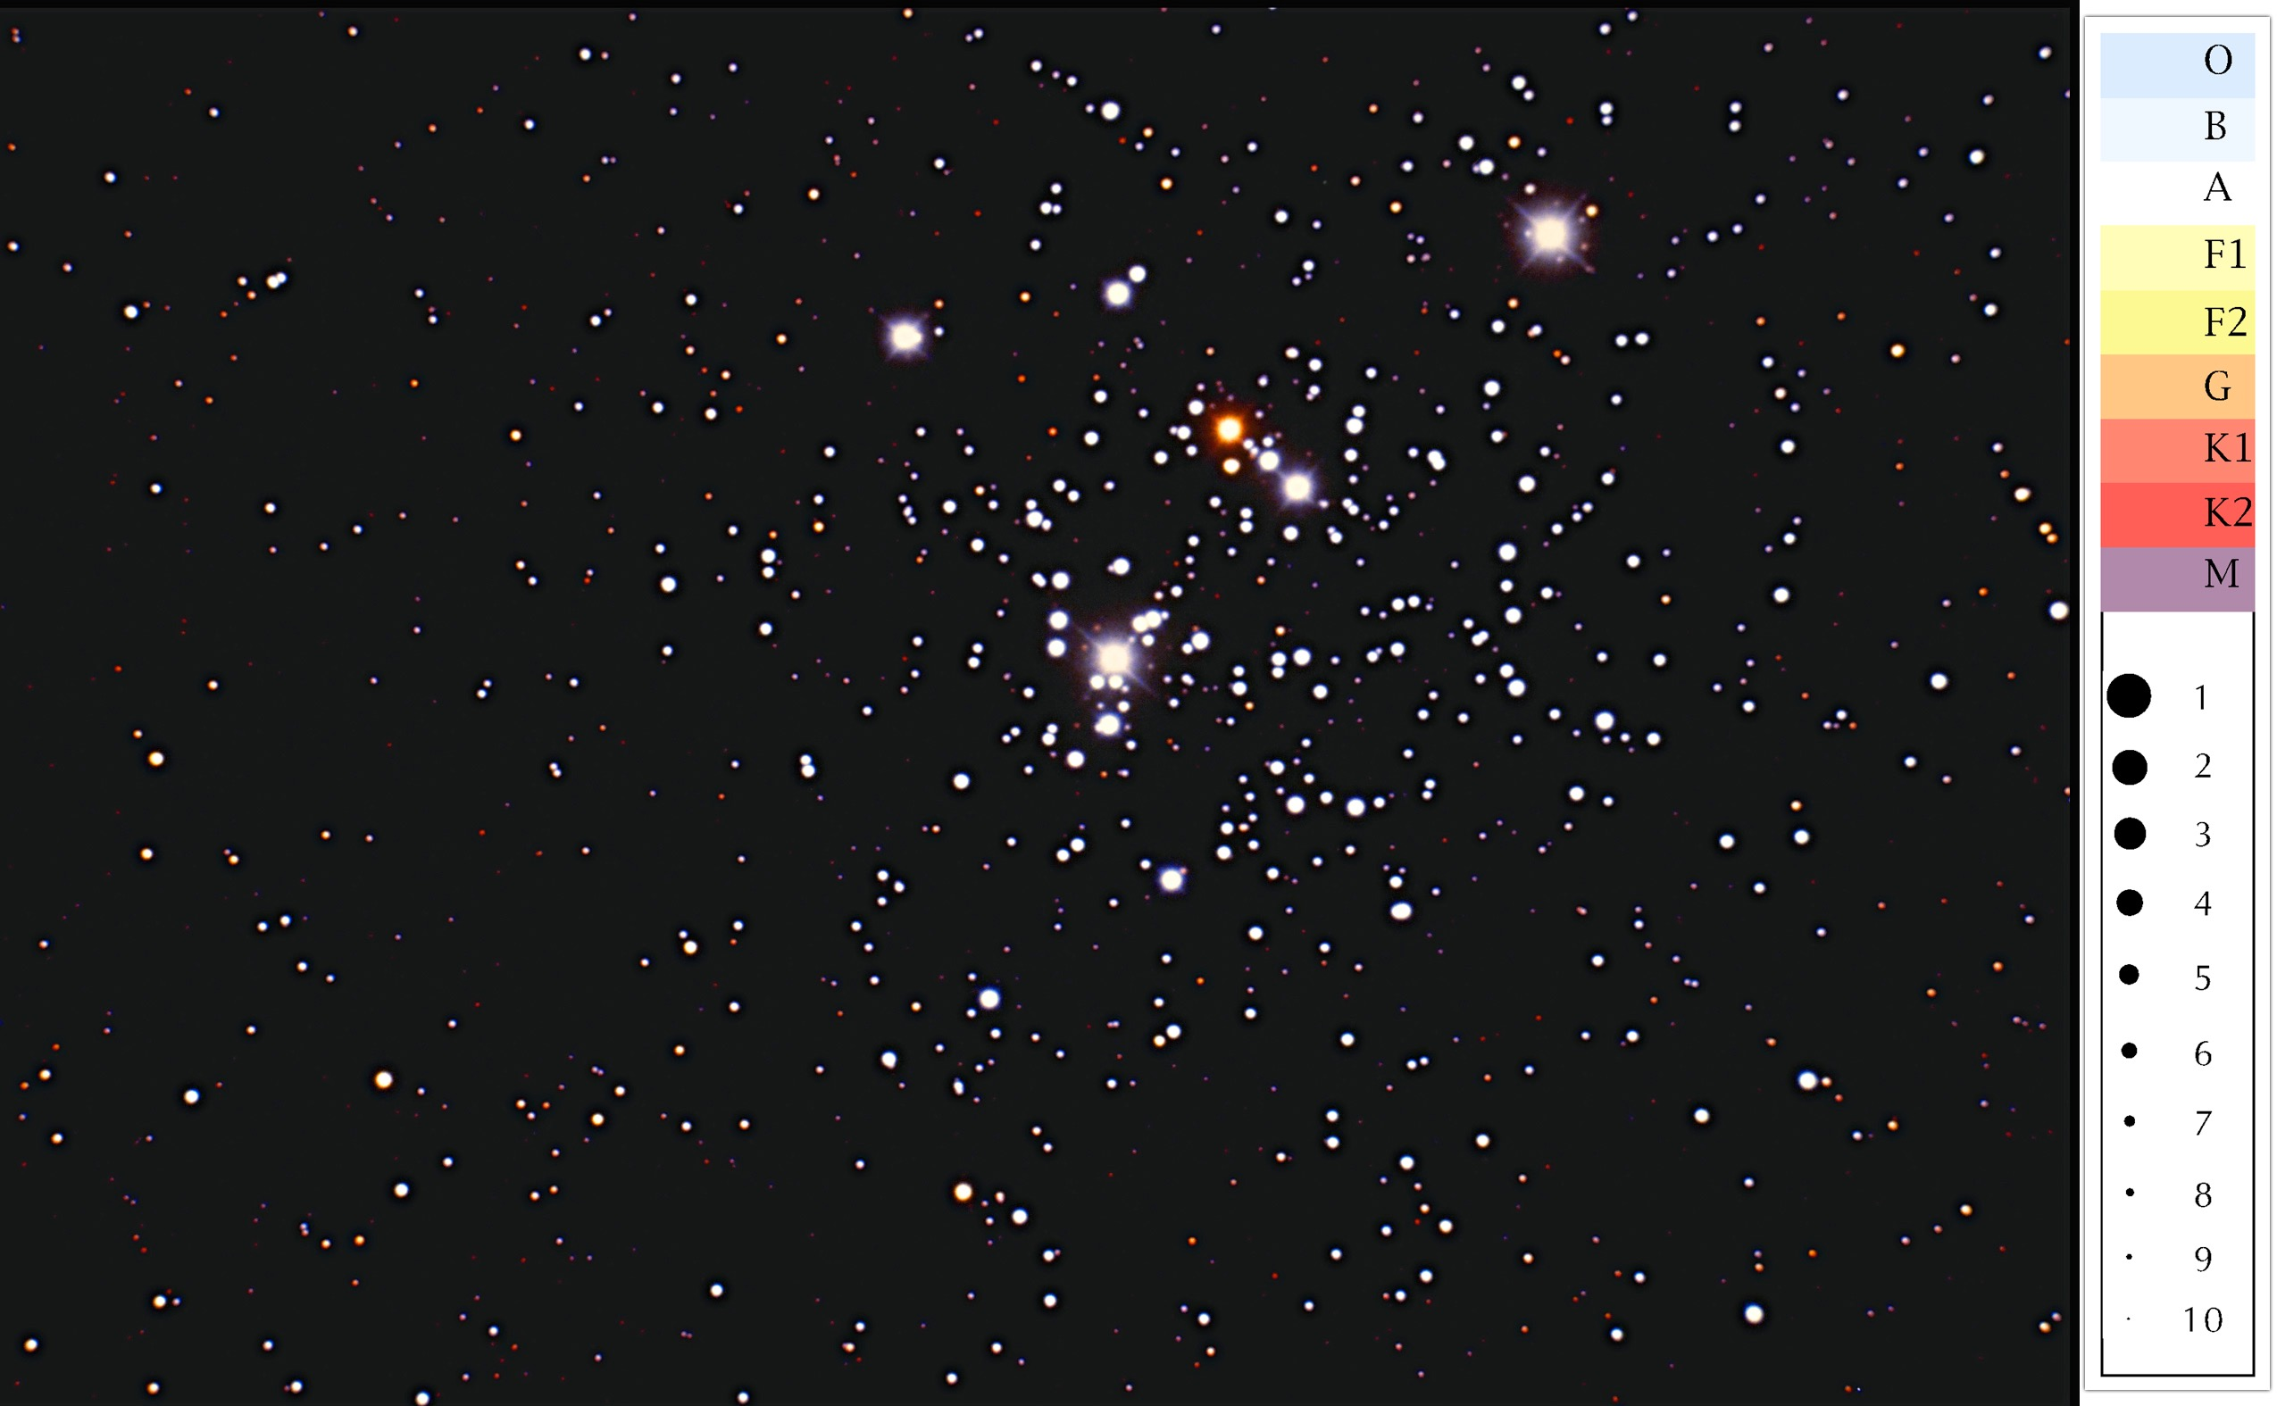
The Jewel Box Cluster
Class participation activity
CA2 3.1 P. 156

Slide 4
Spectral class K2
Magnitude 3

Slide 5
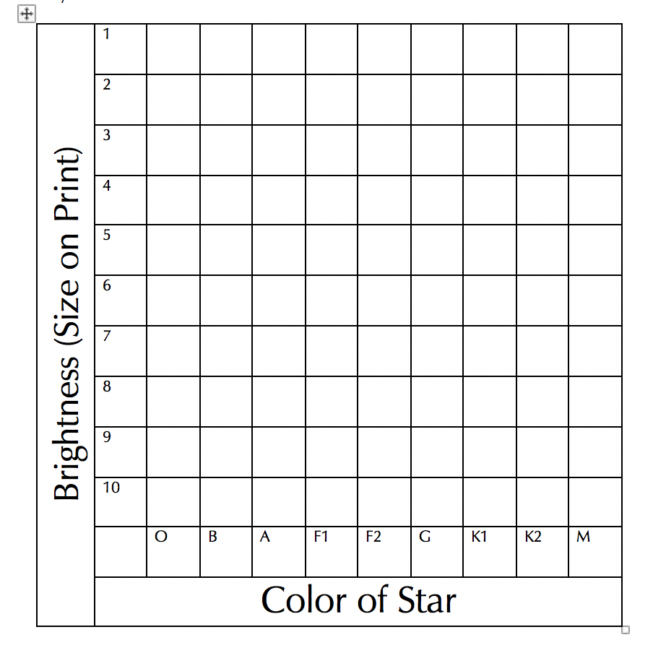

Slide 6
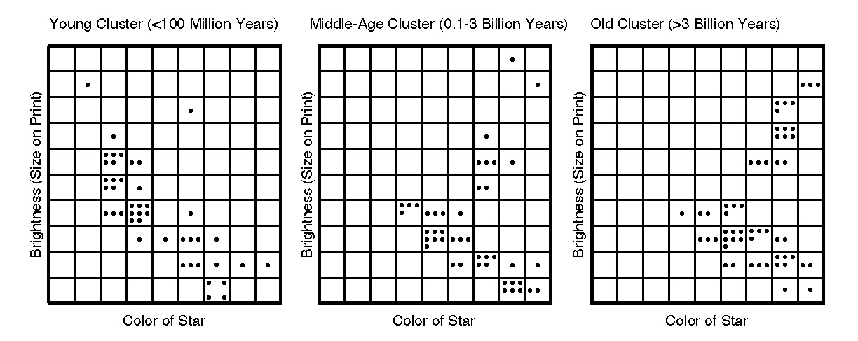
Ages of Clusters
If there are any blue, bright stars, it must be a young cluster

